Slide 1
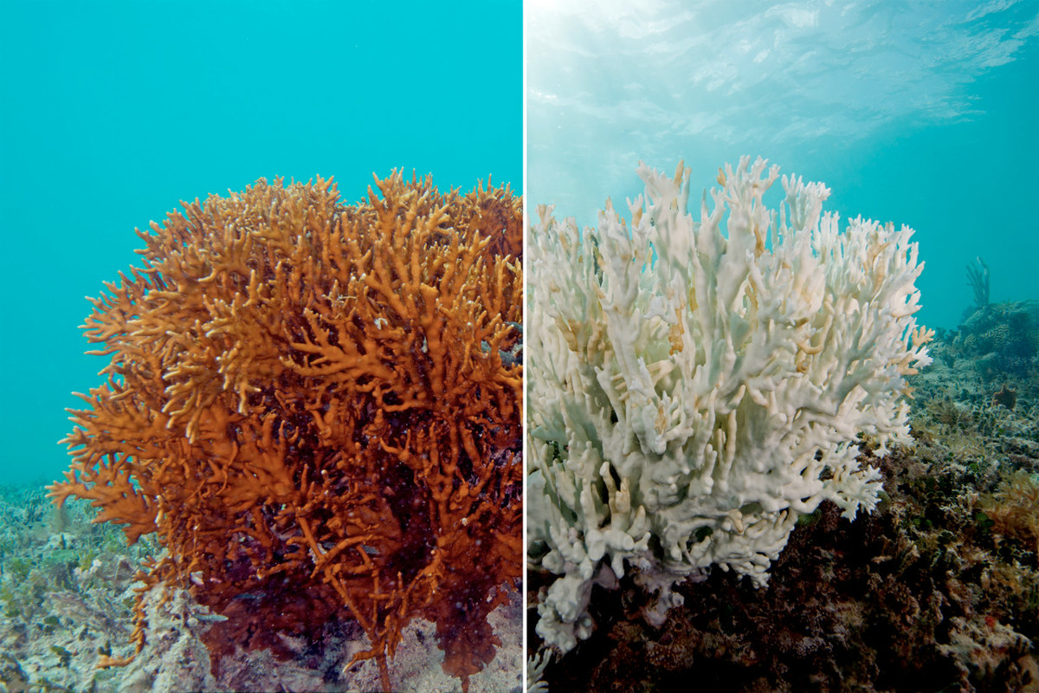
Coral Bleaching
Leah Hong

Slide 2
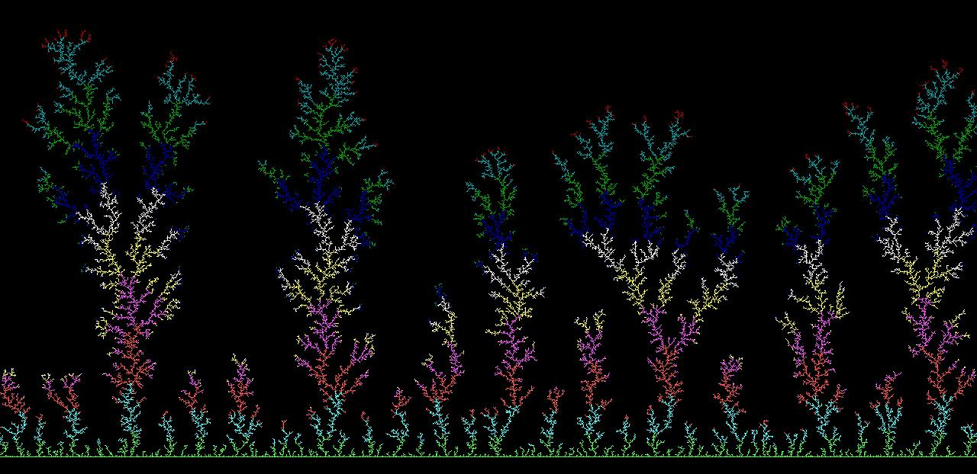
Coral Bleaching
METHODS
Diffusion-limited aggregation (DLA)
Random walks
BACKGROUND INFORMATION
Coral bleaching happens when corals are stressed by changes in environmental conditions such as temperature, light, or nutrients
Other causes include water pollution or dynamite fishing
The coral loses its colors and turns white or pale when expelling the algae living in its tissue
SIMULATION
Created part of a “coral reef” using the DLA method and showed the “bleaching” effect by selecting random filled positions and “destroying” it (indicating that it has been bleached)
The circles indicate parts of the coral simulation where the bleaching occurred

