Slide 1
Earthquake Wave Simulations
Brandon Wong

Slide 2
Project Basis
Objective: Model the different types of body waves that move through the surface during an earthquake
P-wave: compression wave
Wave diminishes over time and distance
Faster through denser material: Birch Equation
S-wave: perpendicular to direction of travel (up and down or side to side)
Travels outward from epicenter
Up and down

Slide 3
P-Wave Simulation

Slide 4
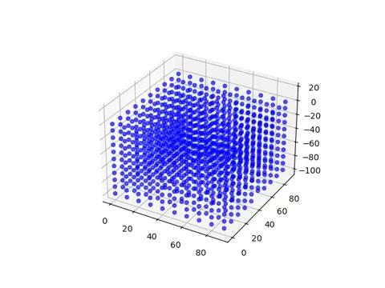
S-Wave Simulation

Slide 5
References
https://www.mtu.edu/geo/community/seismology/learn/seismology-study/surface-wave/
https://www.sciencelearn.org.nz/resources/340-seismic-waves
https://www.aegweb.org/assets/docs/updated_final_geology_of_san.pdf

