Slide 1
A Response to Climate Change Denialism
Sasha Vanley

Slide 2
Topic and Methods
Climate Change Denialist Argument
Faint Young Sun: Sun’s luminosity was 30% lower during Earth’s creation and continues to increase over time
Counter
11-year sunspot cycle explains current climate dynamics (around 4000 days)
Recent solar minimum corresponds is coupled with some of the hottest recorded temperatures
Methods
Gathered a data .txt file from NOAA’s public database
Created a graph of solar irradiation since 1980
Animated data with 1-2 points per year

Slide 3
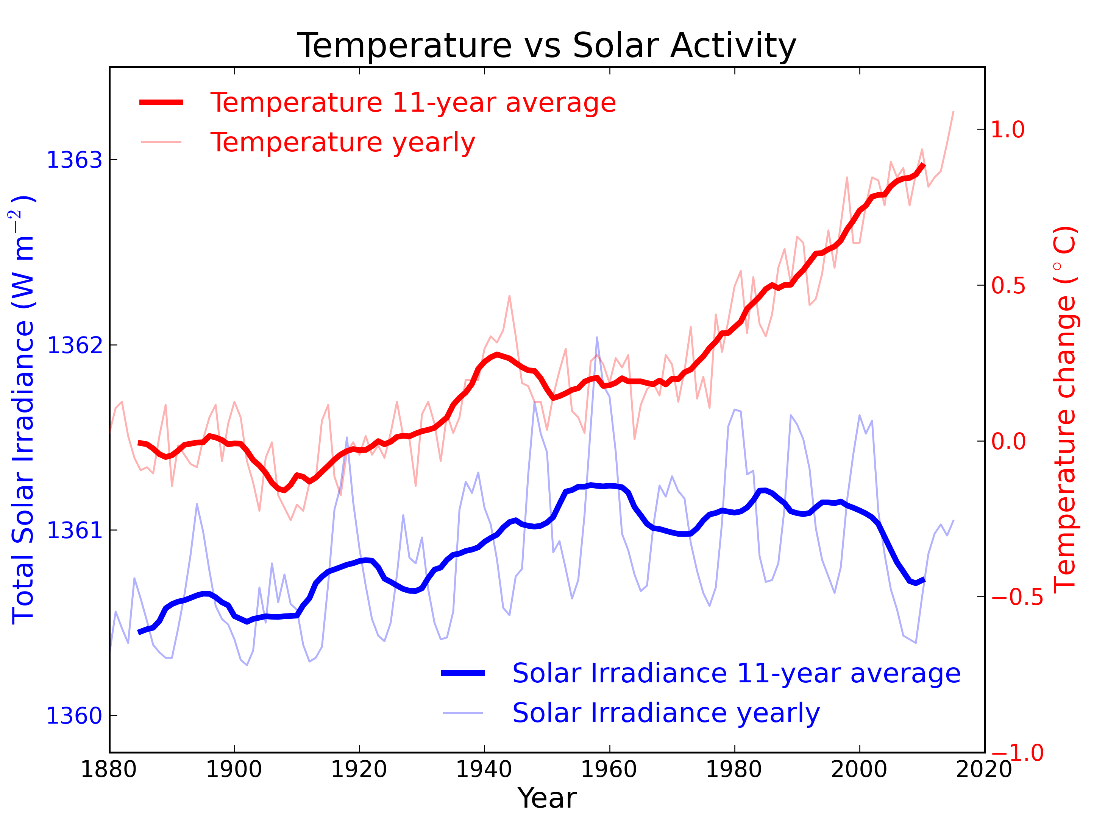
Solar Irradiance vs. Temperature

Slide 4
Solar Irradiation Trends
Solar Irradiation (W/m²)
Time (in days since Jan-01-1980)

