Slide 1
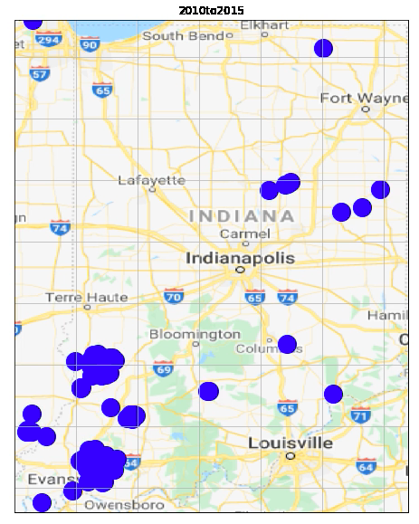
Modeling the change in Earthquakes before and after saltwater injections (fracking) in Indiana and Kansas
Mary Chiu
EPS 109
FA2021

Slide 2
Why choose these states? Methods:
Indiana and Kansas are both major states for fracking activity
Both states are roughly rectangular
Doing estimations without huge error
---------------------------------------------------
Data exploration (hw + lab)
Visualize summary data via animation (histogram + line plot)
Visualize landscape qualitative data via animation

Slide 3
Animated line plot overlying histogram of earthquake activity
Indiana: # of Earthquakes > 3.0 per year overlaid by fracking activity
Kansas: # of Earthquakes > 3.0 per year overlaid by fracking activity
Methods: ObsPy, FuncAnimation, matplotlib, etc.
minMag: 3.0 [disturbing to general population + enough datapoints to visualize

Slide 4
Notice 17 year lag, repercussions continue
Methods: ObsPy, FuncAnimation, matplotlib, etc.
minMag: 3.0 [disturbing to general population + enough datapoints to visualize

Slide 5
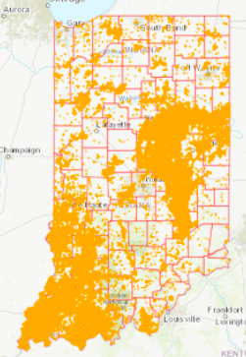
Animated earthquake activity via google maps by year
Notice the overlapping of major activity counties such as Evansville and Carmel

Slide 6
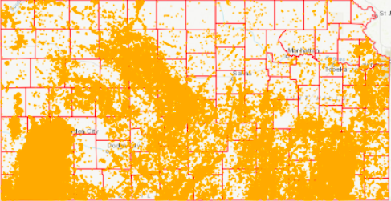
Animated earthquake activity via google maps by year
Notice the overlapping of major activity counties in South Kansa

Slide 7
Challenges to overcome
Some years have no earthquakes above minMag
Use ‘continue’ to exit for loop
Balance between coarse data + speed VS fine data + delay

Slide 8
References
https://igws.indiana.edu/OilGas/HydraulicFracturing
https://www.eia.gov/dnav/ng/hist/na1160_sin_2m.htm
https://www.eia.gov/dnav/ng/hist/na1160_sks_2A.htm
https://www.digitalocean.com/community/tutorials/how-to-use-break-continue-and-pass-statements-when-working-with-loops-in-python-3
https://www.codegrepper.com/code-examples/whatever/png+sequence+to+mp4+ffmpeg
https://www.fractracker.org/map/us/indiana/
https://www.fractracker.org/map/us/kansas/

