Slide 1
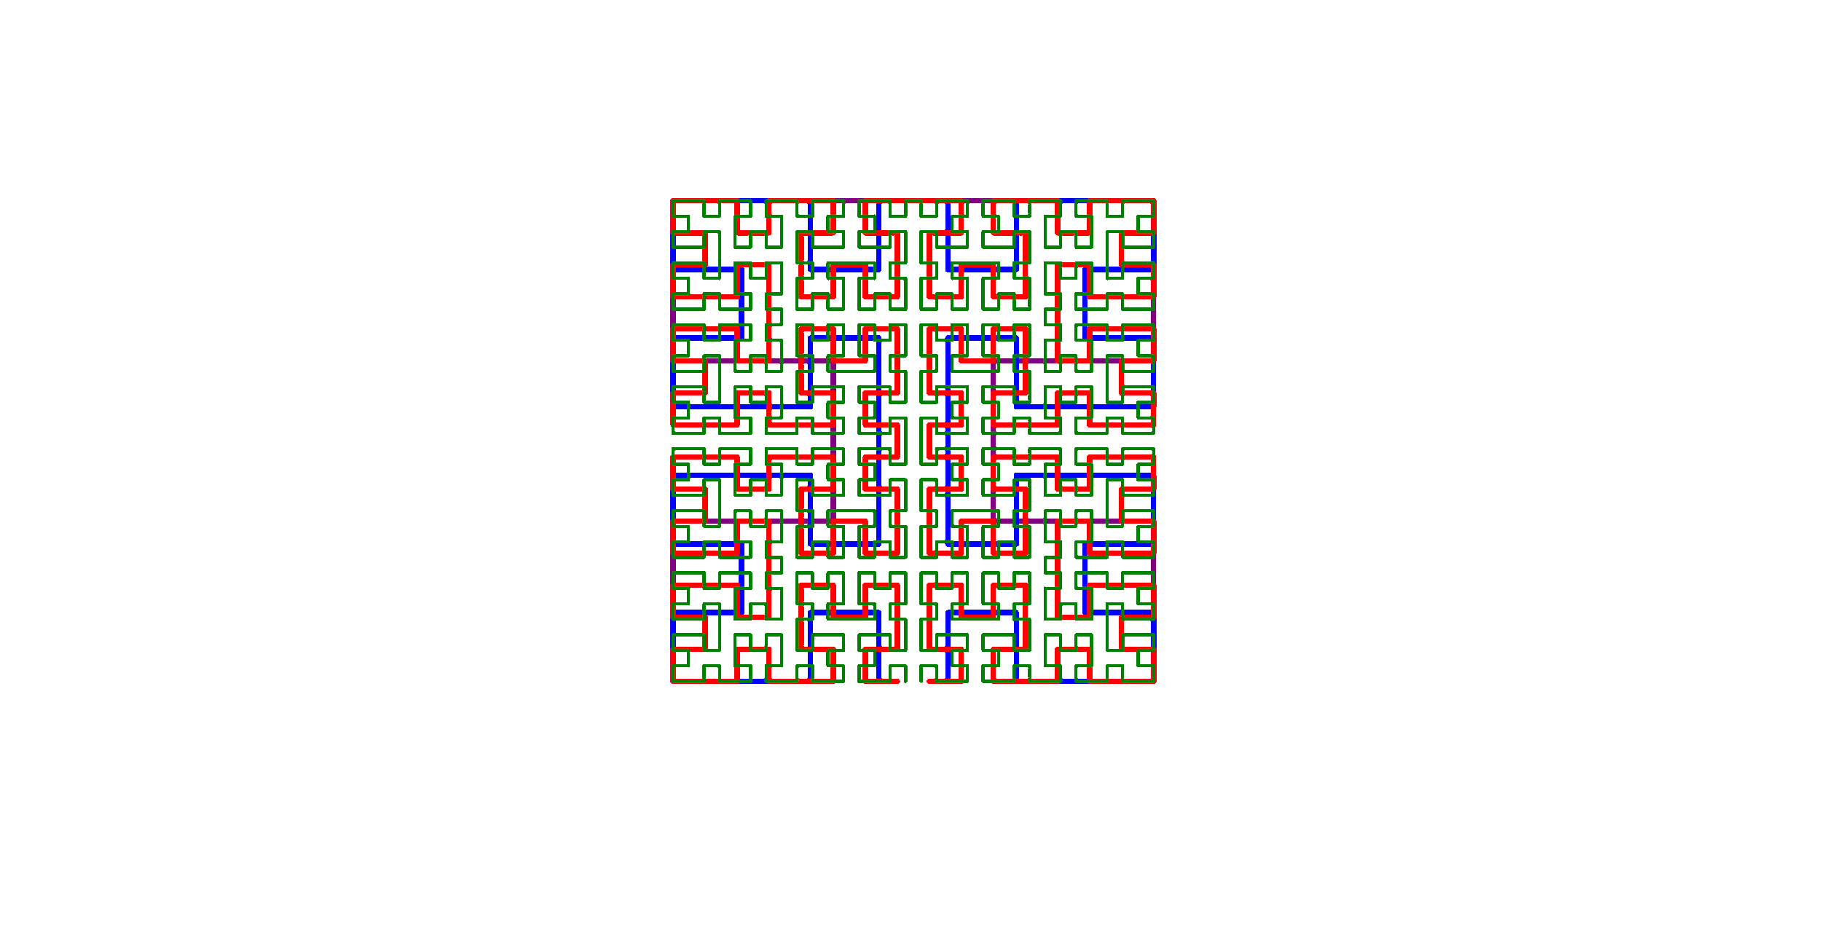
Moore Curve Simulation
Caytyn Abono

Slide 2
Topic and Methods
Lindenmayer system:
Alphabet: L, R
Constants: F, +, −
Axiom: LFL+F+LFL
Production rules:
L → −RF+LFL+FR−
R → +LF−RFR−FL+
Turtle Graphics
Citations:
https://elc.github.io/posts/plotting-fractals-step-by-step-with-python/
https://stackoverflow.com/questions/41319971/is-there-a-way-to-save-turtles-drawing-as-an-animated-gif

