Slide 1
Simulating Bee Populations
Rishi Upadhyay 12/1

Slide 2
Goal
Simulate bee populations under various environments
Different amounts of food available, different amount of hives
Understand how environment affects populations and dynamics

Slide 3
Methods
Particle simulation type techniques
Simulation runs on a rectangular grid
Makes code simpler and reduces computational complexity
Multiple different types of “Entities”:
Bees
Hives
Predators (can represent humans or other creatures)
At each time step, each entity makes a move depending on pre-set rules

Slide 4
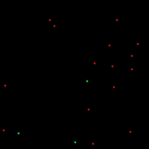
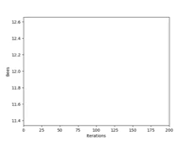
Results

Slide 5
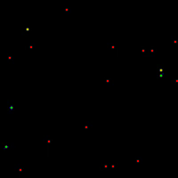
Results (2)

Slide 6
Next Steps
Add more details to bee hives
More divisions of bees
More complicated food-searching habits
Add more types of food

