Slide 1
Sierpinski’s Carpet Simulation
By: Kavin Vasudevan

Slide 2
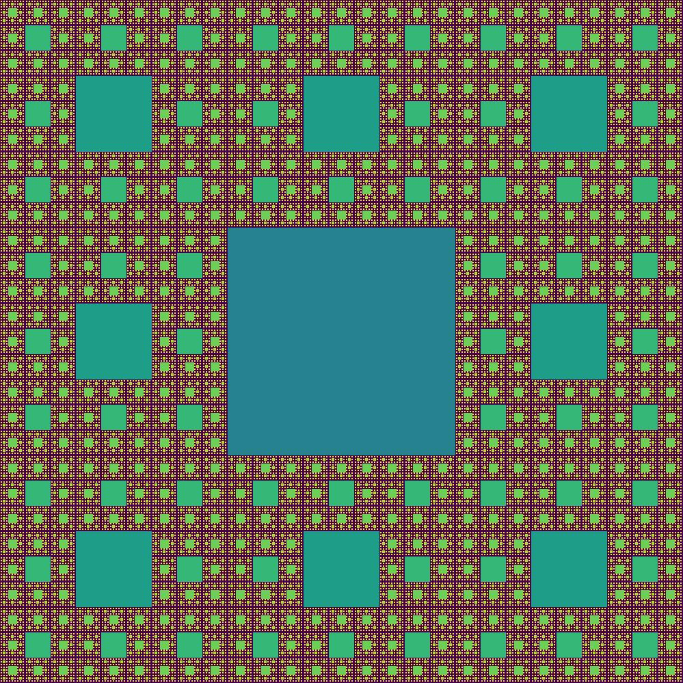
Topic and Methods
Sierpinski’s Carpet
A self-similar fractal
Has Mathematical concepts
Two Functions:
One that divides a given matrix into 9 parts and removes the center square
Parameters: a matrix, the start and end of the x-coordinates and y-coordinates
One that uses recursion to iterate through the other 8 squares and apply the first function on each square
Parameters: a matrix, the start and end of the x-coordinates and y-coordinates

