Slide 1
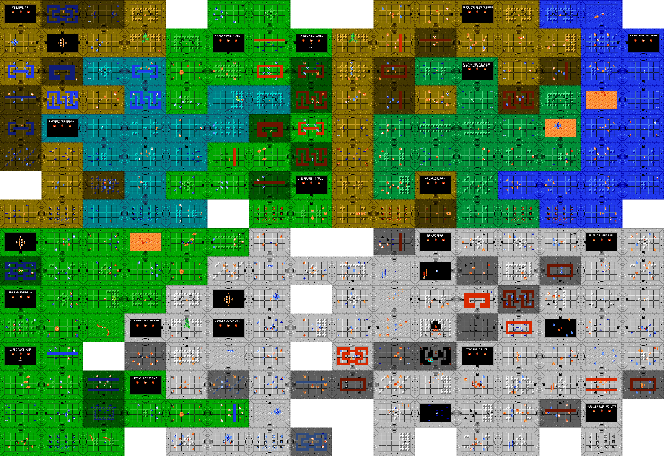
Random Level Exploration
Billy Bao

Slide 2
Goals & Level Generation
How does the method of level generation impact player exploration of the level?
Time taken
Percentage of rooms explored
Methods of generation:
Grid (no generation, fully open)
Depth-first tree (only one path between each two rooms)
Random open (typically in-between fully open and fully closed)
Fairness of comparison: place exits at same traversal distances from start
Graphics & Animation: matplotlib

Slide 3
Level Generation Examples
Grid
Random Open
Depth First

Slide 4
Player Model
Random walk “with memory”
Remember paths to visited rooms
Remember unvisited rooms adjacent to visited rooms (“noticed”)
Pick a random noticed room and move to it
Follow remembered paths
Chance of selecting a room is inversely proportional to distance
Repeat when we reach that room

Slide 5
Exploration
Grid
Random Open
Depth First

Slide 6
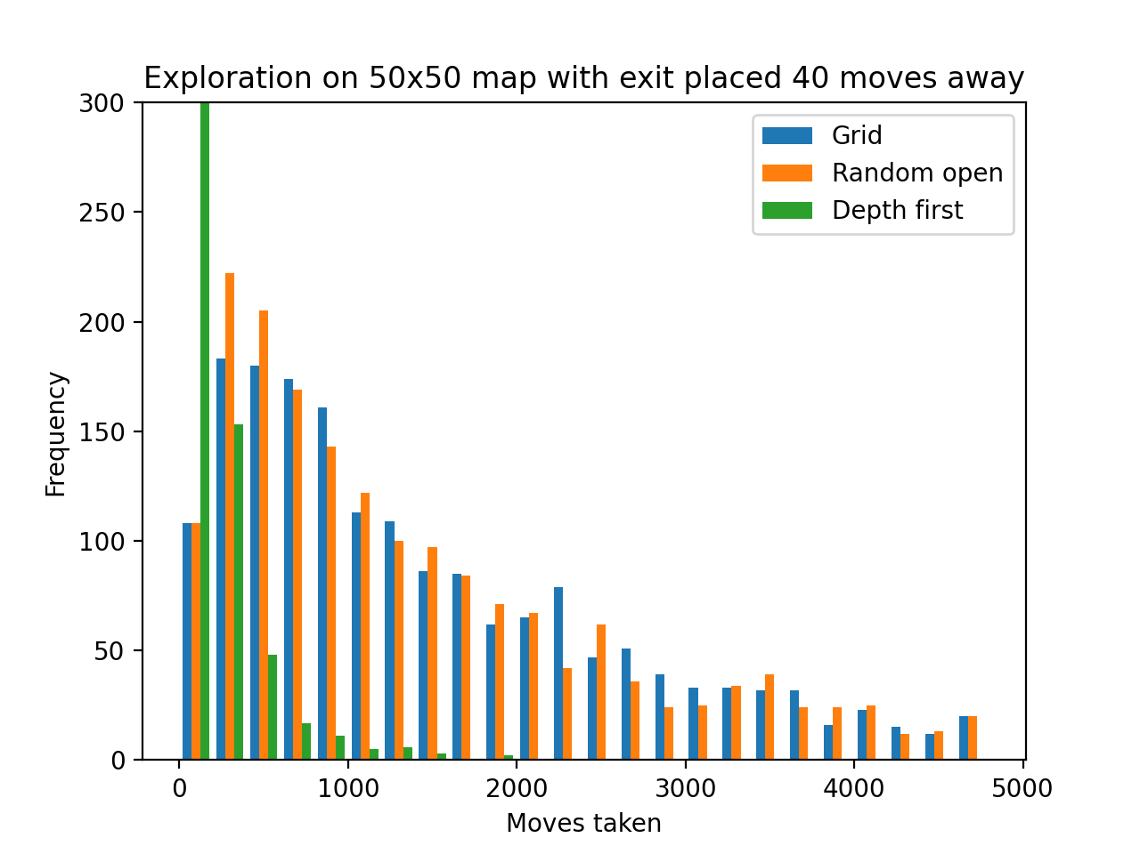
Repeated Simulations

