Slide 1
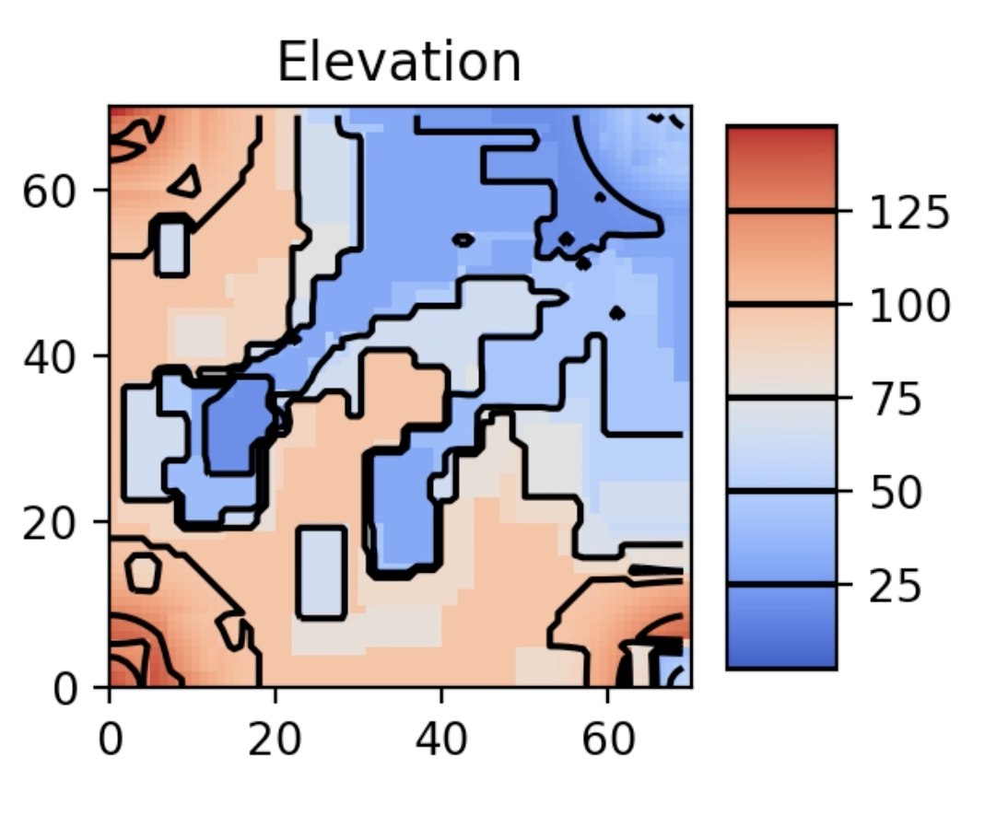
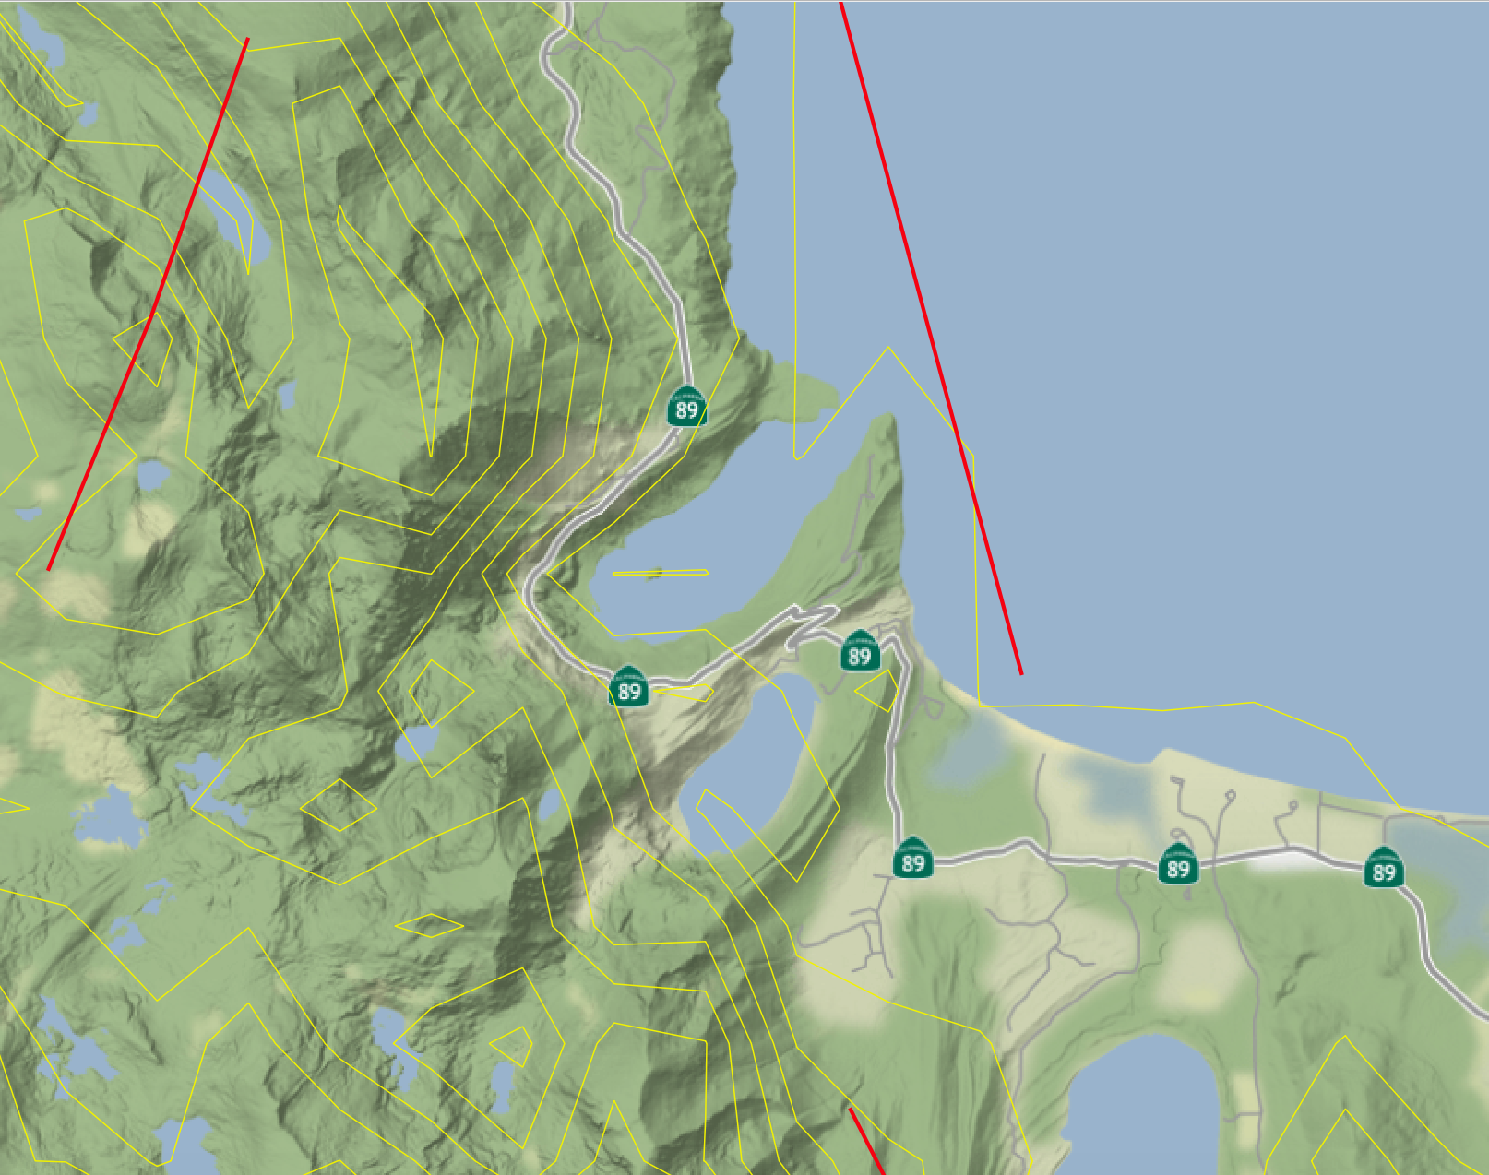
Landscape Evolution of the Lake Tahoe Area
Josie Christon
QGIS – USGS

Slide 2
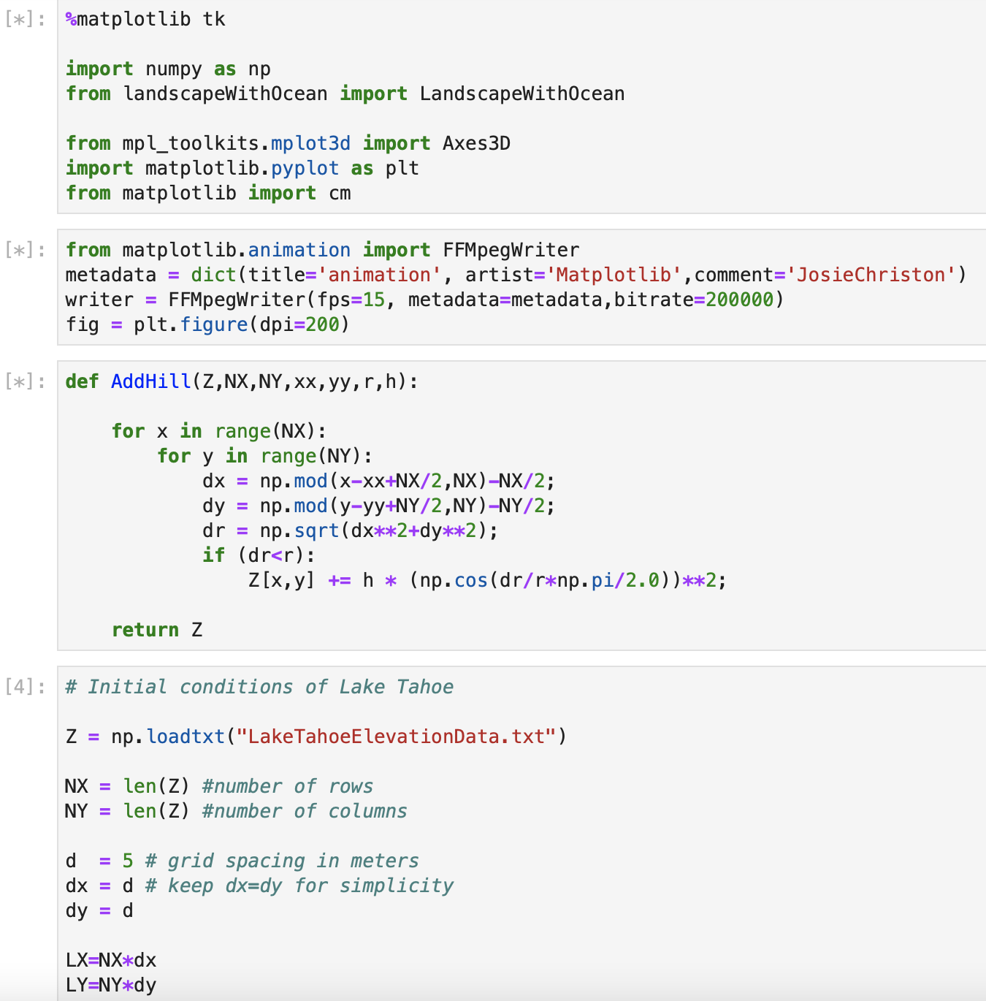
Using Lake Tahoe data with our Landscape Erosion Model to better understand glacial erosion
Lake Tahoe is a very geomorphologically interesting area. In this demonstration, I try to model the fast Sierra Nevada Uplift and the past glacial erosion and see how they work together to create the interesting landscape
Interesting to see bow the glacial expanses and retreats erode and deposit at different timescales. I wanted to explore how glaciers can be somewhat protective against erosion on shorter timescales, and huge factors of erosion on longer timescale
Data Source:
Compilation of EPS 117 2019 class data, USGS Earth Explorer, and Natural Earth

Slide 3
On what timescales do glacial erosional processes operate?
Short-Term Protection
Long-Term Erosion

