Slide 1
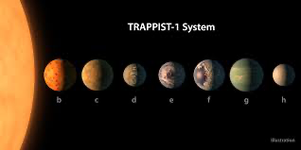
Exoplanet system Simulation
Faie Hernandez

Slide 2
