Slide 1
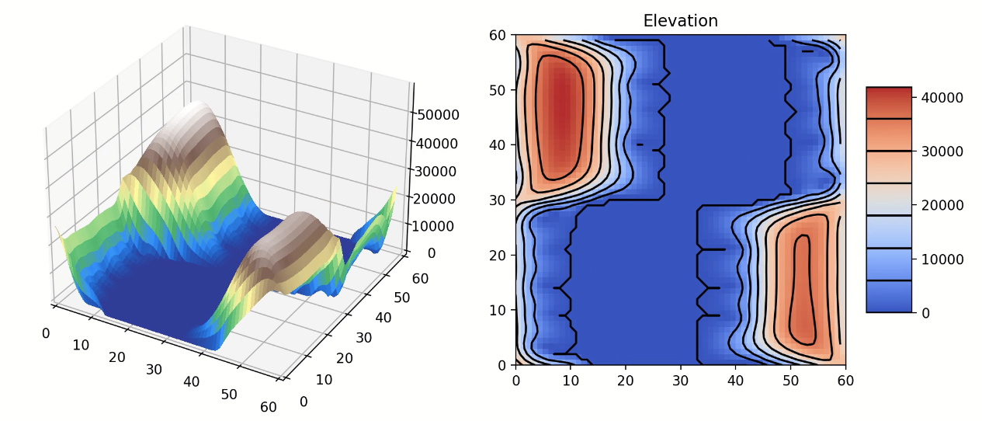
EPS 109 Final Project
“Fault-crossing effect on a channel”
Winnie Lau

Slide 2
Goal and Method
Motivation
Goal: Show the changes of a channel by a lateral fault
Method: Set up the initial condition of the landscape, model a right-lateral fault movement, modify and apply Landscape Evolution Simulation (Perron et al., 2008)
z = elevation
K = erosion rate at the land that surrounded by the ocean
D = diffusion rate
m = area exponent
n = gradient exponent
θc = erosion threshold
E = rate of change of land surface elevation relative to base level
Portion of Creek & Watershed Map of Oakland & Berkeley
Source: Oakland Museum of California http://explore.museumca.org/creeks/1140-OMStrawberrySchoolhouse.html

Slide 3
Animation: Fault-crossing
According to the U.S. Geological Survey, the average rate of creep on the Hayward is 4.6 millimetres per year

Slide 4
Animation: without a fault

Slide 5
Comparison
Given all other parameters the same,
(K = 1.0e-6, D = 0.01, m = 1.2, n = 1, θc =10)
 | With fault: | Without fault:
Max Elevation | 40407.639 m | 40986.973 m
Ocean level | 11742.109 m | 11777.889 m
Ocean surface fraction | 45.583% | 43.778%
579.334m lower than
1.905% higher than

