Slide 1
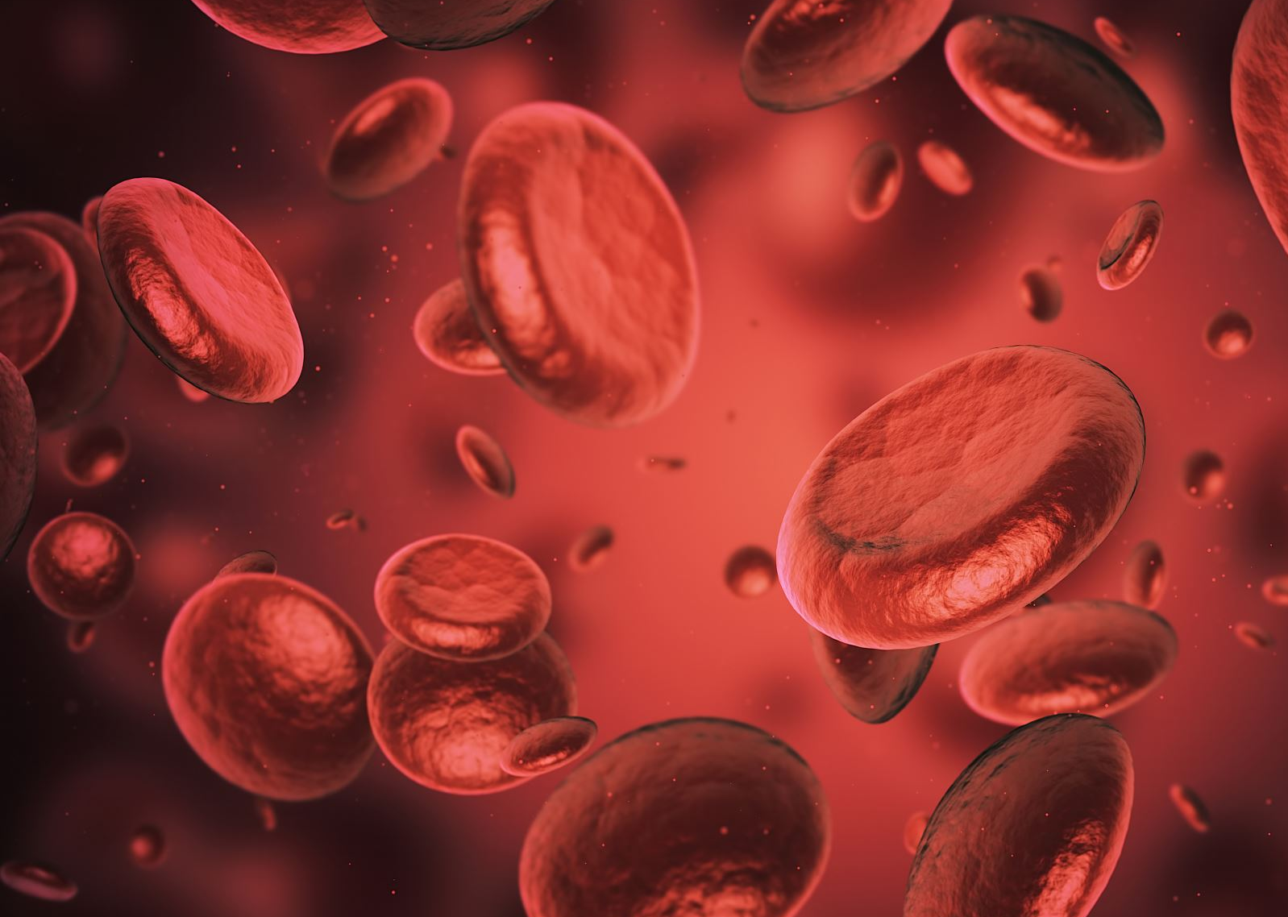
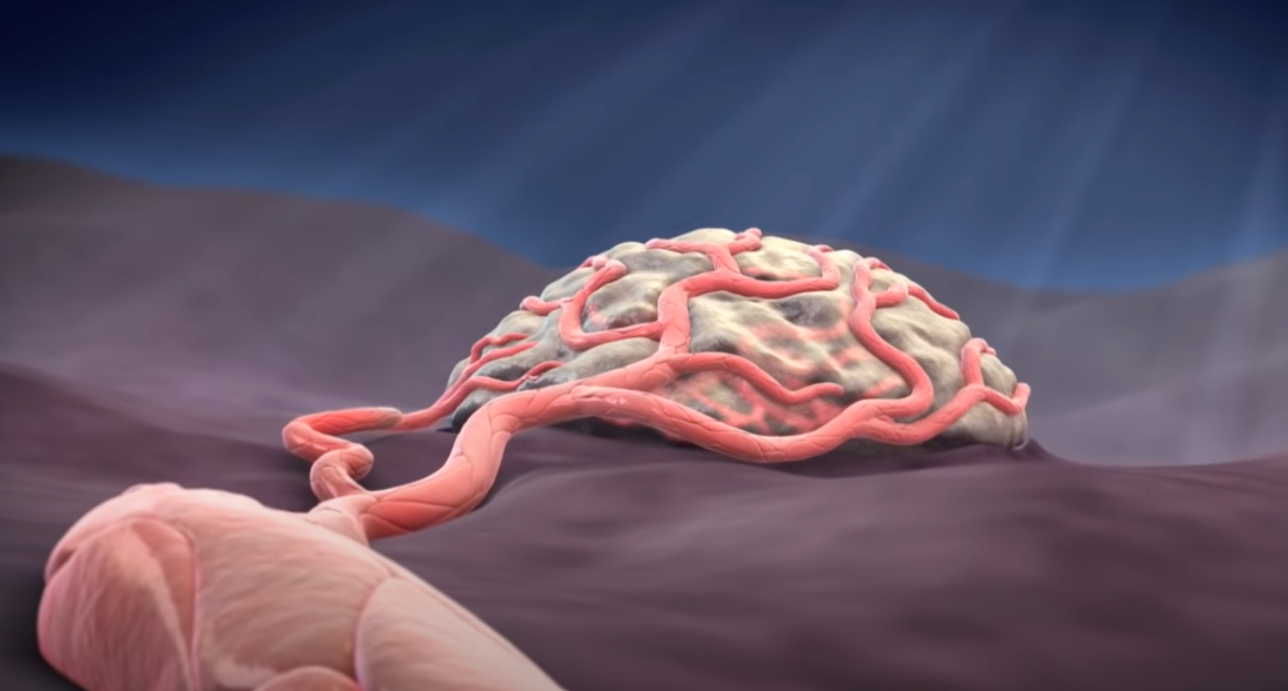
Blood Vessel Formation
Jeannette Pham
EPS 109
Professor Militzer
Blood vessels branching during tumor angiogenesis

Slide 2
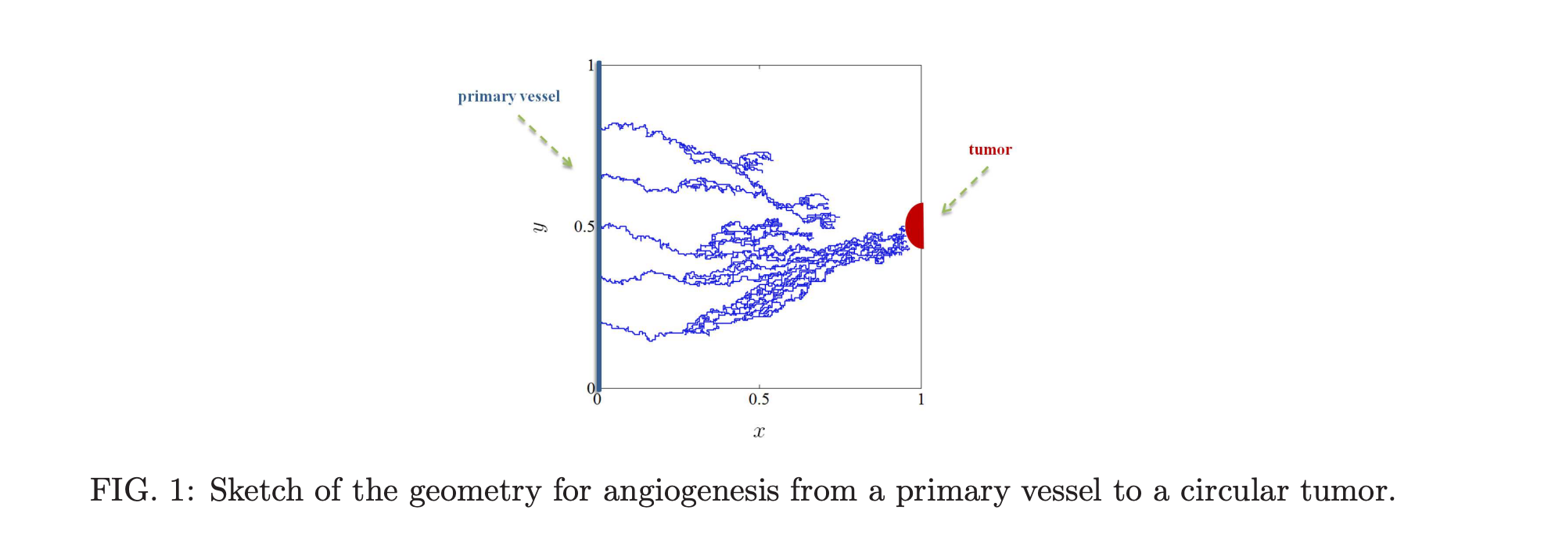
Purpose
The goal of my project is to show the paths that blood vessels form during angiogenesis in which they are trying to reach a tumor in order to feed it during tumor angiogenesis.
Tumor angiogenesis the process of which new blood vessels form pathways to supply tumors with oxygen and nutrients to sustain it.
The method is used is random walks.
Works cited: https://arxiv.org/pdf/2009.00939.pdf
https://medium.com/analytics-vidhya/simulating-random-walk-in-python-ed95bfb55210

Slide 3
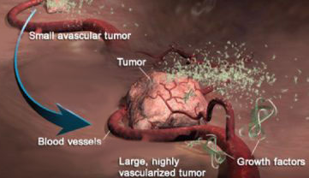
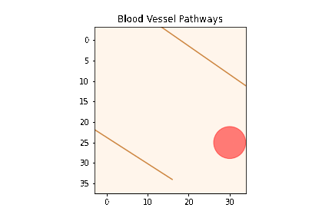
Tumor angiogenesis
Each individual blood cell travels through blood vessels within endothelial cell walls to reach the destination of the tumor.

Slide 4
Tumor angiogenesis
A network of blood vessels contains several pathways containing billions of blood cells that supply a tumor with nutrients.

