Slide 1
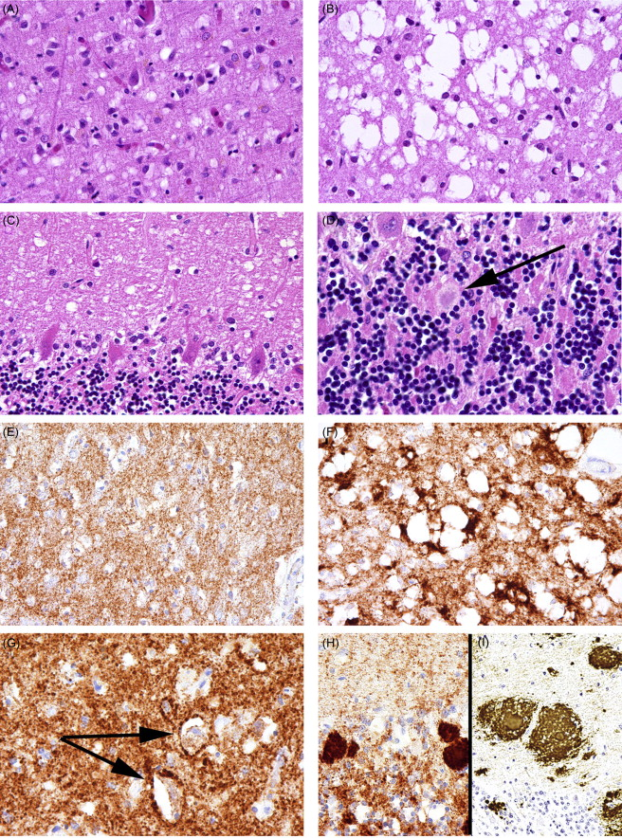
Simulation of Prion Diseases in the Blood-Brain Barrier
Zain Chuadry

Slide 2
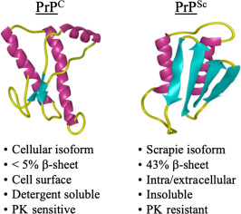
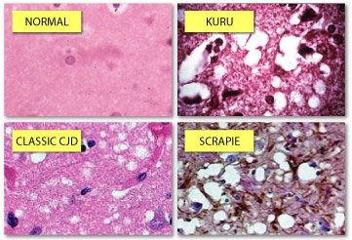
Topic and Methods
Skeleton code:
Def prionreplication
Def prpc
For iterations
Record amount of prions
For ix
For iy
Boundary conditions
Conditions for movement
Conditions for collisions
Contracting a Prion
Procession of disease
Misfolding contact
Spongifrom syndromes

Slide 3
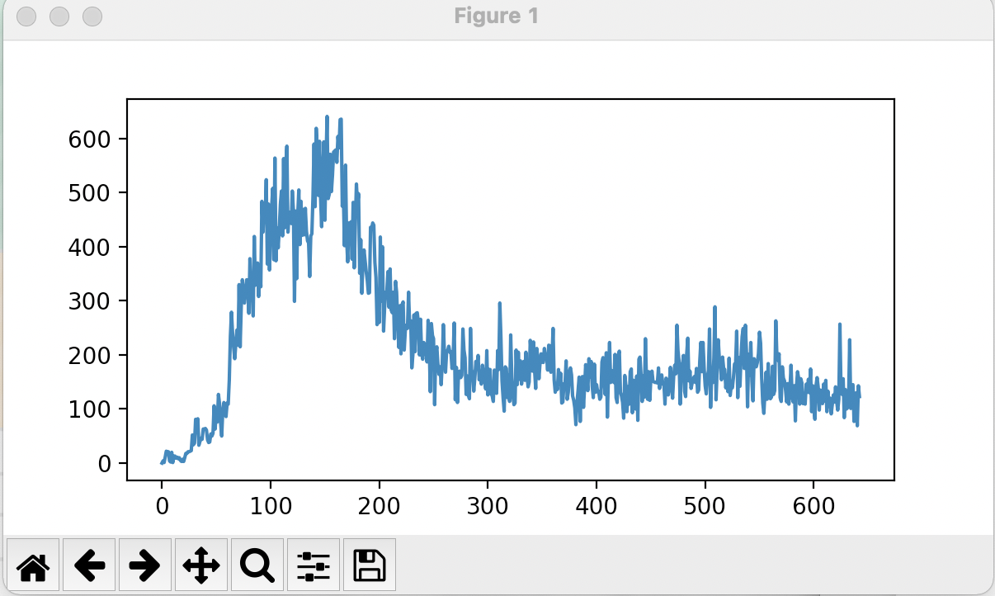
Animation

