Slide 1
Erosion of the Appalachian Mountains
A presentation by Sapphire Botell
EPS 109: Computer Simulations with Jupyter Notebooks
12/1/2021

Slide 2
Background of the Appalachian Mountains
The Appalachian Mountains were created when the ancient continents Gondwanaland and Laurasia collided to form the super continent Pangea.
This built a mountain range that was much higher than the what we call the present Appalachian Mountains.
Over the following 200 million years, Pangaea broke apart; the modern Atlantic Ocean formed; and erosion wore down the mountains.

Slide 3
Image Created in Python
GMTED2010N30W090 dataset courtesy of the U.S. Geological Survey

Slide 4
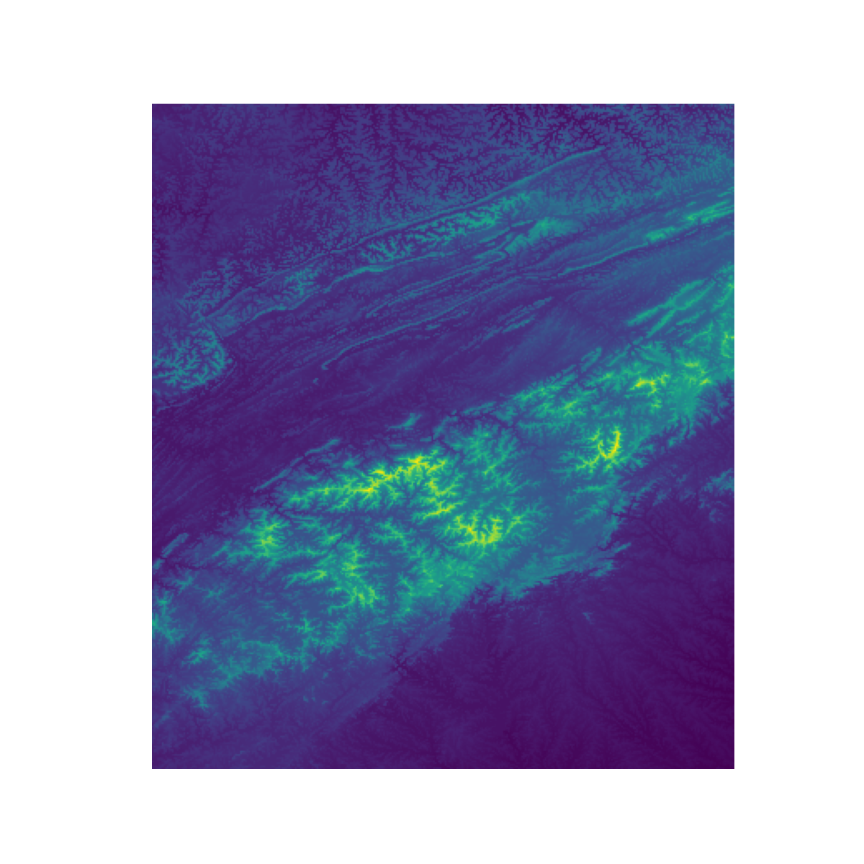
Zoom In
Area Including Georgia, North Carolina, Tennessee, Virginia , West Virginia and Kentucky

Slide 5
Simulation
The Current highest point in the Appalachians is 2,037 m, at Mount Mitchell's summit

Slide 6
Citations
“Appalachian Mountains.” NASA, NASA, https://earthobservatory.nasa.gov/images/80088/appalachian-mountains.
GMTED2010N30W090 dataset courtesy of the U.S. Geological Survey

