Slide 1
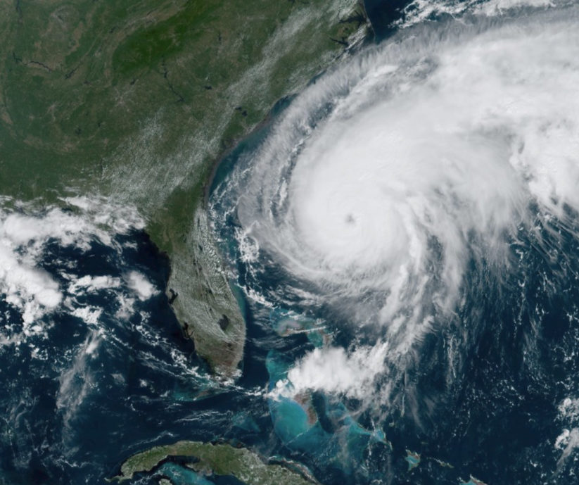
Monte Carlo Hurricanes
Aron Delevic

Slide 2
Background
Hurricane alley: area of warm waters in the Atlantic ocean conducive to system formation
Factors for formation: thunderstorm cells, low wind shear, warm water, prior weather event
Goal: Simulate the travel path of hurricanes in the southeast US and Caribbean theatre using Monte Carlo methods
Monte Carlo Method: use random inputs to create a system model and predict the probability of outcomes to produce probable events

Slide 3
Principles
Simulate each proposed, randomly generated move:
Resulting distribution
New proposed move
Prob old move
Prob proposed move
Acceptance prob
Potential at new location

Slide 4
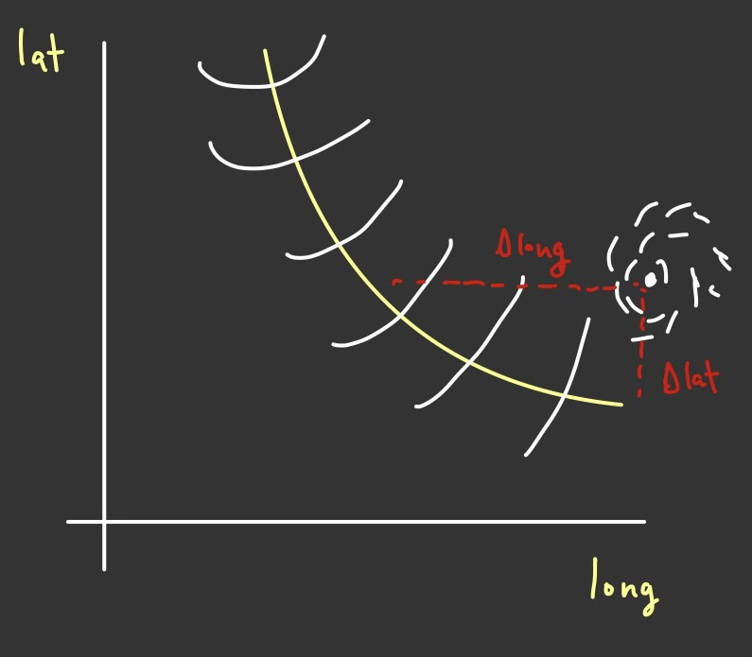
Diagram

Slide 5
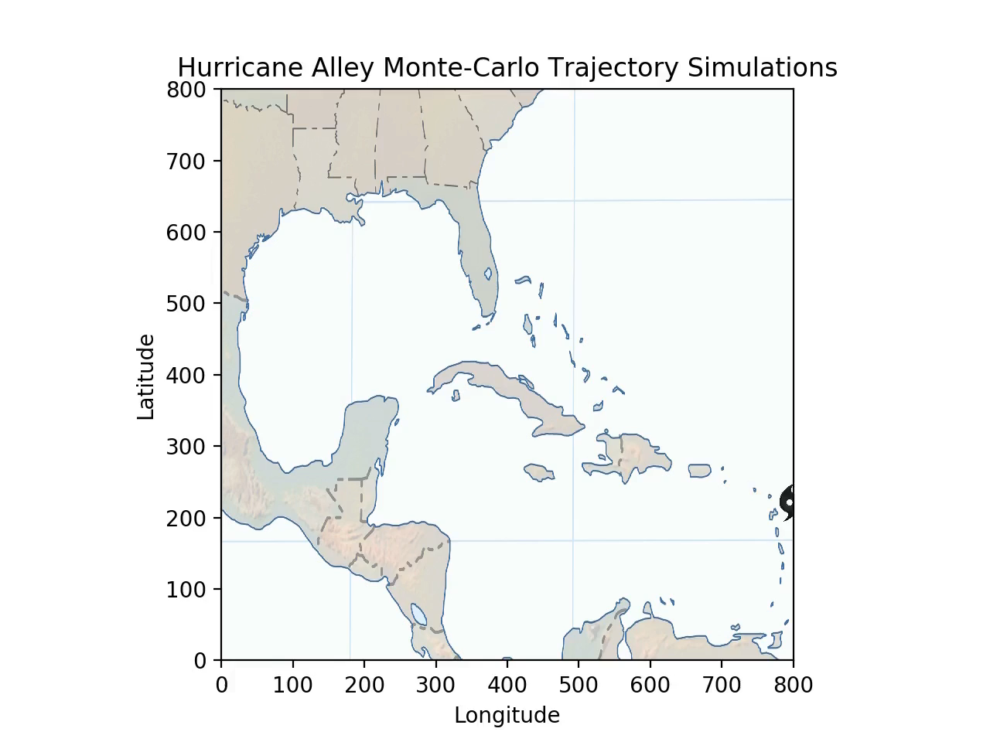
Animation

