Slide 1
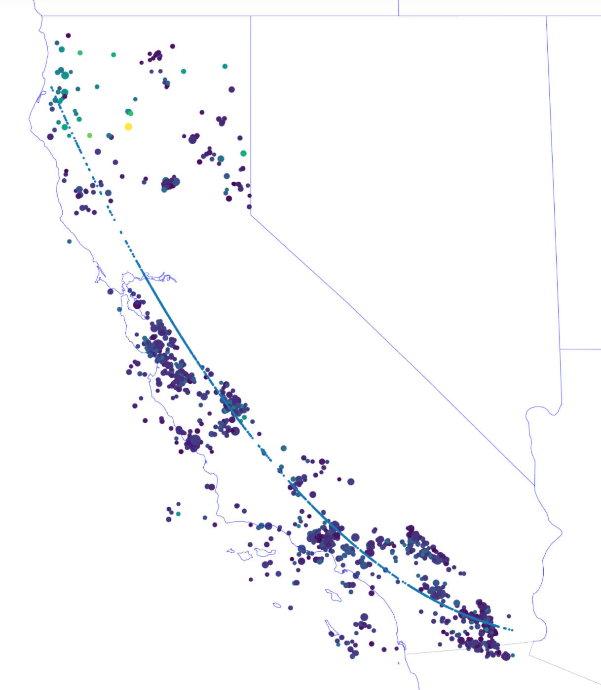
Identifying Fault Lines from California Earthquake Patterns
Sierra Dean, 3033700297

Slide 2
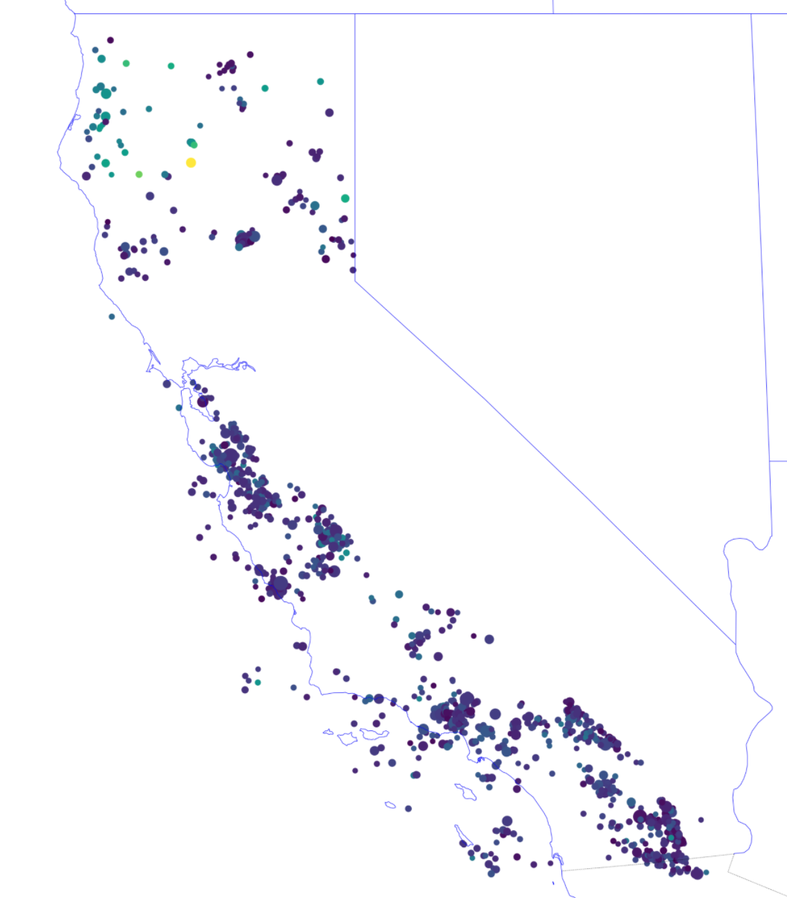
Goal 1: Locate the San Andreas Fault Line
Locate all 4+ magnitude Earthquakes in California from 1970 – present
Methods: Cartopy for plotting and Earthquake DB for earthquake data, parsing via GPS coordinates to best fit California
Calculate line of best fit through all earthquakes to determine approximate plate boundary
Methods: Numpy ployfit
Figure 1: All California Earthquakes 1970 - Present

Slide 3
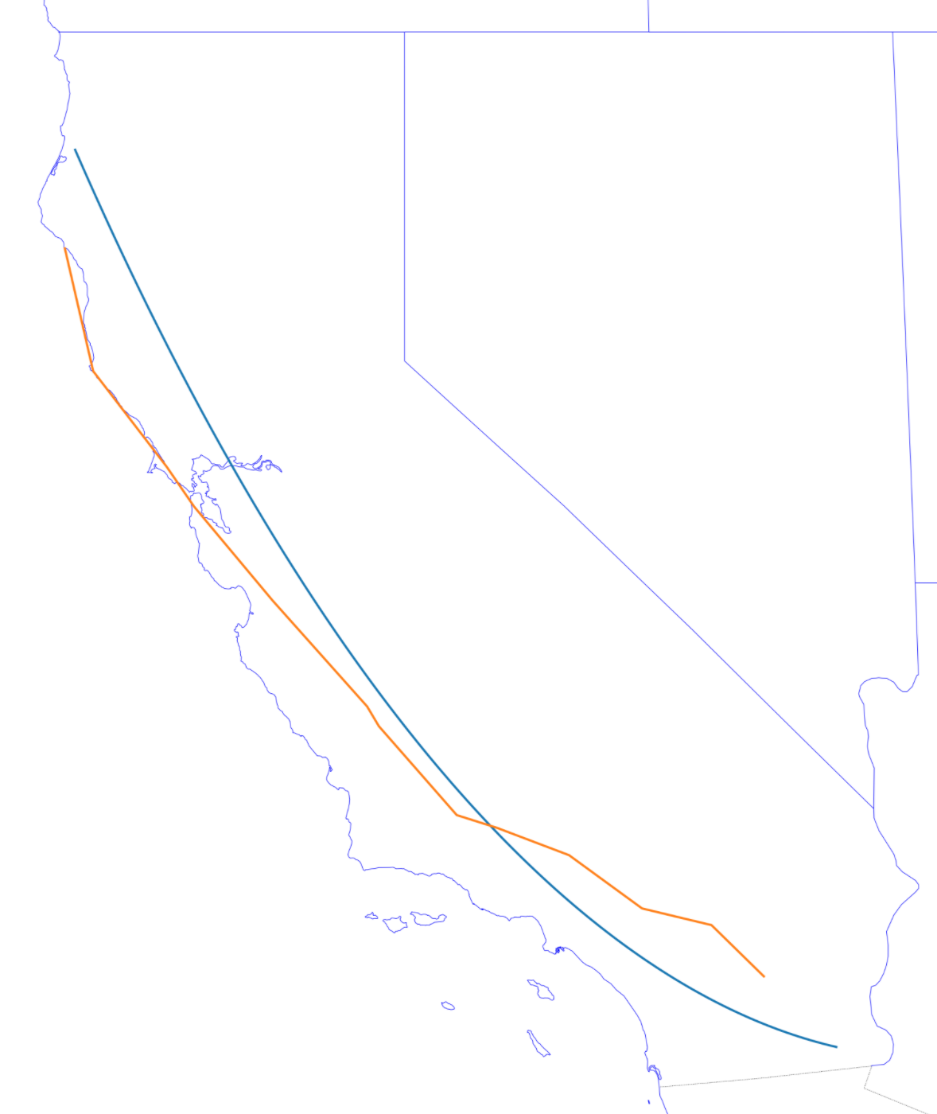
Goal 1 Results and Discussion
Important assumptions:
There is only 1 fault line in California
Nope! There are many!
All earthquakes are caused (in some form) by a plate shift / are related to the fault line
Nope! Earthquakes can occur for other reasons!
Notes:
Skewed due to northern earthquakes pulling away from coast from other faults
Chose polynomial of degree 2 to attempt to account for the curved nature, actual fault line contains much more variation than 2-degrees can provide
Figure 2: San Andreas Fault Versus Found Fault

Slide 4
Goal 2: Show the spread of earthquakes on the San Andreas fault
From the calculated plate boundary, for each earthquake, determine whether the earthquake is within 10 km
Methods: haversine formula from earthquake lab to account for earth distance, calculating closest point on fault line to earthquake (projection)
Split the earthquake data by year, such that all earthquakes for one year are separated
Methods: recording of plot FFMpegWriter
Figure 3: Projection onto Fault Line from known Earthquake to find Distance from Fault

Slide 5
Final Animation

