Slide 1
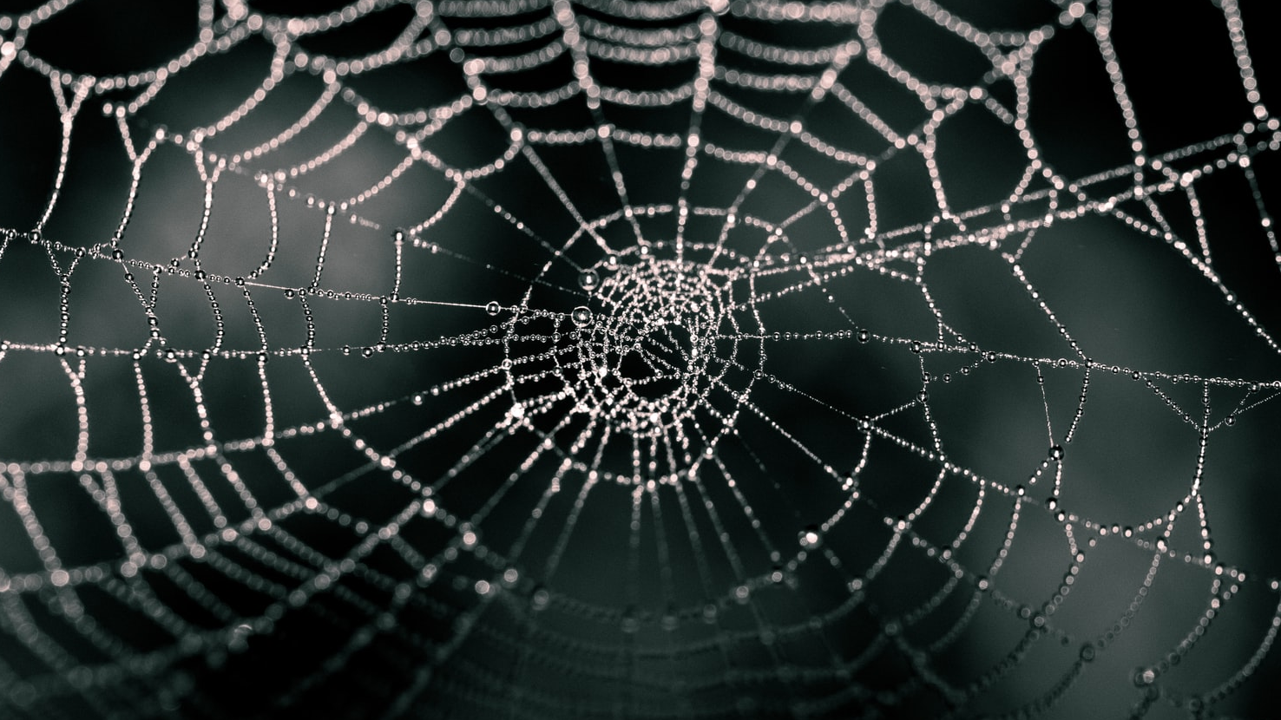
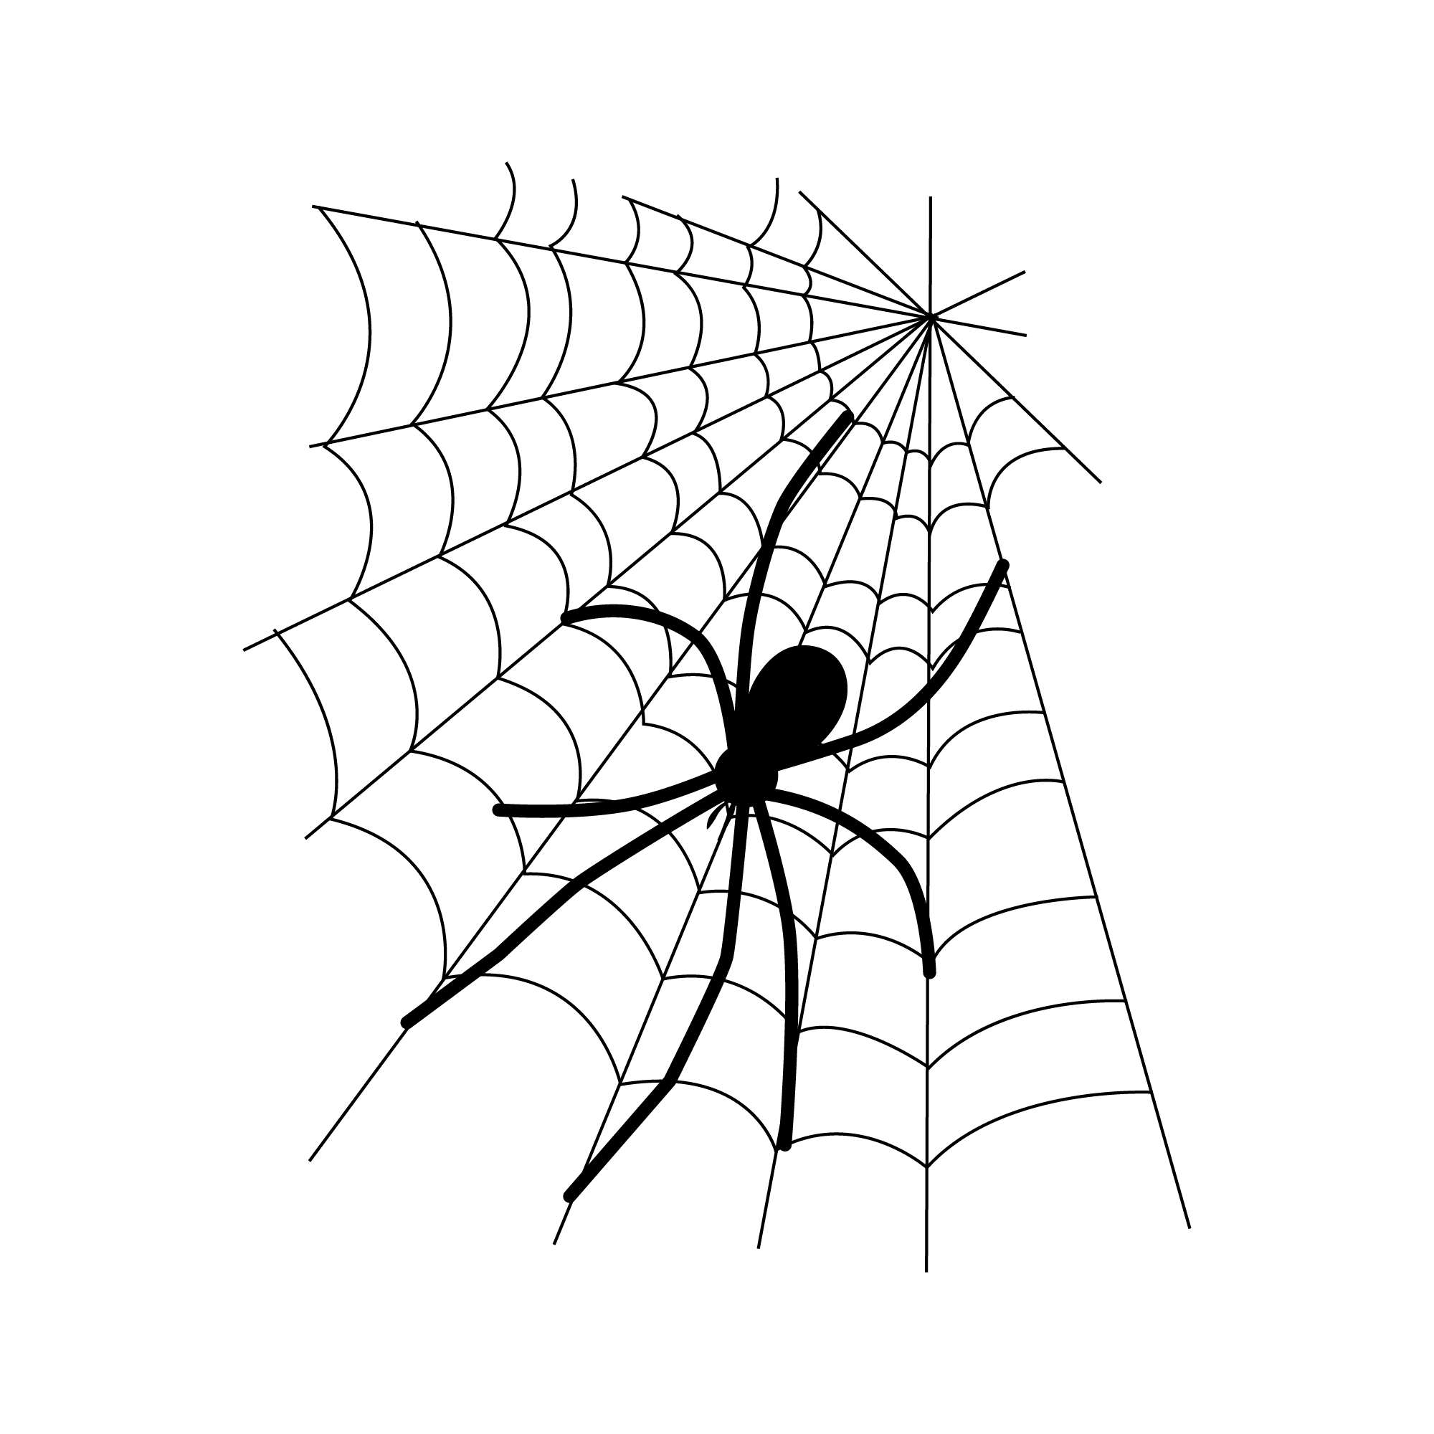
Sticky Spider Behavior
By John Cho

Slide 2
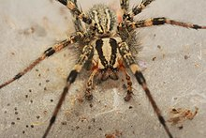
Overview
Modeling the dispersion patterns of the Agelenopsis Aperta,
a sheet-web weaving spider over time.
Desirable Habitats: grassland, flowering shrubs, litter, feces.
Limited Websites: the resident spider must protect its territorial fitness level, often engaging in aggressive behavior.
Variables: desirable habitat proximity & proximity to resident spiders.
Simulation Method: Random walks over time within an environment over a random spider distribution.

