Slide 1
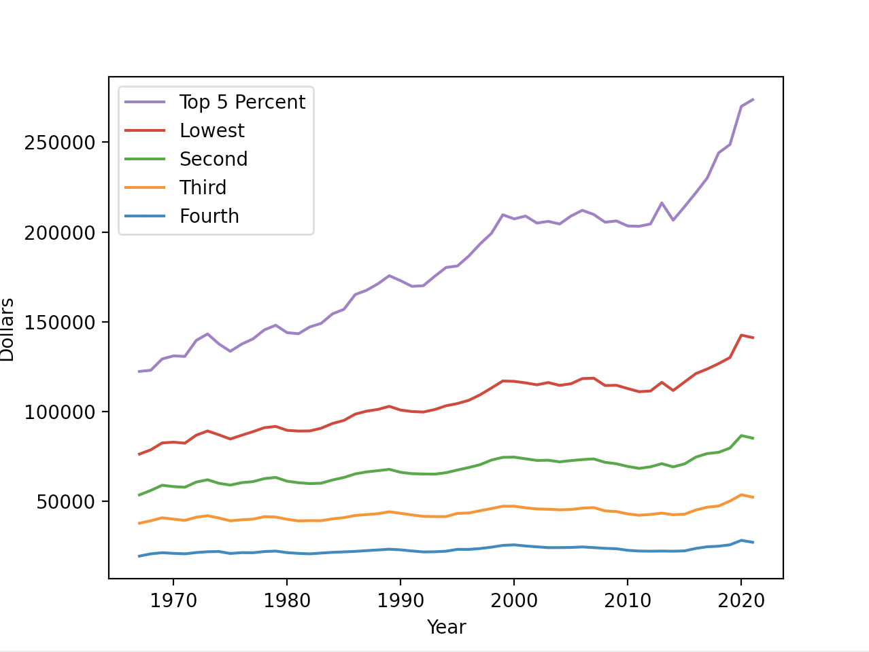
Income Limits for US Households
Rena Yan, EPS 109 Final Project

Slide 2
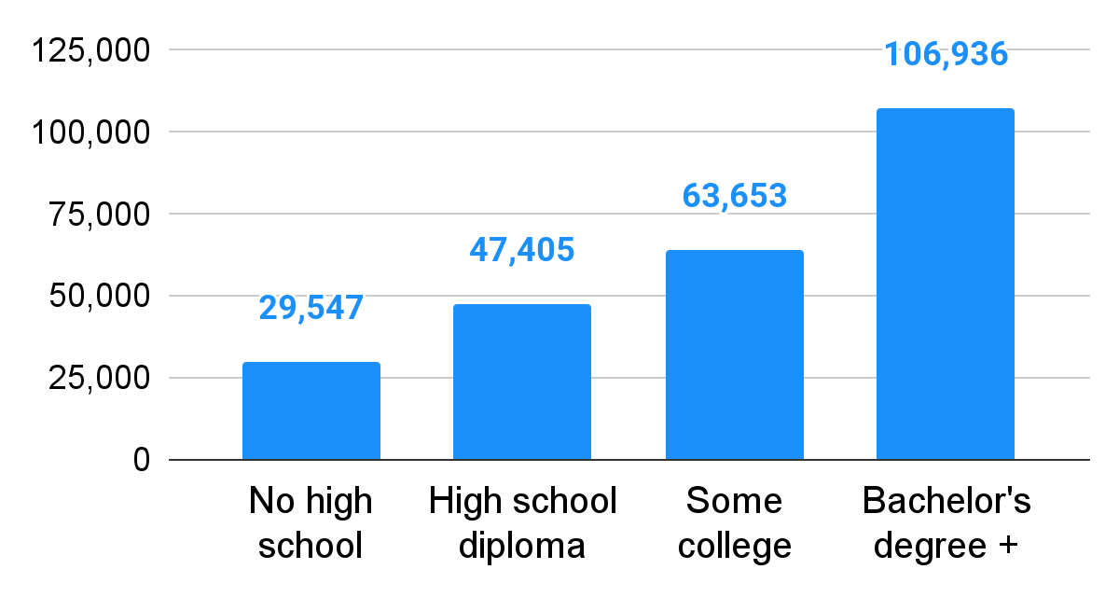
2020 Summary Measures
$67,521
1
2
3
4
United States Census Data - census.gov
HOUSEHOLD TYPE
Family / Non-family
Married / Male / Female
2020 Median Household Income
RACE
White, White (non-Hispanic) Black, Asian, Hispanic
Education of Householder
NATIVITY
Native-Born / Foreign-Born
Naturalized / Not a Citizen
REGION
Northeast, Midwest, South, and West

Slide 3
Analyzing Income Over Time
SOURCE
1967 - 2020 US Census Bureau Income Data
Upper limits of annual incomes for each fifth and lower limit of income for top 5 percent of all households
PROJECTED GROWTH
ACTUAL GROWTH
Begin with initial 1967 figures
Assume inflation rate of 2.5%
Project random growth
50% chance of no change
50% chance of matching inflation
Begin with initial 1967 figures
Project out actual income numbers
Notes:
Upper limits of annual incomes for each fifth and lower limit of income for top 5 percent of all households from 1967 to last year

Slide 4
Widening Inequality
PROJECTED GROWTH
ACTUAL GROWTH
Notes:
Upper limits of annual incomes for each fifth and lower limit of income for top 5 percent of all households from 1967 to last year

Slide 5
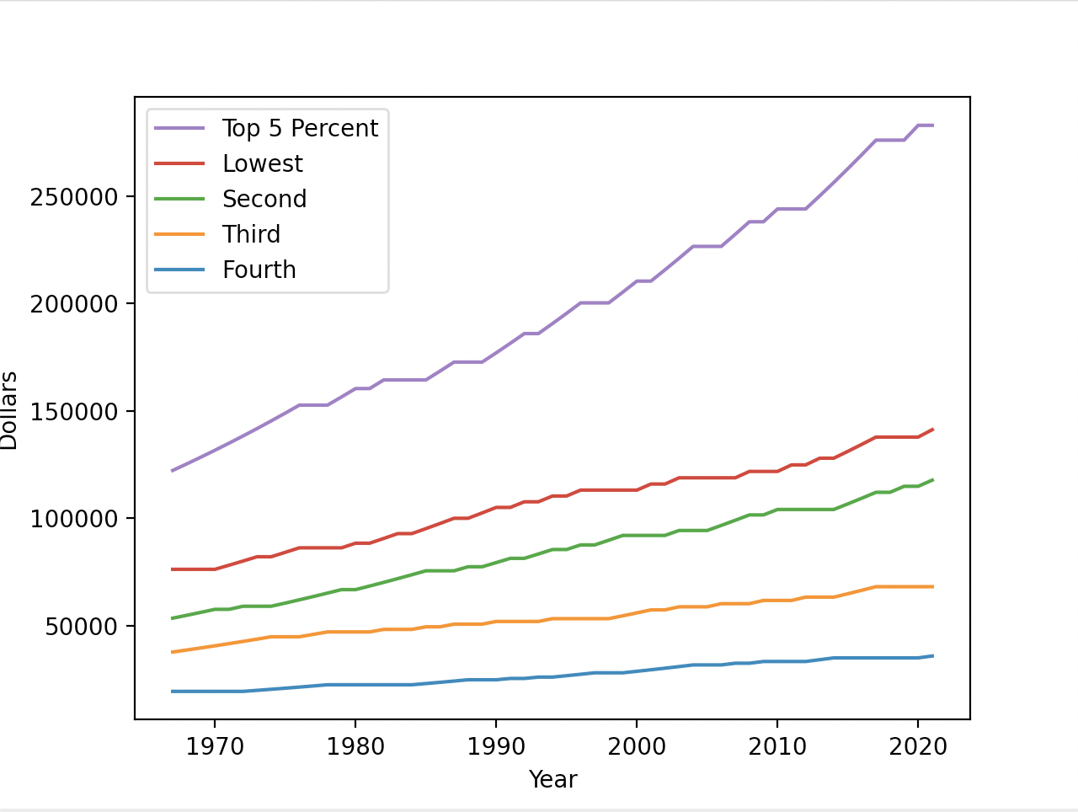
Widening Inequality
PROJECTED GROWTH
ACTUAL GROWTH
Notes:
Upper limits of annual incomes for each fifth and lower limit of income for top 5 percent of all households from 1967 to last year

Slide 6
Thank you!

