Slide 1
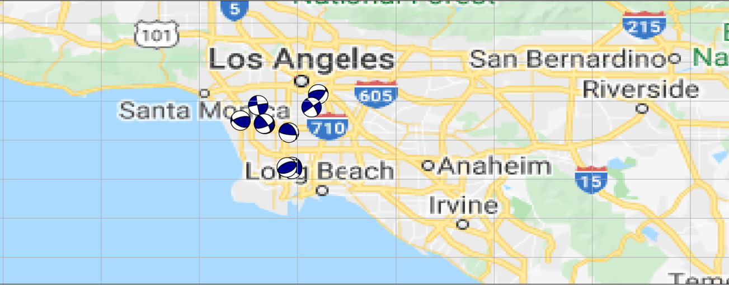
Characterizing Earthquakes in Southern Los Angeles
Kimberly Vargas

Slide 2
January 1st, 2020 – October 31st, 2021 South Los Angeles / Long Beach 129 Events

Slide 3
Event Locations

Slide 4
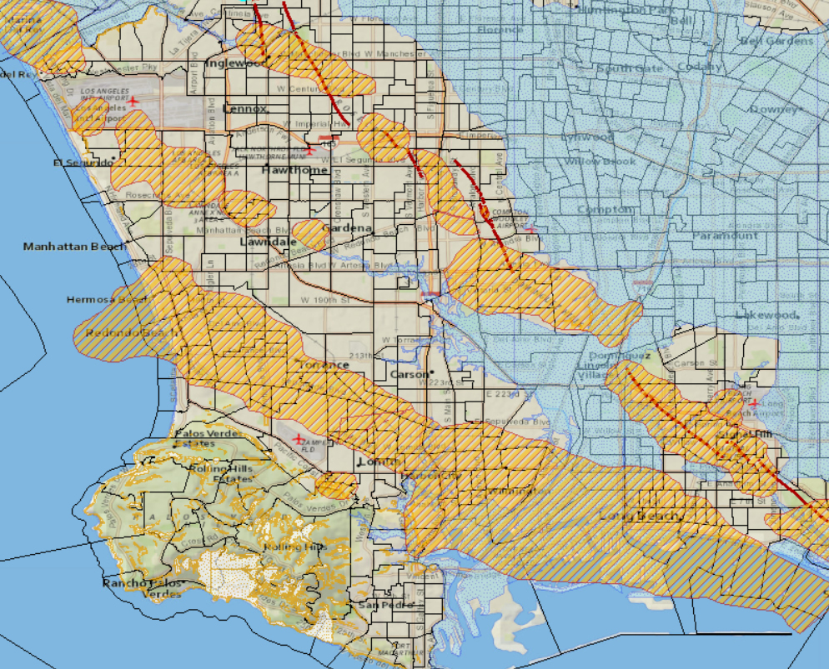
Site Map
Events locations coincide with oil field locations
Note the oil fields trending with the fault zone

Slide 5
Fault Plane Solution
Modeling earthquake generation by frictional slip
Plot first wave arrivals on two planes along great circle
Separate compressional (+) and extensional motions (-), nodal planes
Double couple: either 2 nodal planes can be the fault plane
Nodal Plane measurements:
Strike and Dip specify orientation of fault plane
Rake specifies orientation of slip vector on that plane
Implement ObsPy beachball function
Note: full focal mechanism characterization includes origin time, epicenter location, focal depth, seismic moment, magnitude and spatial orientation of 9-component moment tensor
Source: Vince Cronin, A Primer of Focal Mechanisms for Geologists

Slide 6
Fault Geometries and Corresponding Patterns
Source: Emile A. Okal, Encyclopedia of Solid Earth Geophysics

Slide 7
Focal Mechanisms with Event Locations

Slide 8
Next Steps…
Project ends here
Further investigation would focus on determining whether these events/events within the Los Angeles were caused by injection/extraction in oil fields
Subject still highly debated
Examine potential geological hazards

Slide 9
Methodology:
Data:
Earthquakes: USGS
Map Polygons: CA State Geoportal
Map Creation:
Site Location: ArcGIS
Event Simulations: CartoPy
Focal Mechanisms:
ObsPy
Animation:
FuncAnimation, FFmpeg
Code/Implementation:
https://docs.obspy.org/packages/autogen/obspy.imaging.beachball.beach.html
https://github.com/rahulks9/COVID_VIZ/blob/master/animation.ipynb

