Slide 1
Physics Simulation of a Rock Climbing Fall
Charlie Faramarzi

Slide 2
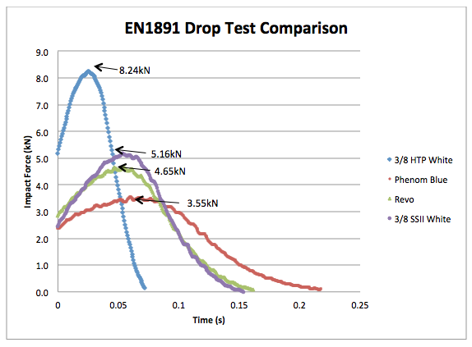
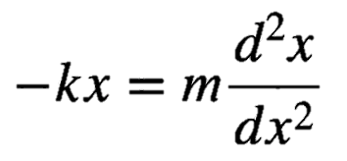
Methods
Represent climber and belayer as point masses
The rope is represented as a spring,
with the modification that k=0 for the
first few meters (slack in system)
3) Assume a given elasticity and friction coefficient,
iteratively update acceleration,
position, and velocity with differential equation
4) Adjust amount of slack, dynamic elongation of rope,
and climber/belayer weights to view effects on
fall length and force
**Helpful library: Dartmouth’s cs1lib for graphics and animation**
$$Fall factor (f) = h/l$$

Slide 3
Animation

