Slide 1
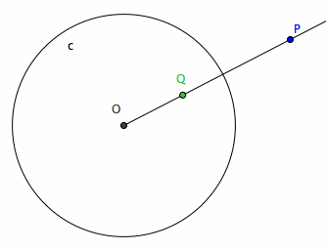
Inversive Circle Geometry
By Saul Lopez Cruz
Courtesy of http://xahlee.org/

Slide 2
Common Inverses

Slide 3
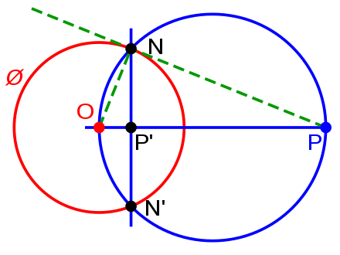
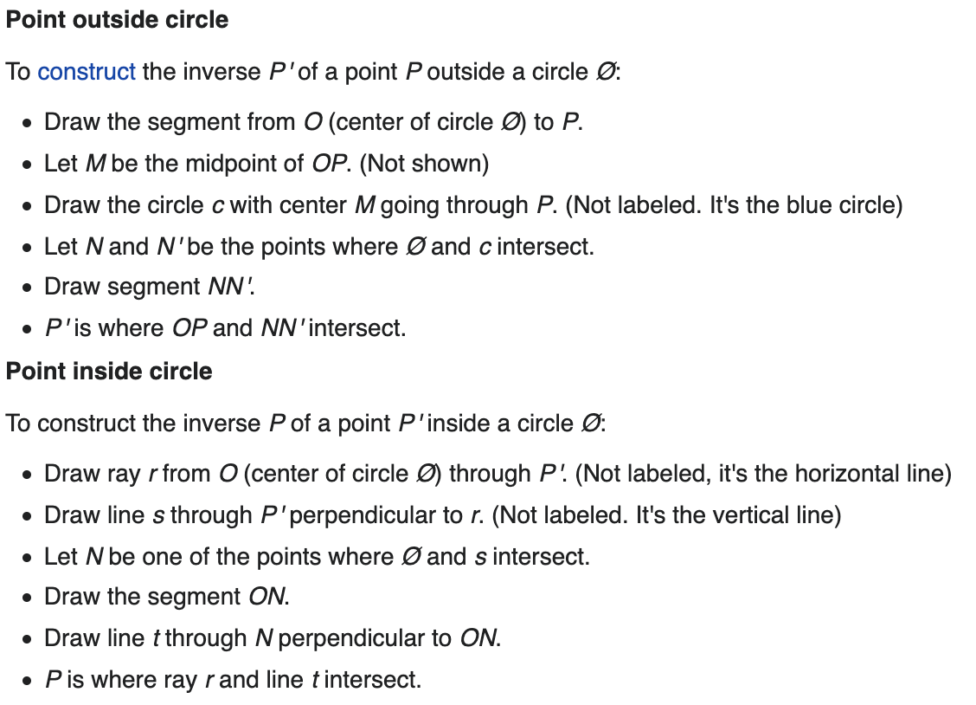
For a circle?
It’s complicated
Images courtesy of Wikipedia

Slide 4
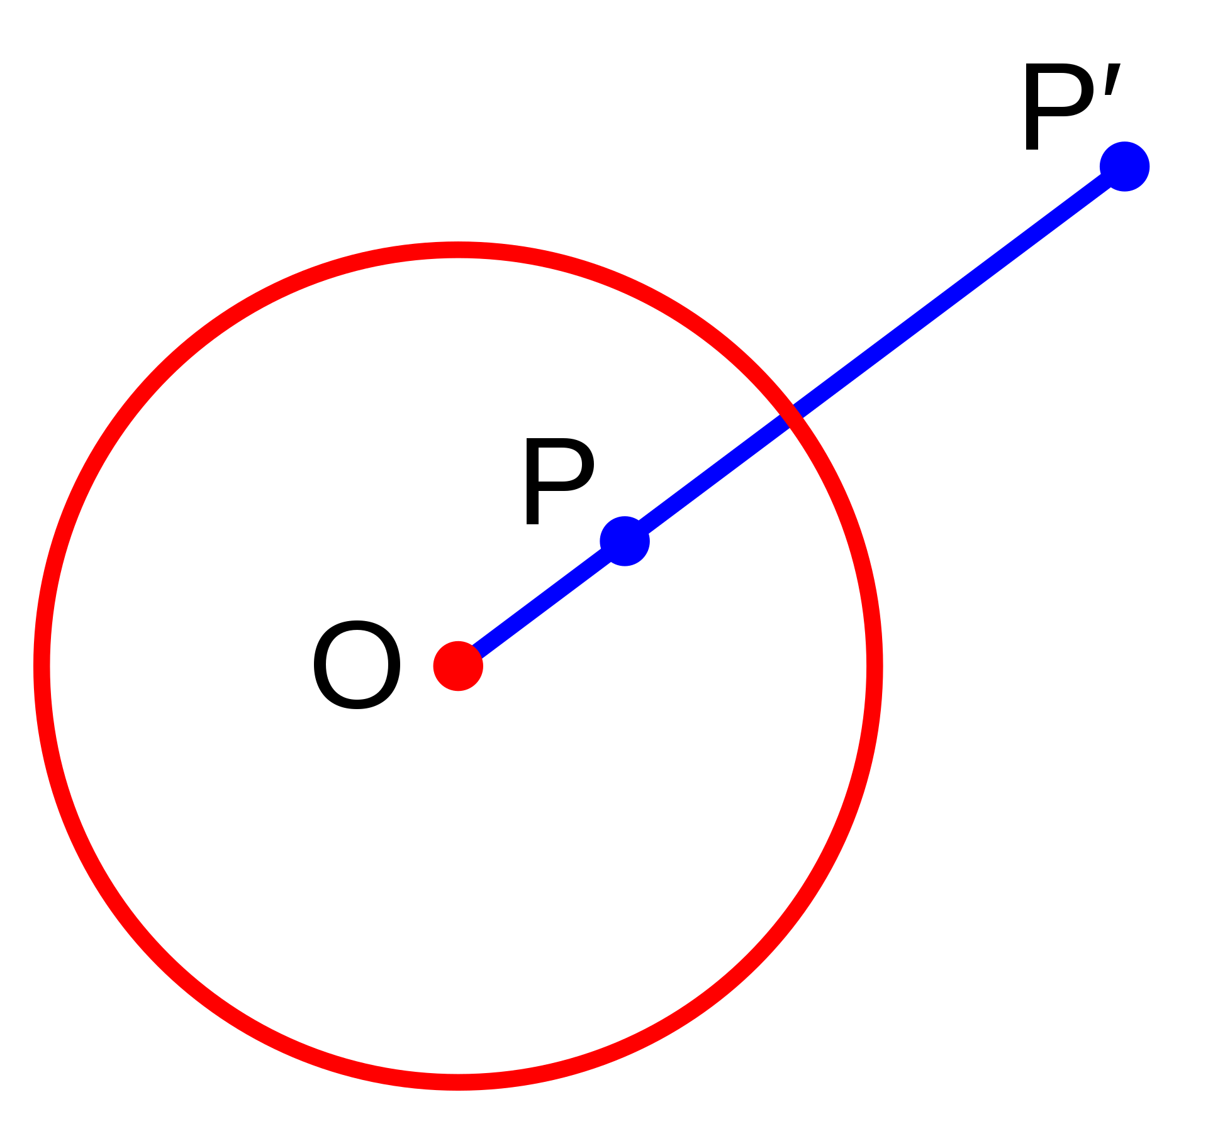
Linear Algebra makes it easy
Images courtesy of Wikipedia

Slide 5
Methodology
For animation
FFMpegWriter
For building circles
Created a function that takes two parameters.
Radius of the circle
Origin of the circle
Create a series of points stored as a list
Created a function to compute the inverse lambda scalar for each point in a list.
Added the inverted points to a matrix.

Slide 6
Here’s my animation

