Slide 1
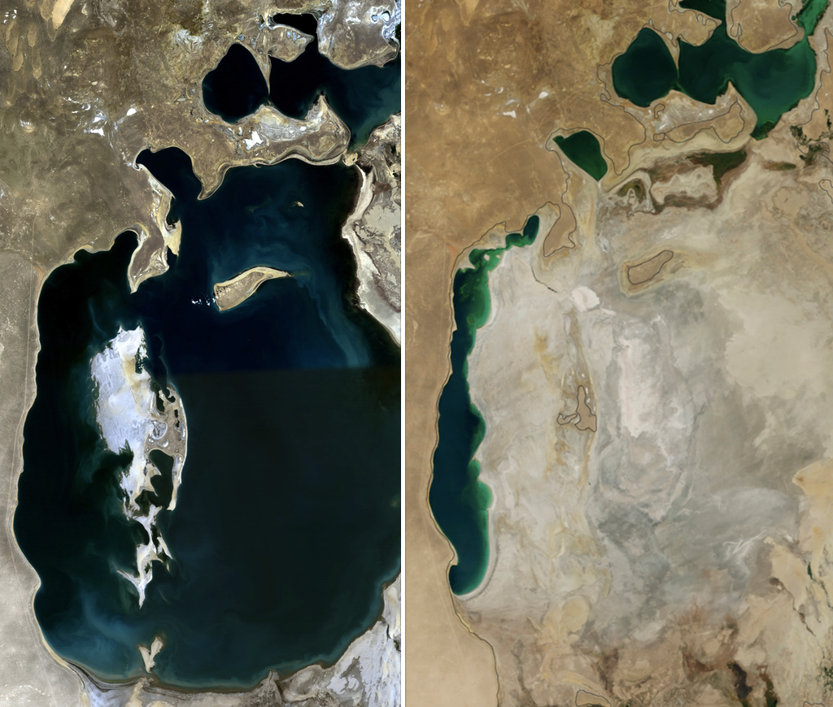
Recent Shrinking of the Aral Sea
Rishi Anand

Slide 2
Topic and Methods
The idea behind this presentation is to determine whether or not the Aral Sea has stopped shrinking.
To do this, I harvested data from the Sentinel 2 mission which took a picture of the Aral Sea every six months or so.
I used the harvested images' RGB values to highlight deep blue water and count the totals over a four-year period from 2017 to 2021.

