Slide 1
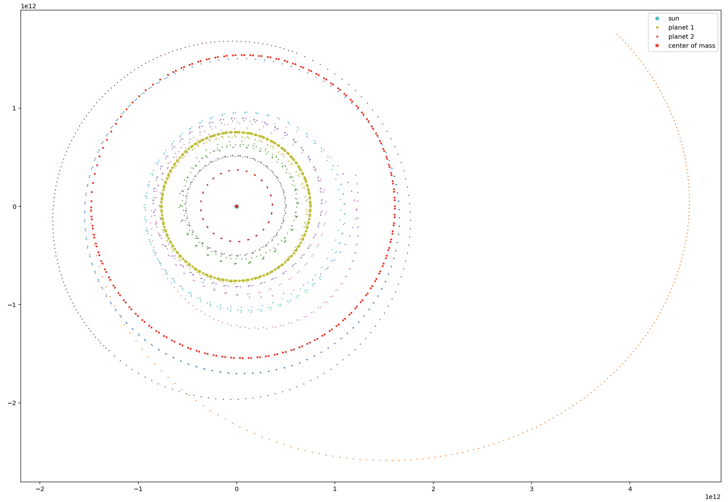
Asteroid Toss: A Simulated solar system
Helen Buchanan

Slide 2
Topic and methods
A system of two Jupiter like planets orbiting a star with randomly generated asteroids
Why?
What happens to asteroids near planets?
Methods:
Random asteroid generator
Solving Ordinary Differential Equations using Runge – Kutta
Kepler’s laws of planetary motion
Angular velocity
Gravitational Forces
Animation writer
Math
Blood, sweat, and tears
Mainly tears

