Slide 1
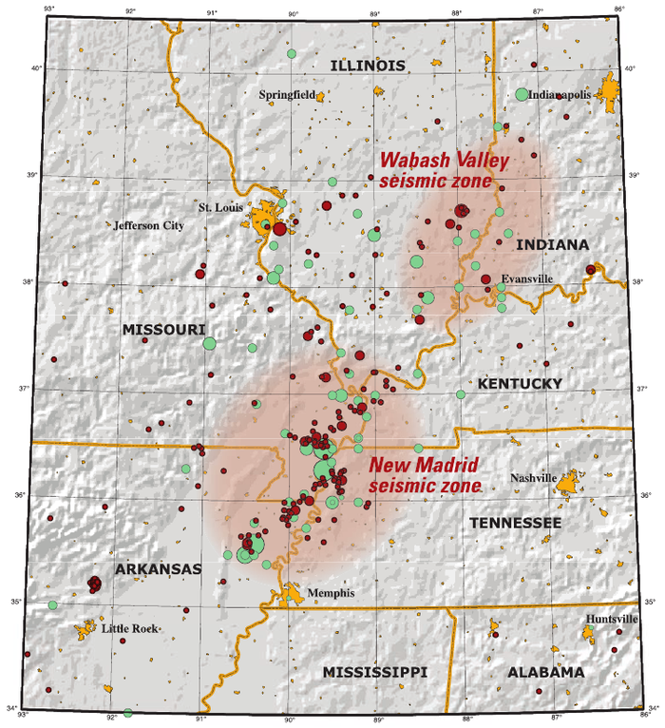
Wabash Valley vs. New Madrid Fault Line
Keira Colleluori

Slide 2
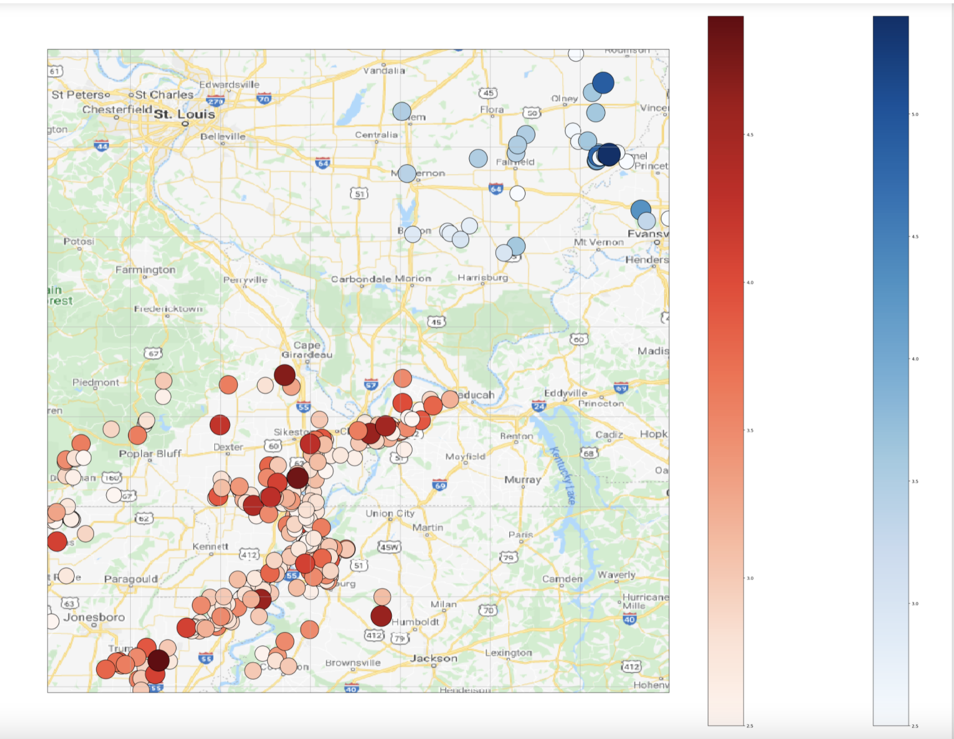
Method
There are two main fault lines in the region surrounding Illinois: Wabash Valley and New Madrid
Seismologists are concerned that the New Madrid fault line is becoming less active, while the Wabash Valley one is becoming more active
Using the obspy library, I wanted to see if I could replicate this pattern

Slide 3
Movie

Slide 4
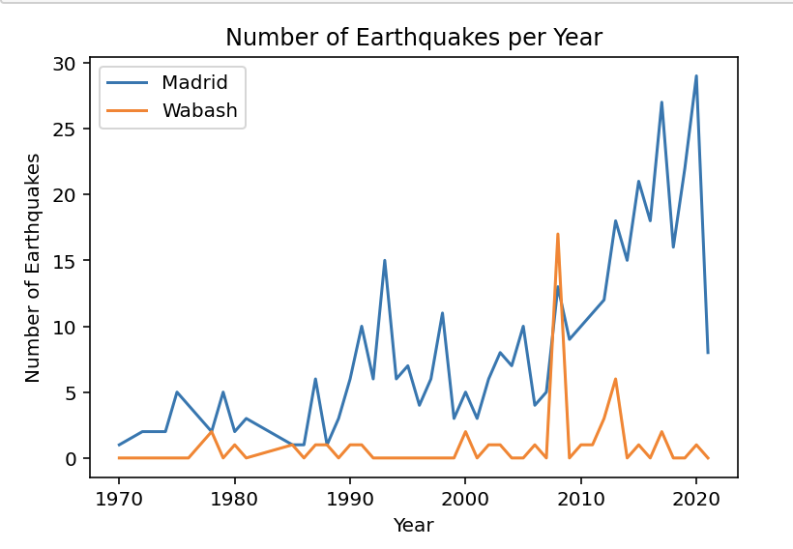
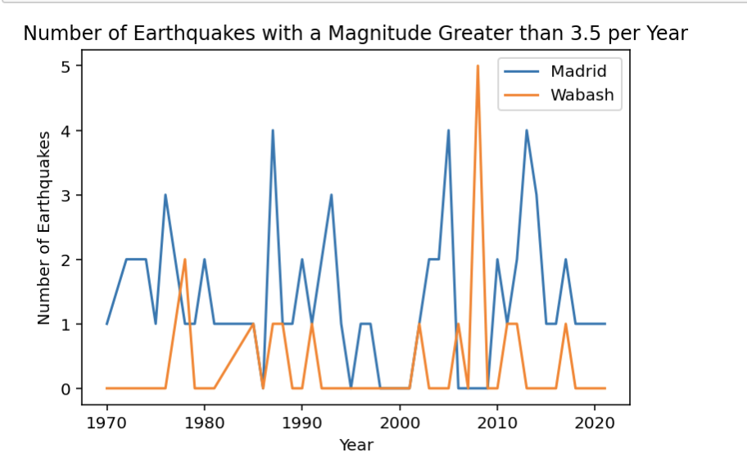
Additional Graphs

