Slide 1
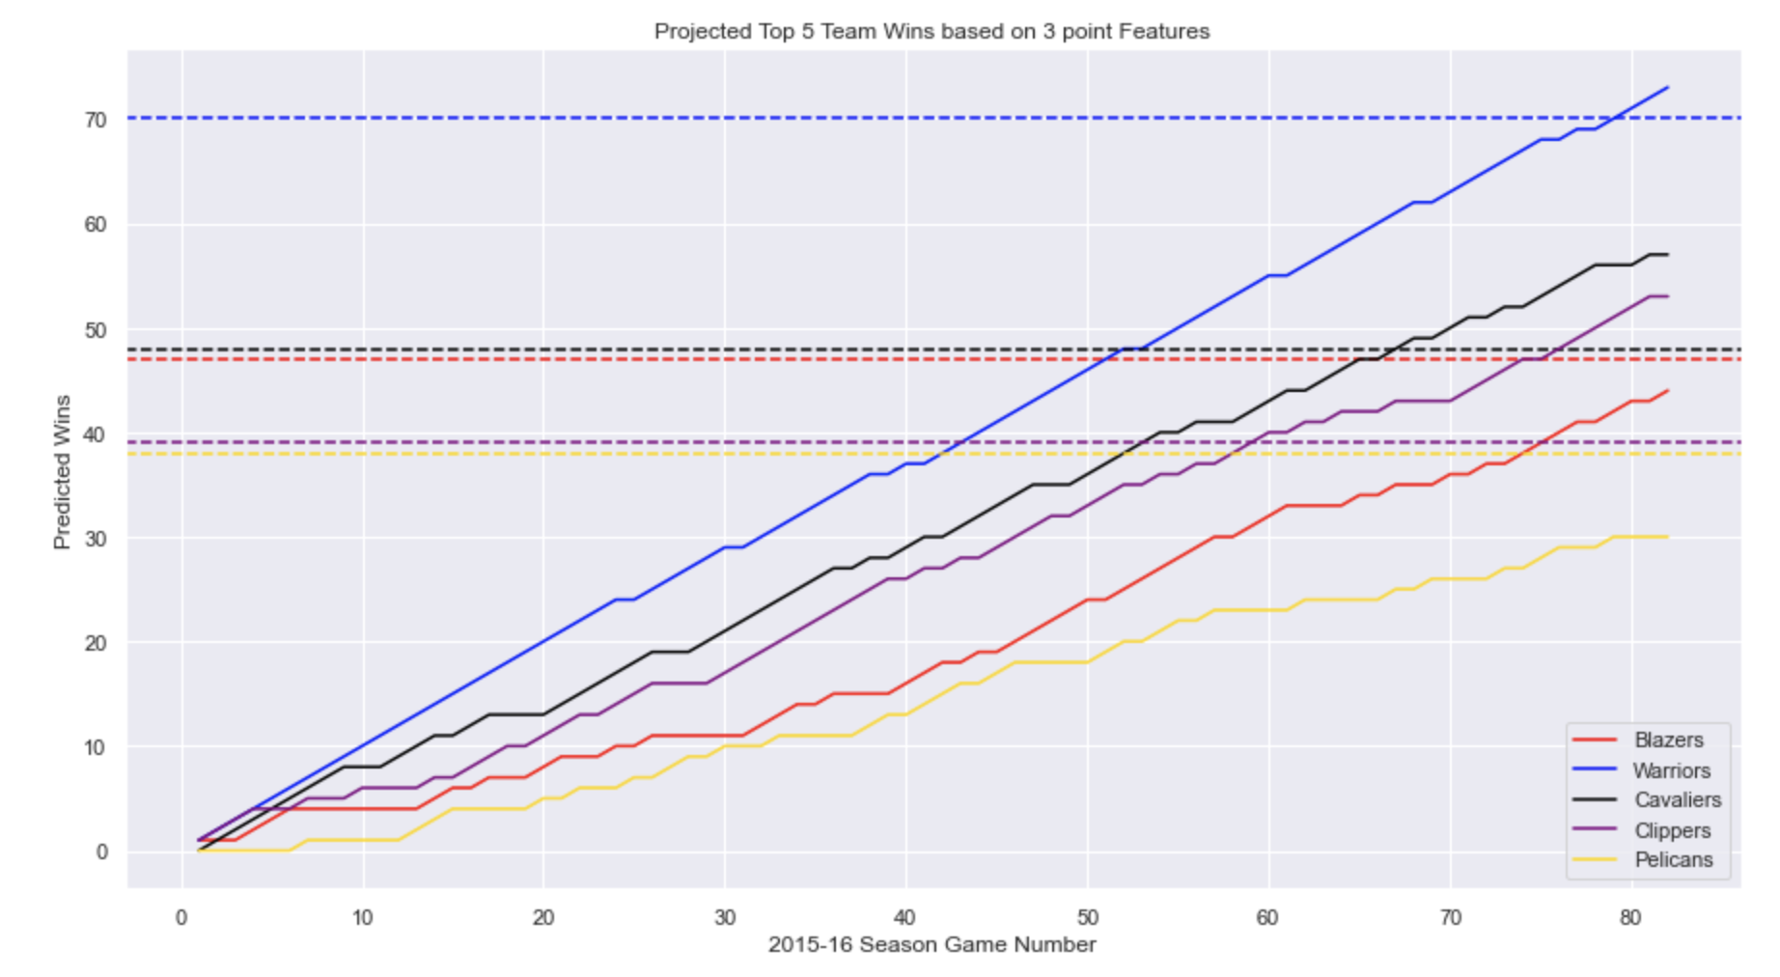
Predicting NBA Wins Based on 3 Point Features
Kellen Rice, EPS 109 Final Presentation

Slide 2
NBA Background
The NBA founded in 1946 has gone through many changes in it’s 75 year run
Most recently there has been a huge increase in the number of 3-pointers taken and attempted
The league-wide 3-point rate has increased in each of the last 10 seasons, rising from 22.2% in 2010-11 to 39.2% last season.
I want to look at how well 3 point features can predict NBA standings

Slide 3
The Plan
My goal was to train, fit and create a predictive a model that will estimate the number of wins a team gets based on their 3-pointers attempted, 3-pointers made, and 3-point percentage.
I used historical data to train the model for the last few years. Starting in 2016-17 and going through 2018-19. The reason being that was the last full year (82 games played) due to COVID.
Used Sk-learn kits to train and fit the model
The simulation will use RMSE to help make predictions and see how accurate those predictions are. These predictions will be compared against the real standings at the of the 2015-16 season.

Slide 4
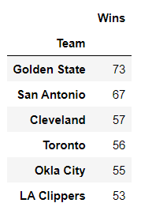
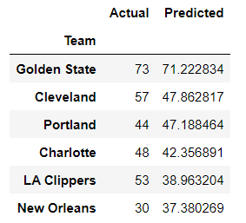
2015-16 RMSE Values
2015-16 RMSE
Mean Absolute Error – 9.85
Mean Squared Error – 154.61
RMSE – 12.43
Not enough features or 3-point statistics available to make a nearly perfect model
Actual Standings
Predicted Standings

Slide 5
Animation

Slide 6
Citations
https://www.nba.com/news/3-point-era-nba-75
https://www.teamrankings.com/nba/
https://www.basketball-reference.com/
https://stackabuse.com/linear-regression-in-python-with-scikit-learn/

