Slide 1
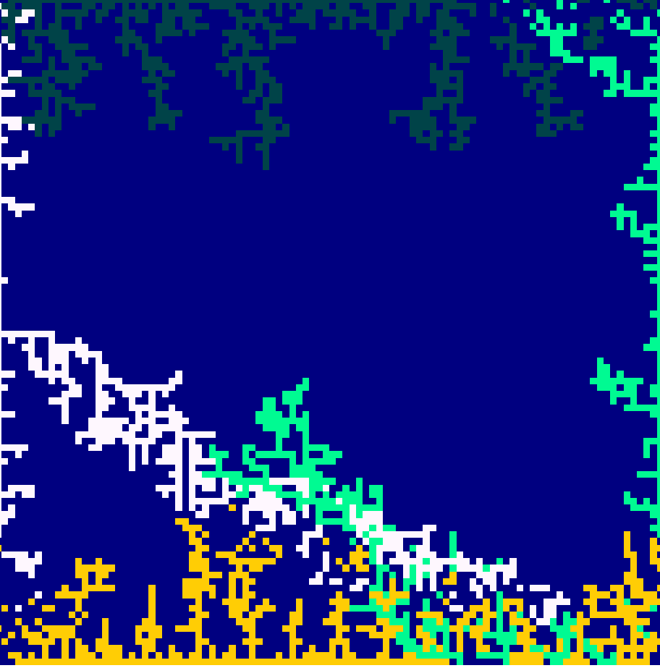
Competitive DLA
Sebastian Batali

Slide 2
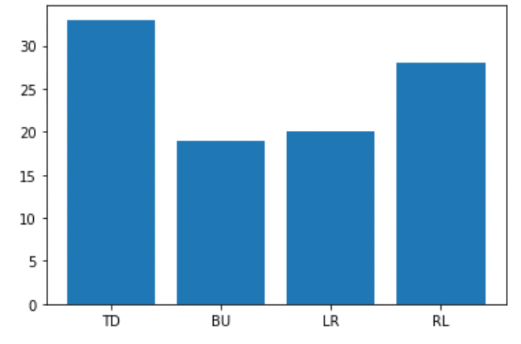
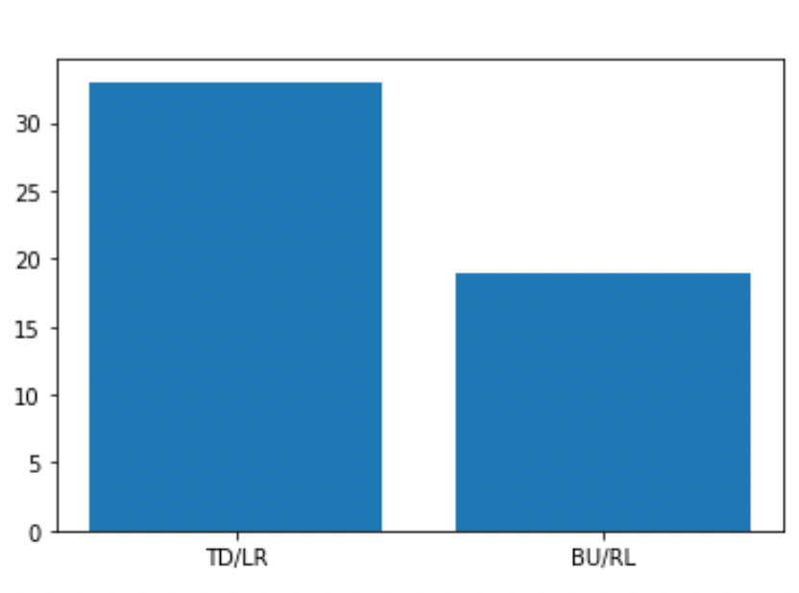
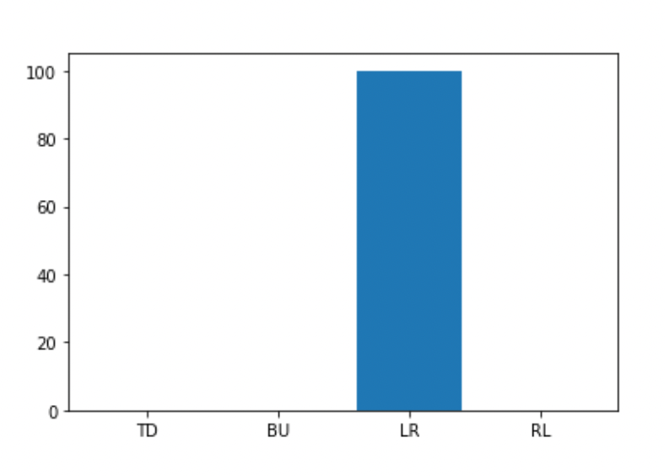
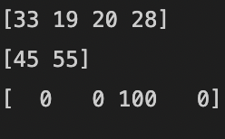
RPS
2v2
Poison
Topic:
The optional reaction DLA homework got me thinking about other applications
I was curious about how to make different DLA structures interact in an interesting way
This led to the idea of “competition” and different games for structures to play against each other
Method:
I altered a regular monte carlo based DLA simulation to change the direction and chance, direction preference for the 2D grid, and also run the walks at the same time on each iteration
RPS: The left structure takes over the right in adjacent area on stick and impact (clockwise)
2V2: One corner vs. another, one plays defense and “explodes” attackers while attackers try to get to the other side first
Poison: 3 structures try to get to the other side, and only interact with 1 who has precedence over everything else
Interesting Ideas for the Future:
Alter the chance of stick as well as the chance of direction based on Q-Learning
Expand resolution and see if it drastically affects the win distribution

Slide 3
RPS L/R Win

Slide 4
2v2 TD/LR Win

Slide 5
Poison
Poison Win

