Slide 1
Microbial Growth and Competition
Kaylee Christensen
Notes:
https://media.springernature.com/full/springer-static/image/art%3A10.1038%2Fs41598-018-23649-z/MediaObjects/41598_2018_23649_Fig1_HTML.jpg

Slide 2
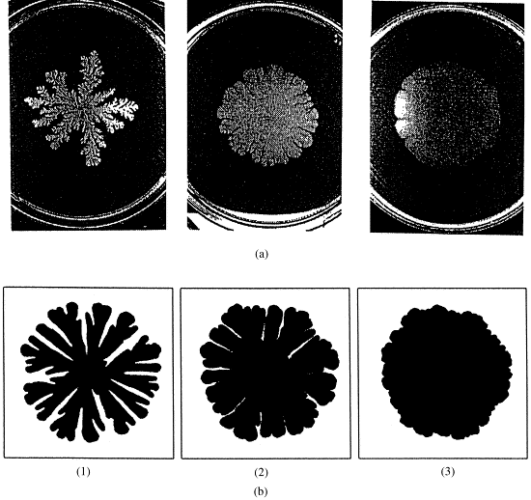
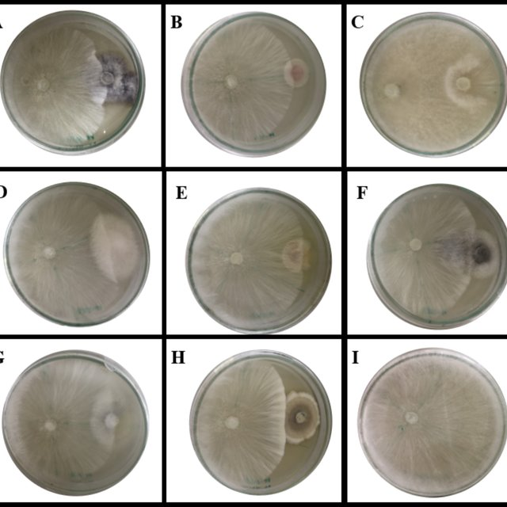
Methods + Background
Certain bacteria and fungi have been shown to grow in diffusion-limited aggregation-like colony formations, ex. Bacillus subtilis and fungal mycelium
When placed in a medium with limited nutrients, competition occurs between two species
In the code, used previous DLA rendering to model growth of microbes, created two separate growing colonies, and added competition rolls with preset parameters to simulate competition where the colonies meet.
Notes:
https://ars.els-cdn.com/content/image/1-s2.0-S0378437100000856-gr4y9.gif
https://www.researchgate.net/publication/341132671/figure/fig2/AS:888375858978816@1588816718133/Dual-culture-plate-assay-between-some-endophytic-fungi-against-the-pathogen-A-rolfsii_Q640.jpg

Slide 3
Strong competition (0.1/99.9), compact growth

Slide 4
About even competition (40/60), compact growth

Slide 5
Strong competition (10/90), open growth

Slide 6
About even competition (40/60), open growth

