Slide 1
Epidemic Simulator
Lai Wei

Slide 2
Project Description
Goal: Simulate spread of virus based on SEIRD model
Method: Solve systems of Ordinary Differential Equations numerically using Runge–Kutta method
Graph: Line plots of each group plus the cumulative count of infection

Slide 3
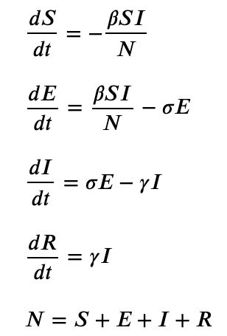
Set-Up of The Model

Slide 6
Virus Mutation - Type I
Lethality
Infectivity
Mutation

Slide 7
Virus Mutation - Type I

Slide 8
Virus Mutation - Type II

Slide 9
Government Response: LockDown

Slide 10
Reference
Cover Photo by: https://www.ukri.org/news/laser-study-to-understand-virus-spread/
Model Set-up: Menda, K., Laird, L., Kochenderfer, M.J. et al. Explaining COVID-19 outbreaks with reactive SEIRD models. Sci Rep 11, 17905 (2021). https://doi.org/10.1038/s41598-021-97260-0

