Slide 1
The “Ultimate” Simulation
Modeling a Frisbee’s Flight Path
Evan Magsig

Slide 2
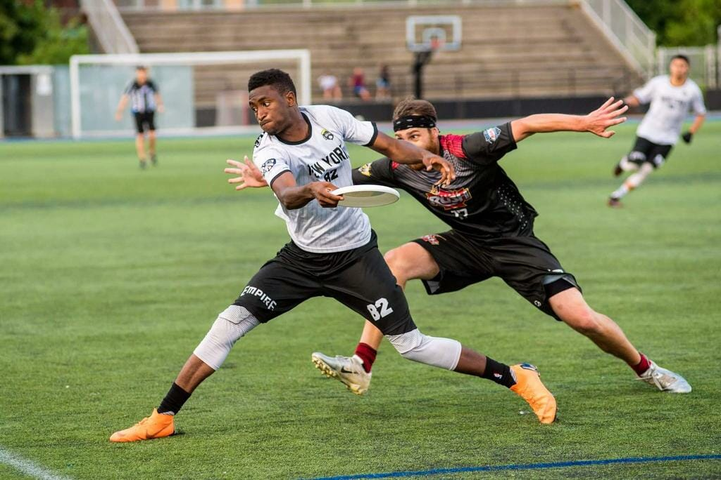
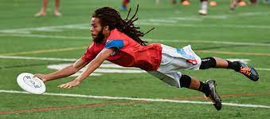
Why Should We Simulate Frisbees? Let’s “Discus”
Fast Growing Sport
Professional league!
Big Player Base
Impact: Data can be helpful for training
Achieving max throwing distance can have a numerical level (X-MPH on release)
Optimum Angle for Release to achieve max distance

Slide 3
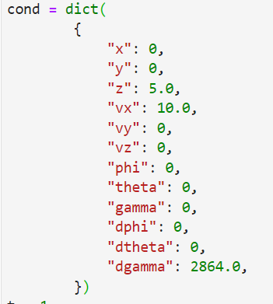
A Complex Problem! Lots of “Forces” in play -- not just flick or backhand
Methodology:
Start With Initial Conditions
Compute Forces and Moments
Find dt of t-1 conditions from step 2
Update t-1 conditions with t-1 * dt
Drag Force Roll Moments
Lift Force Pitch Moments
Force of Gravity Spin Down Moments
(Robins-Magnus Force -- negligible)
Lots of help from Hummels, Sarah. (2003l). Frisbee Throw Aerodynamics

Slide 4
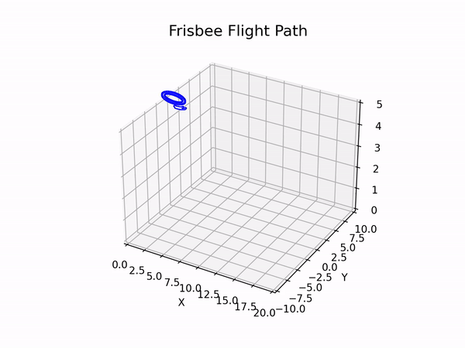
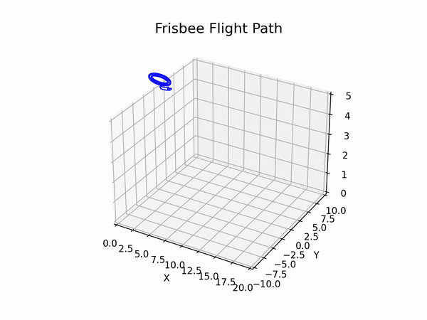
The Simulations
Initial Cond
"z": 5.0, "vx": 10.0, “dgamma”: 2864 "z": 5.0, "vx": 10.0, “vy”:3, “vz”:10
“dgamma”: -1400

