Slide 1
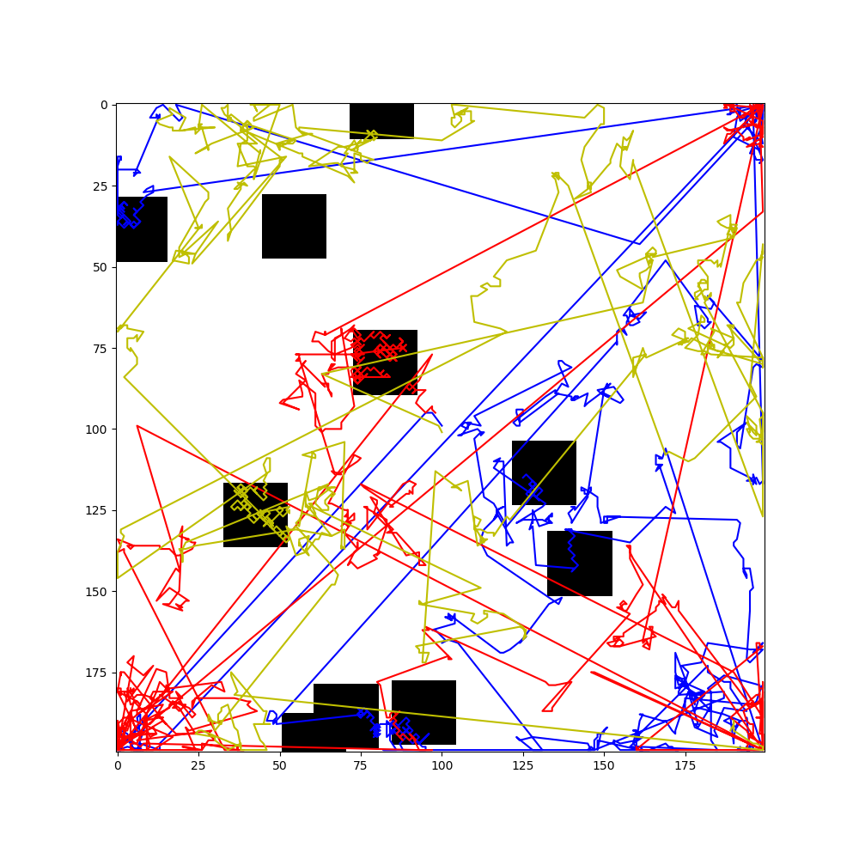
Levy Flight Simulations
Brian Lin

Slide 2
Project Description
Levy flight: random walk with step sizes from a heavy-tailed random distribution
Models flight foraging – predators with sparsely distributed prey
Simulation
Large grid with ‘critical’ areas
Blocks centered around random points in different quadrants
Random motion with 4 directions + uniform step size in ’critical’ sections
Predators travel with small jumps in areas with prey
Otherwise pick random angle and step size from distribution
Stable distribution skewed towards positive values
scipy.stats.levy function
Occasional large jumps in location

Slide 3
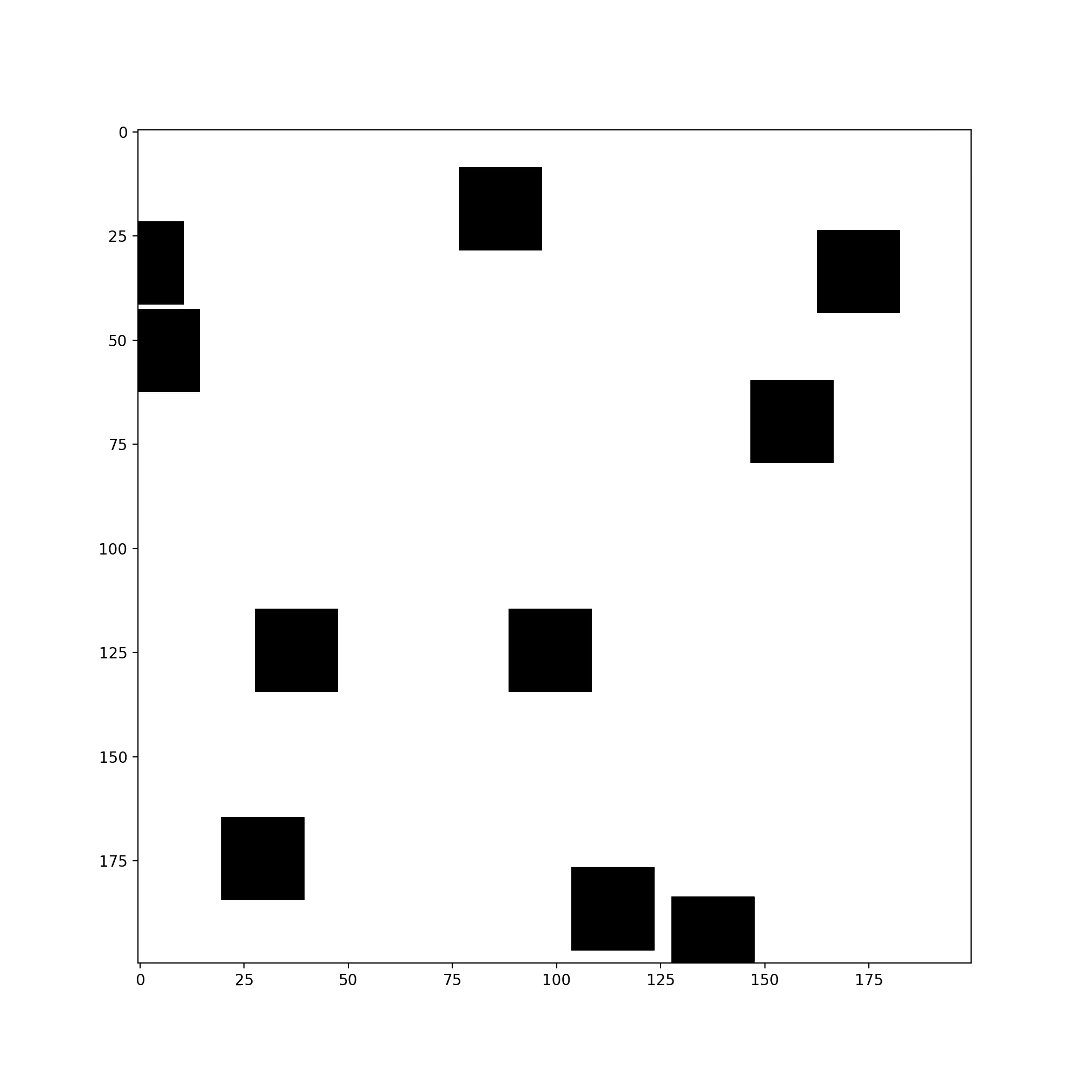
Grid with some ‘critical’ areas

Slide 4
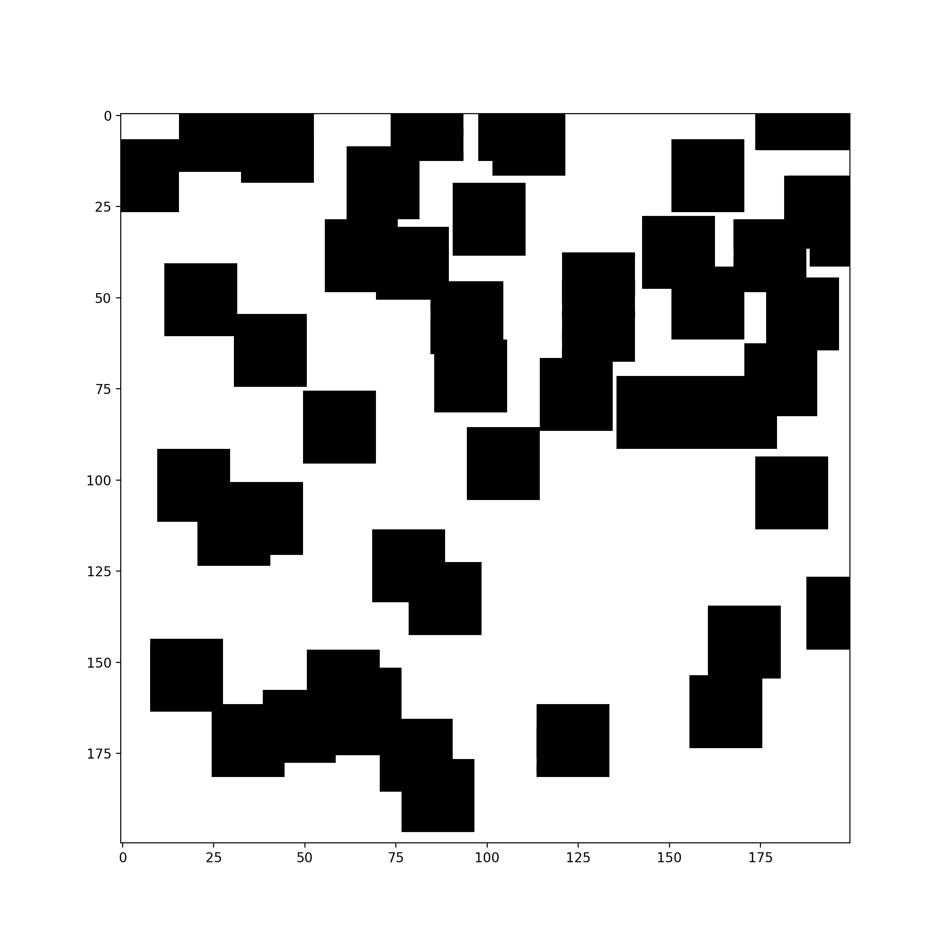
Grid with many ‘critical’ areas

