Slide 1
Michaelis-Menten Enzyme Kinetics
Ajitesh Nanda

Slide 2
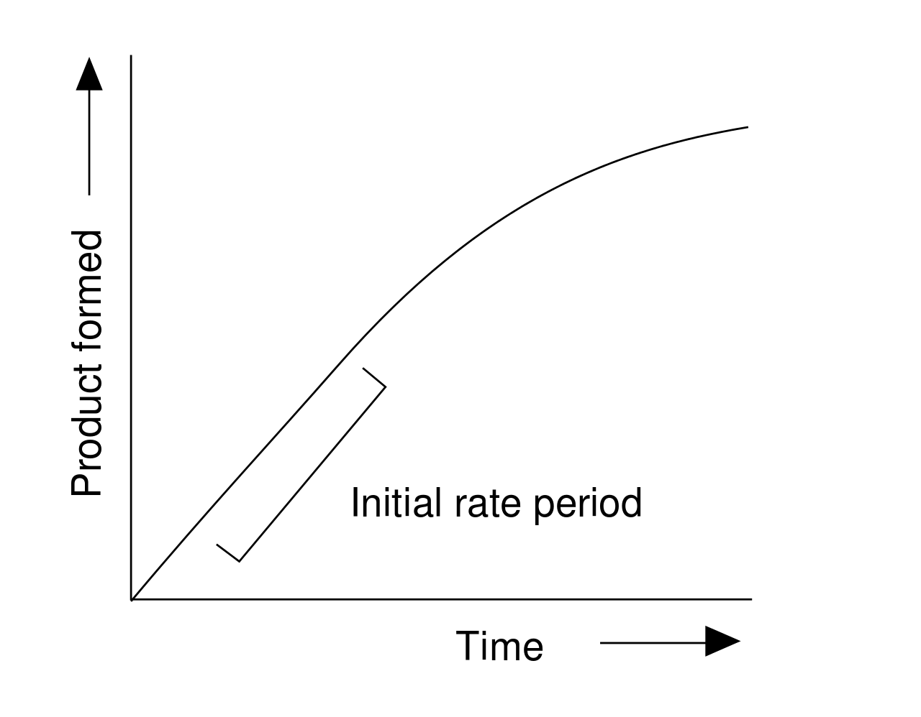
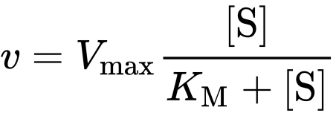
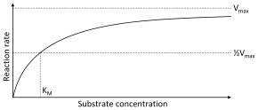
Background
What is Michaelis-Menten?
Experiment scheme to determine two properties of enzyme kinetics: V_{max} and K_{M}
Methods/Approach
Built a visual simulation using random walks and DLA-type of “reactions”
Probability-based rather than ODE
2D array, where the A[x,y] describes the type of particle
For a specific [S]_{initial} :
v = slope
Repeat for many [S]_{initial} :
Eqns and Graphs from Wikipedia

Slide 3
Animations
V = 6.86e-05

Slide 4
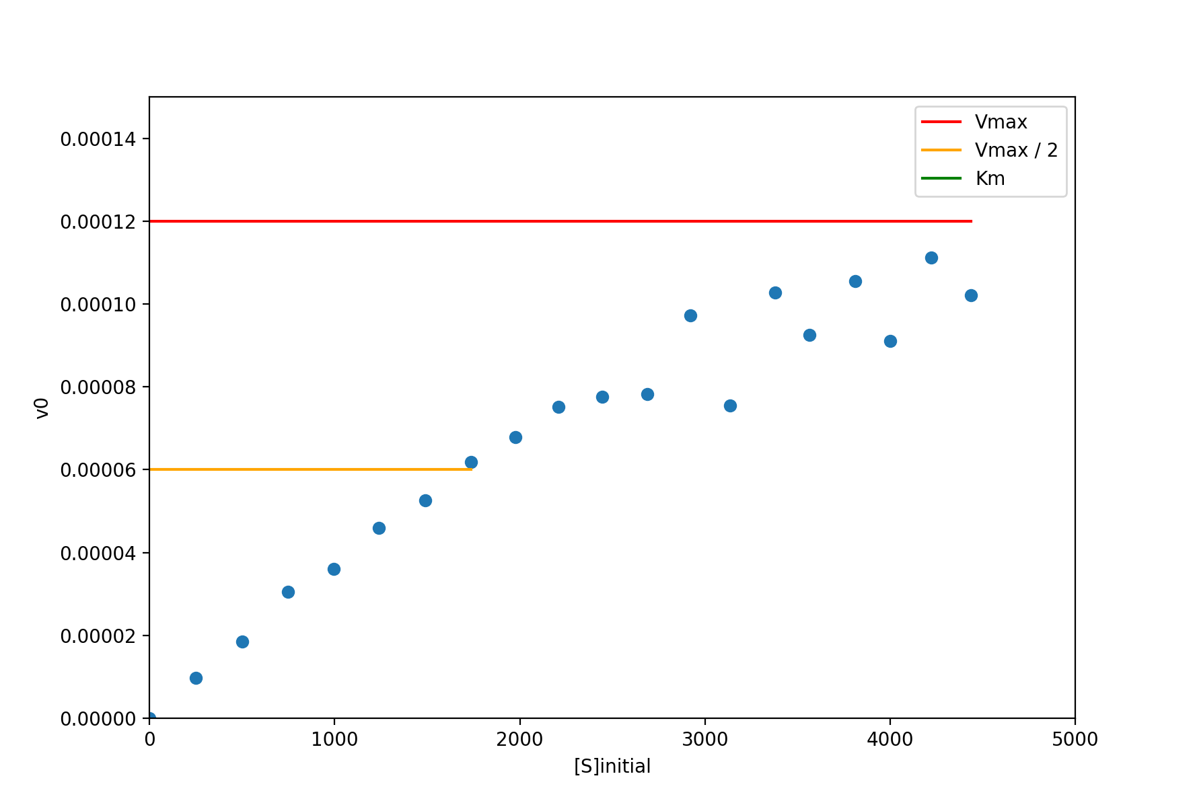
End Result

