Slide 1
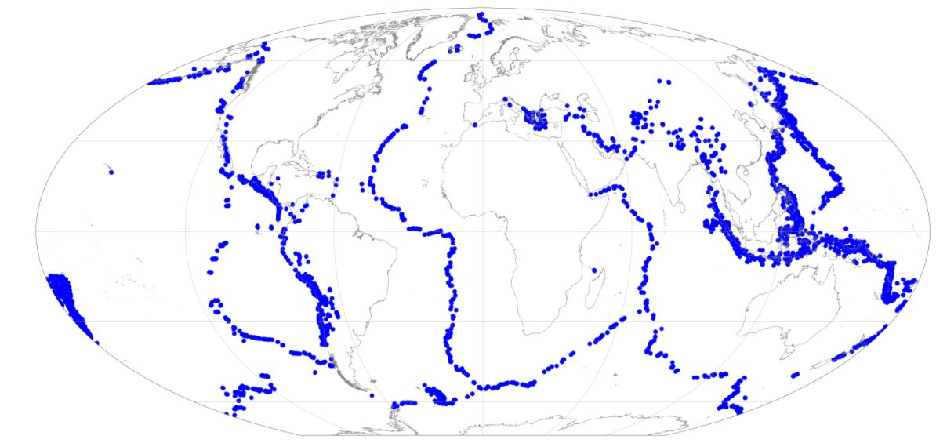
Using Earthquake Proximity to Plot Plate Boundaries
Jenny McKeown-Green
Figure 1. Map of Earth where each point is an earthquake which occurred along a plate boundary.

Slide 2
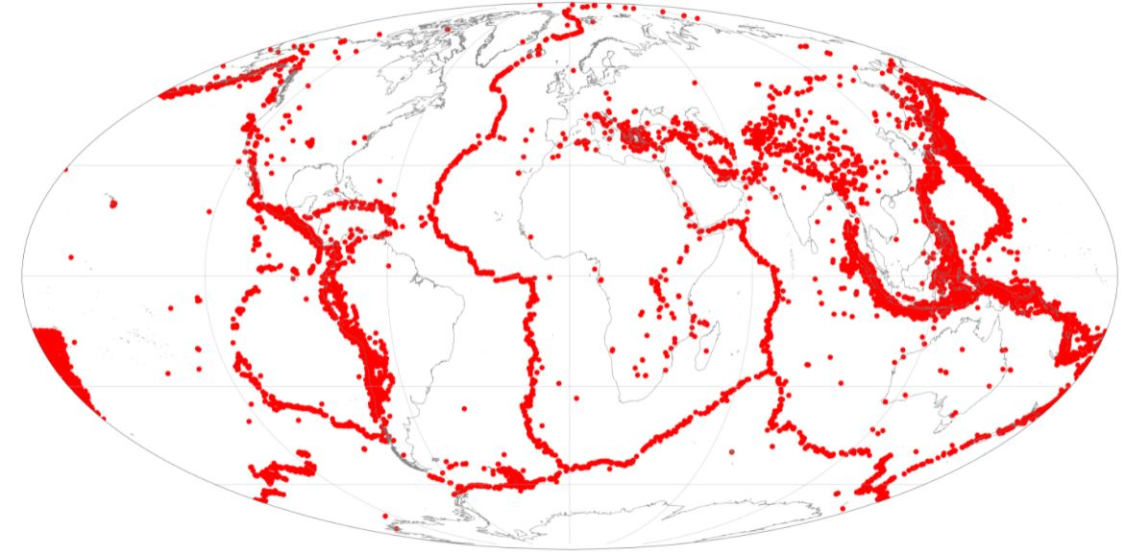
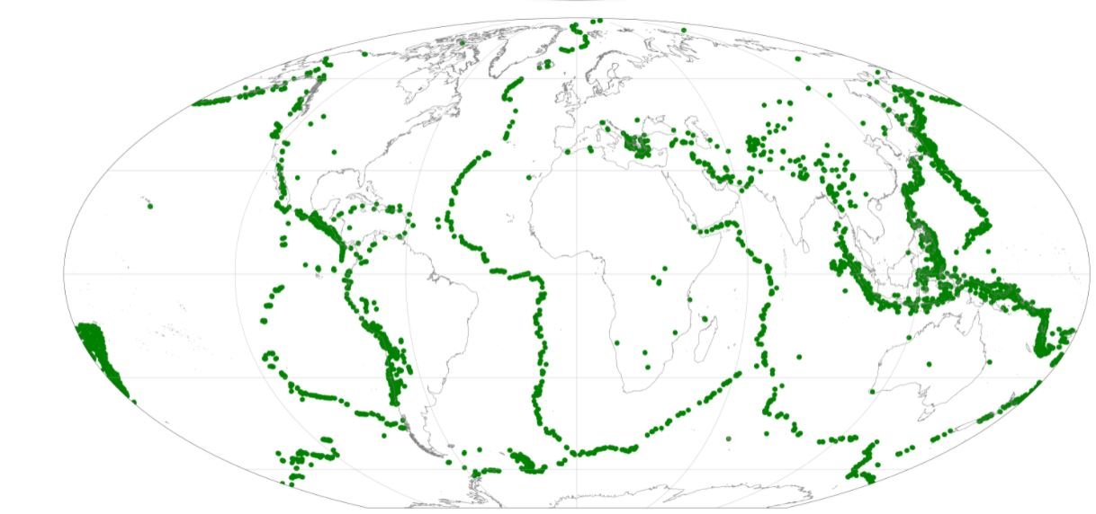
Total Earthquakes
Catalog of all the earthquakes from 2011 to 2021 greater than magnitude 5 to form a data set.
Plot on globe to identify rough outlines of plate boundaries.
Proximity Earthquakes
For loops and lists to store earthquake indexes
If statements to select out earthquakes within 20km of each other
Extracted the latitudes and longitudes from the indexes
Plotted the resulting lists to see outlines of plate boundaries and identify outlying groups.
Cluster Earthquakes
Eliminated outlying points by looking for clusters of earthquakes with neighboring earthquakes.
Took proximity data, used a for loop and distance function to determine for each earthquake the sum of distance between its nearest neighbors and the number of earthquakes it had within that distance.
Set conditions to only plot earthquakes with distance < 500 km and clusters of neighbors > 10.

Slide 3
Final Plot and Animation: Earthquakes Along Plate Boundaries Accounting for Both Proximity and Nearest Neighbors.
Animation 1. Clusters of Earthquakes in Close Proximity Occurring Along Plate Boundaries

Slide 4
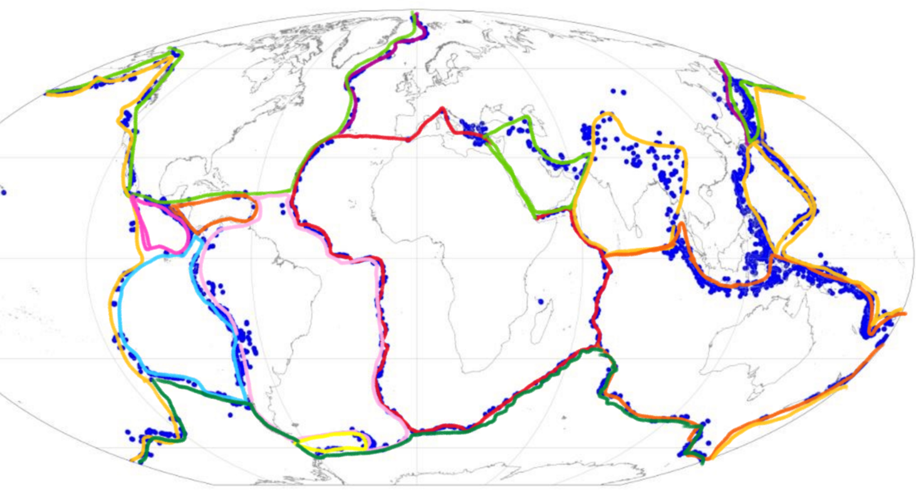
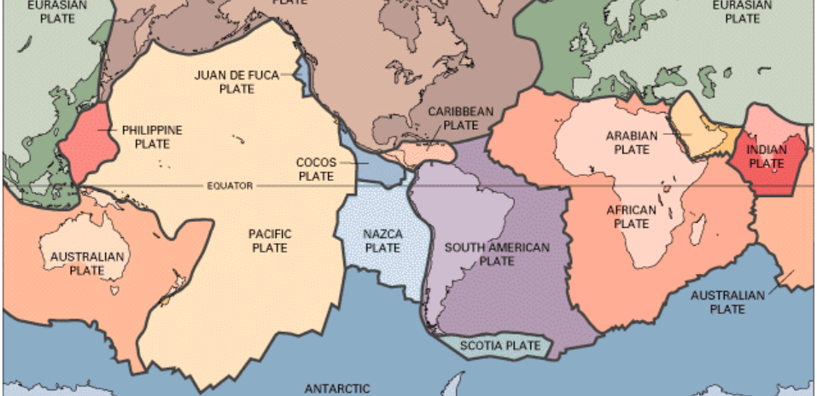
Figure 2. Hand Sketch of Plate Boundaries Over Generated Earthquakes
Figure 3. USGS Plate Boundary Map Showing Outline of Plate Boundaries
Image in public domain. https://www.usgs.gov/media/images/tectonic-plates-earth

