Slide 1
Modelling intelligence mismatch using random walks and naïve AI
Aidan Curran

Slide 2
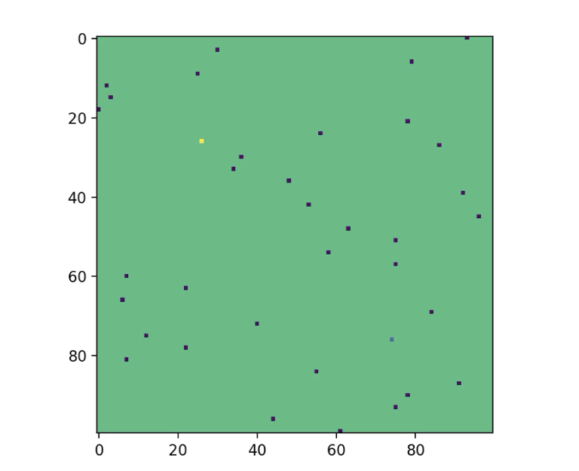
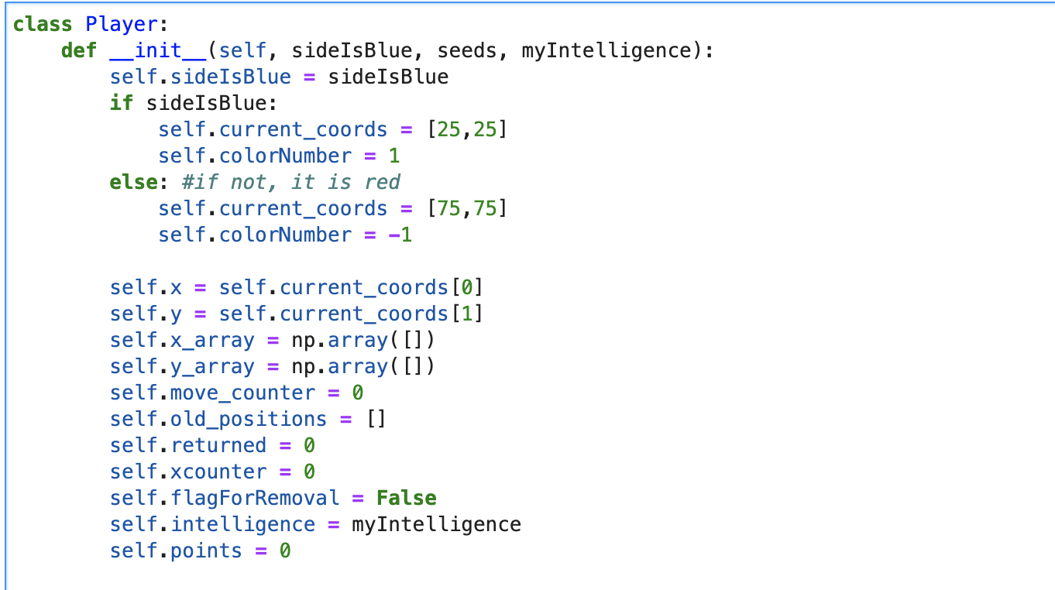
Background
Beginning board state
Competitive model based on DLA - two players competing for a limited number of points spread randomly across a grid
Used OOP to make 2 ‘players’ doing DLA on the same grid
Each ‘player’ has a naive AI that will cause it to select whatever move brings it closer to the nearest point marker, from the standard set of 8 possible directions (up/down/left/right and all diagonals)
Naturally, if both players have their AIs making moves constantly, they end the game with similar points and in the fastest time possible
But what happens if I make one of them stupider?
Code sample

Slide 3
Equal, high intelligence
Large intelligence mismatch
Player 1’s points: 16
Player 2’s points: 15
Player 1’s points: 29
Player 2’s points: 3

Slide 4
Further Exploration / making AI dumb
For each player, I added a parameter that allows me to make one of the players ‘dumber’ than the other
Depending on the magnitude of this parameter, a player will at certain intervals revert to DLA behavior rather than using the heuristic - basically a ‘random walk’ instead of planned movement
Obviously this allows one player to amass many more points than the other – but what consequences does it have for the state of the game? How much longer does it last? Can I model the effect of the intelligence change on game length, average points per move, etc?

Slide 5
Test Examples (anim.)
Intelligence Difference: 0.1
Avg. point Difference:
1.333
Avg time to finish:
49.63333333
Intelligence Difference: 0.3
Avg. point Difference:
3.66
Avg time to finish:
56.55
Intelligence Difference: 0.5
Avg. point Difference:
16
Avg time to finish:
66.71
Intelligence Difference: 0.7
Avg. point Difference:
21
Avg time to finish:
79.6
Intelligence Difference: 0.9
Avg. point Difference:
25.667
Avg time to finish:
85.75

Slide 6
Data

Slide 7
Data

Slide 8
Something I noticed
Curiosity: when the two AIs have equal intelligence the time taken is longer than when there is even a small difference in the quality of their decision-making. This was happening consistently
This seems to happen because there is a high probability of them being ‘entangled’ and being stuck in a loop of chasing the same points over and over. Even a small amount of variance is usually enough to make this happen a lot less often
Animation shows this happening

