Slide 1
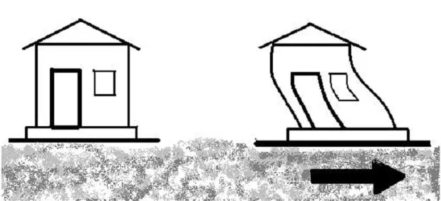
Building Displacement due to Earthquake and Wind Loads
Jeffrey Jeung
EPS 109

Slide 2
Details
Based on a building that is experiencing displacement because of an earthquake and strong winds, both in isolation and in conjunction with each other
Earthquake: single strong force at the base of building
Wind: distributed loading along side of building, with strongest force at the top
Simulated direction of earthquake and wind loads in the same direction and in opposite directions
Exaggerated building deformations, not 100% realistic
Used PDEs, similar to heat equation homework
Used different PDE for boundary conditions
Top and bottom of building both move, unlike heat equation where boundary conditions are constant

Slide 3
Earthquake and Wind Loading in the Same/Opposite Direction
Same Direction Opposite Direction

