Slide 1
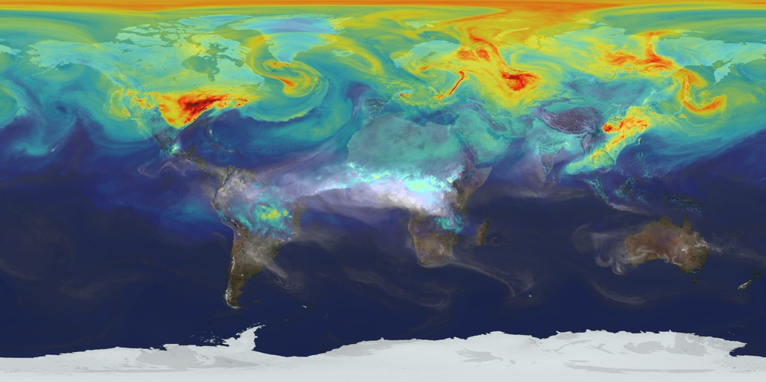
Simulating Atmospheric Transport of Carbon Dioxide Emissions
Paula Rueda
EPS 109

Slide 2
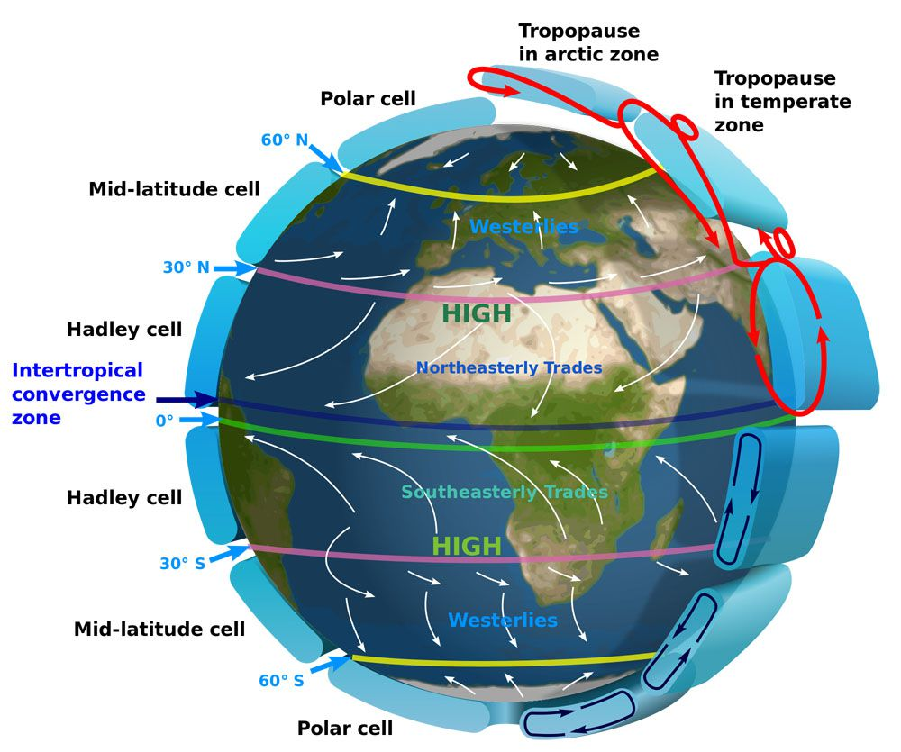
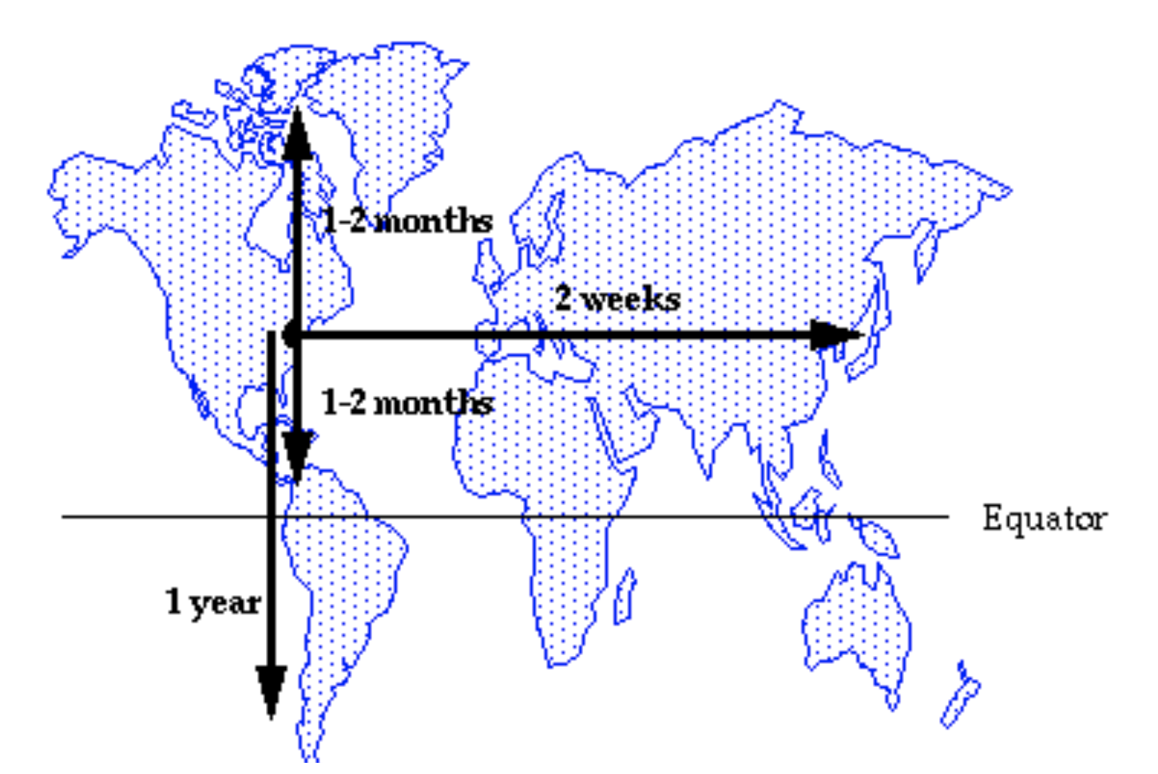
Goal: Simple simulation showing how CO2 emissions from 3 sources move through the atmosphere
Taking into account:
Wind patterns
Atmospheric mixing timescales
Jacob, 1999
Notes:
Single pulse of CO2 at 3 locations, showing how that moves around the globe
Arrows on figure show expected wind direction
mainly mixing in the northern hemisphere, slower transport to southern hemisphere
On the time scale of 1-2 years, we still see mostly CO2 in the northern hemisphere and some starting to go into the southern hemisphere

Slide 3
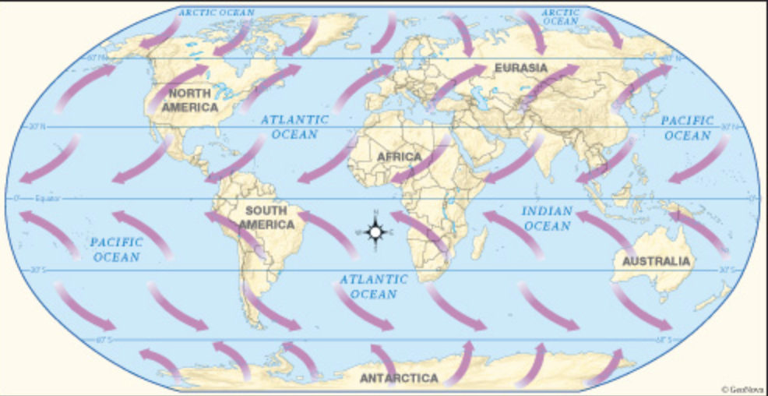
Method: Combination of random movements and nonrandom expected patterns
Equations
$$x=x±v_{x}∗∆t$$
$$y=y±v_{y}∗∆t$$
Create array of particles at 3 locations
Loop through to update positions
Define functions for:
Particle velocities based on latitude
Applying some randomness to direction and velocity at each step
With higher probabilities for expected direction
Updating particle position
Notes:
4 sections of velocities
to work with defined basic velocities, I apply some randomness to the direction and velocity of the particle
the randomness helps the movement look more realistic

Slide 5
Image Sources
NASA's Goddard Space Flight Center, https://svs.gsfc.nasa.gov/11719
Introduction to Atmospheric Chemistry, D.J. Jacob, Princeton University Press, 1999
Wikimedia Commons User Kaidor, https://commons.wikimedia.org/wiki/File:Earth_Global_Circulation_-_en.svg
https://geogermanykat.wordpress.com/2014/10/06/the-surface-winds-of-germany/

