Slide 1
Model of Penetrating Solar Wind Protons as a Source of Atmospheric Hydrogen on Mars
Maria L. Sorgi Johann

Slide 2
Introduction
Mars is too cold and has an atmosphere that is too thin to support liquid water on its surface. Yet, scientists encountered features that appeared to be formed by flowing water. This has motivated scientists to question when and how Mars lost its atmosphere.
One idea says that, once Mars lost its magnetic field 3.8 billion years ago, the atmosphere was made vulnerable to the constant stream of particles coming from the sun and was stripped away.
Yet, the MAVEN mission (go bears!) found that Mars does have a magnetosphere, one that has a different cause than one created by a dynamo at a planet’s center. It’s caused by electromagnetic interaction between the solar wind and the planet itself.

Slide 3
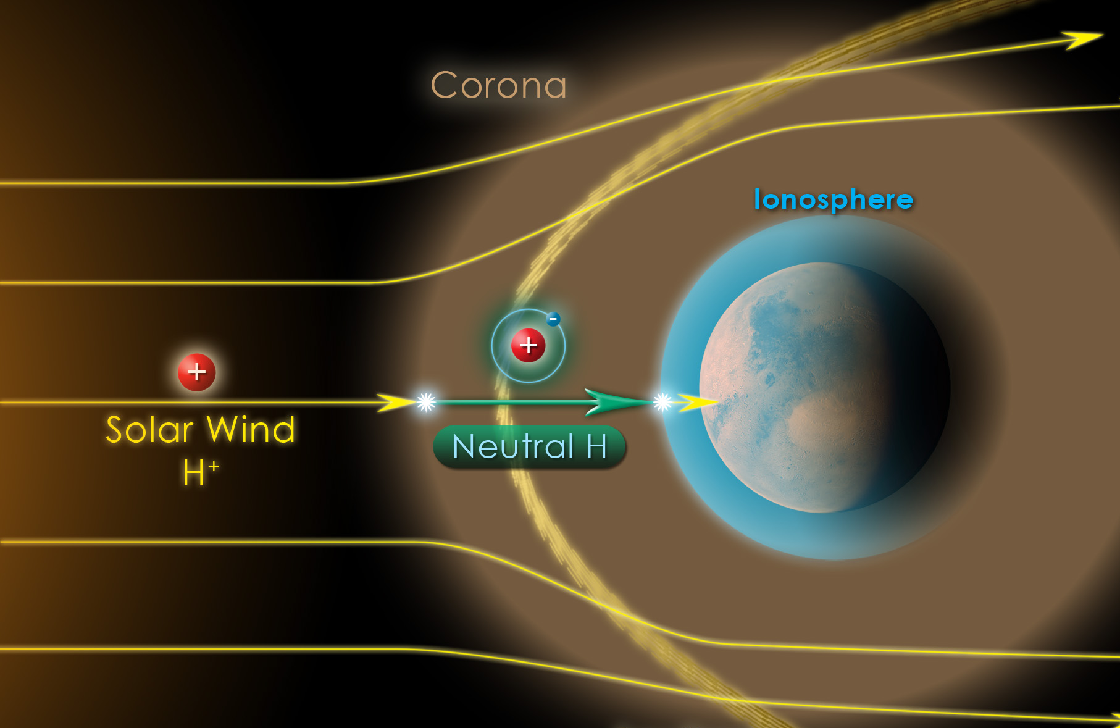
Solar Wind & Hydrogen Column Interaction
Mars has a column of hydrogen that extend above its bow shock (where protons deflect off as a result of Lorentz forces). When the solar wind interacts with this hydrogen column, charge exchange occurs.
Charge exchange results in protons becoming hydrogen atoms, and due to being unaffected by the magnetic field, are able to penetrate directly into the dayside Martian atmosphere.

Slide 4
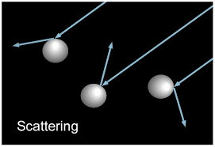
Penetrating Energetic Neutral Atoms (ENAs)
As the ENAs precipitate through the atmosphere, collisions with other atmospheric neutral molecules result in:
Further charge exchange reactions altering ENA’s species between neutral hydrogen and proton form.
Particle directions changing due to scattering.
Some backscattering into space while others formalizing and getting deposited in the atmosphere.

Slide 5
Motivation
The SWIA instrument onboard MAVEN measured a proton flux at very low altitudes - the “visible” part of the solar wind that made it to the atmosphere.
The hydrogen portion that would be present cannot be observed by SWIA for being energetically neutral, but it can me modeled.
This is what motivates my current research with the MAVEN team and my simulation being presented today - looking at solar wind as a source of atmospheric hydrogen on Mars via interactions with the Martian atmosphere and magnetosphere using a model.

Slide 6
The Model
Renders the charge exchange that occur from the interaction between a solar wind proton (yellow particle) and the hydrogen column (light blue area extending above mars in green) with a random number of protons becoming ENAs.
The resulting ENAs (particles in purple) will continue falling down to the atmosphere, passing through the bow shock (thin green line), traveling with random walks which simulates the scattering, and changing species.
Once deposited on the dayside, aggregation of hydrogen and proton will occur as the sun continues to release protons.
The particles that remained protons before passing the bow shock deflect off following a tangent path.

Slide 7
Topics to explore
Understanding and modeling this phenomenon can help us estimate the past and future environments on mars based on past solar activities and predicted storms by allowing us to quantify total hydrogen deposition over time.
Halekas, J. S., et al. (2015), MAVEN observations of solar wind hydrogen deposition in the atmosphere of Mars, Geophys. Res. Lett., 42, 8901–8909, doi:10.1002/2015GL064693
Jolitz, Rebecca & Dong, Chuanfei & Lee, Christina & Lillis, Robert & Brain, David & Curry, Shannon & Bougher, S.W. & Parkinson, Christopher & Jakosky, Bruce. (2017). A Monte Carlo
Model of Crustal Field Influences on Solar Energetic Particle Precipitation into the Martian Atmosphere. Journal of Geophysical Research: Space Physics. 122.
10.1002/2016JA023781.
Steigerwald, Bill. “Maven Maps Electric Currents around Mars.” NASA, NASA, 22 May 2020, https://www.nasa.gov/press-release/goddard/2020/mars-electric-currents.

