Slide 1
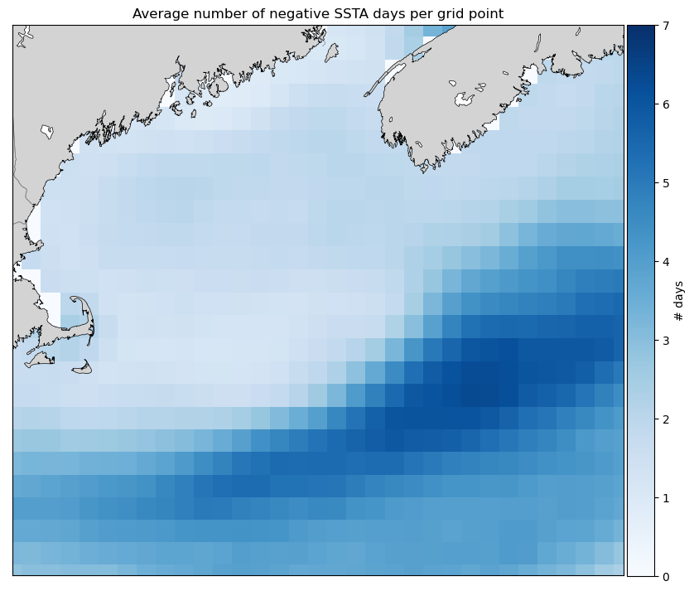
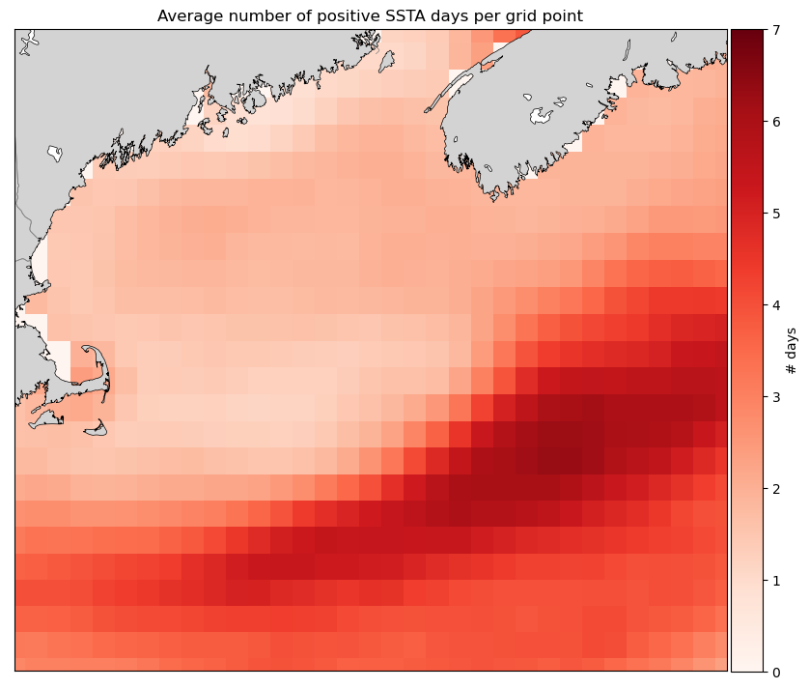
Visualizing SSTAs in the Gulf of Maine from 1982-2020
by Shelby Gibson for EPS 109 FA21
Did you know that the Gulf of Maine is warming faster than 99% of the ocean?

Slide 2
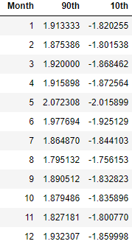
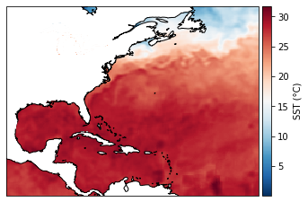
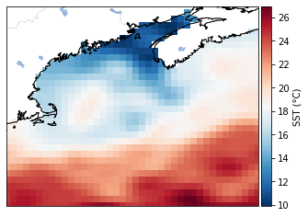
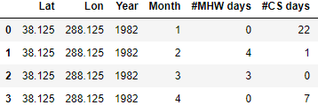
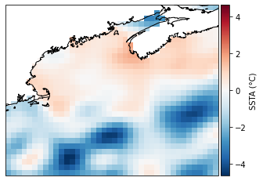
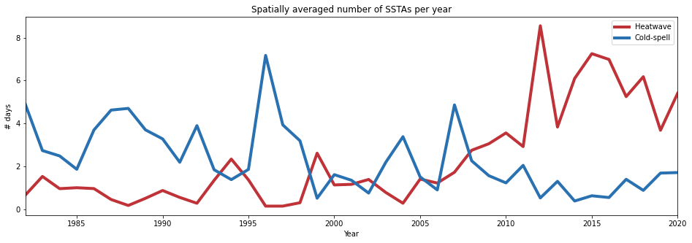
Methodology
Start with: Sea surface temperature data, land-sea mask
NOAA High Resolution SST data provided by the NOAA/OAR/ESRL PSL
Libraries: netCDF4, pandas, xarray, matplotlib, cartopy, hvplot
Step 3. Compute 90% and 10% thresholds
Collect all SSTs at all grid points in the study region
Sort these values from the lowest to highest
Find the SST values at 90% and at 10%
Step 4. Compute heatwave days and cold-spell days
At all grid points, compute # of heatwave days and # of cold spell days
heatwave day: SSTA > 90% threshold SSTA
cold spell day: SSTA < 10% threshold SSTA
Step 5. Plots of trends over time
Step 1. Narrow down data
Combine SST data with a land-sea mask, screening out land data
Select 38°N-46°N, 108°W-118°W
Filter for whole years, 1982-2020
Step 2. Compute climatology
Compute climatology by averaging SST data
Remove climatology from SST data, obtain SSTAs

Slide 3
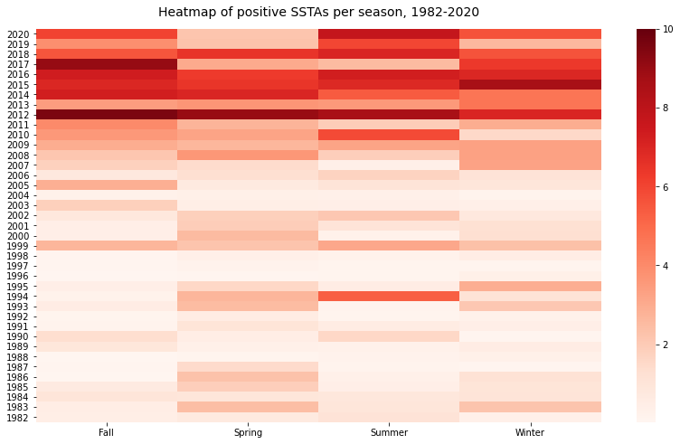
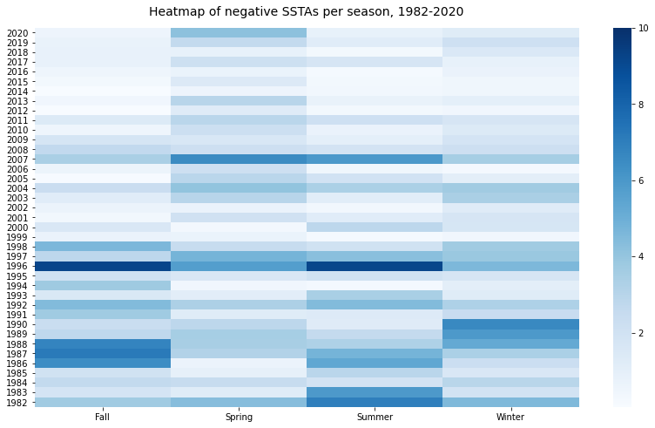
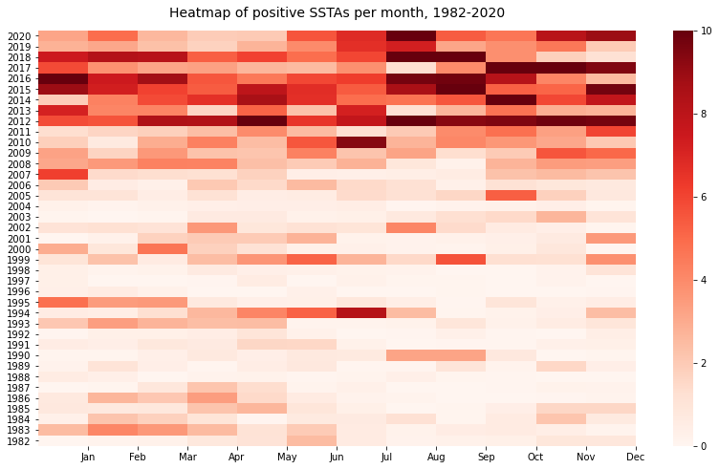
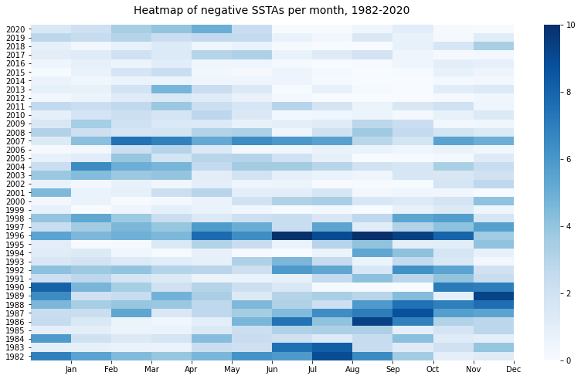

Slide 4
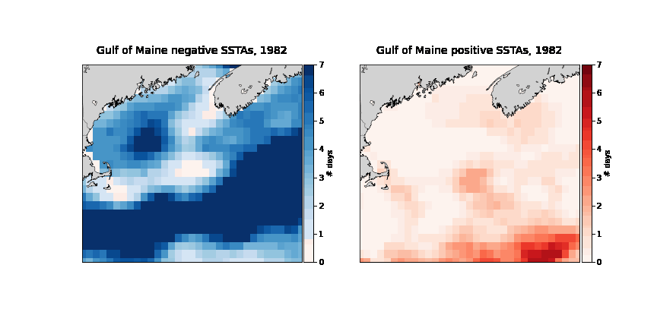
Trends over the years, 1982-2020

