Slide 1
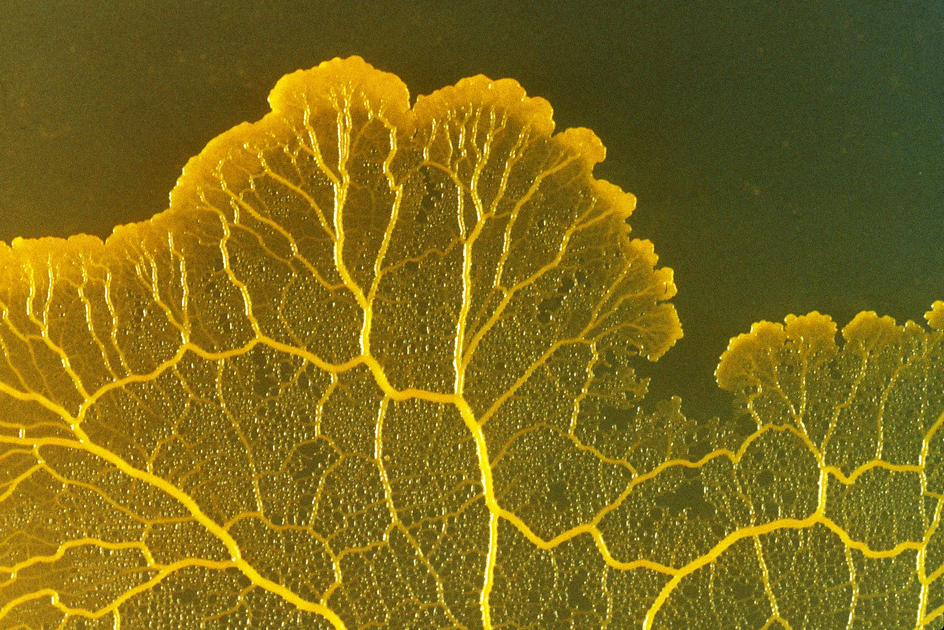
Slime Mold Simulation for Designing Networks
Harmony He

Slide 2
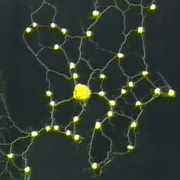
Slime Mold
Physarum polycephalum
Single celled, but aggregates with other slime molds to form a multicellular structure
Intelligent, but brainless
Has the ability to find an efficient network among food particles
Can solve mazes
Tubular network
Tubes get softened when slime mold detect food, causing them to expand
More slime mold goes through, strengthening these tubes
Thickest tubes are efficient paths to food

Slide 3
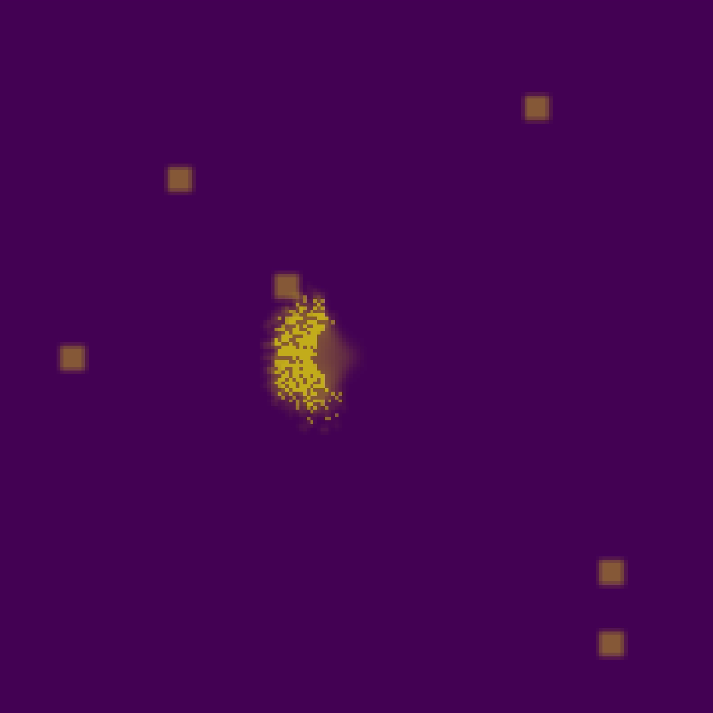
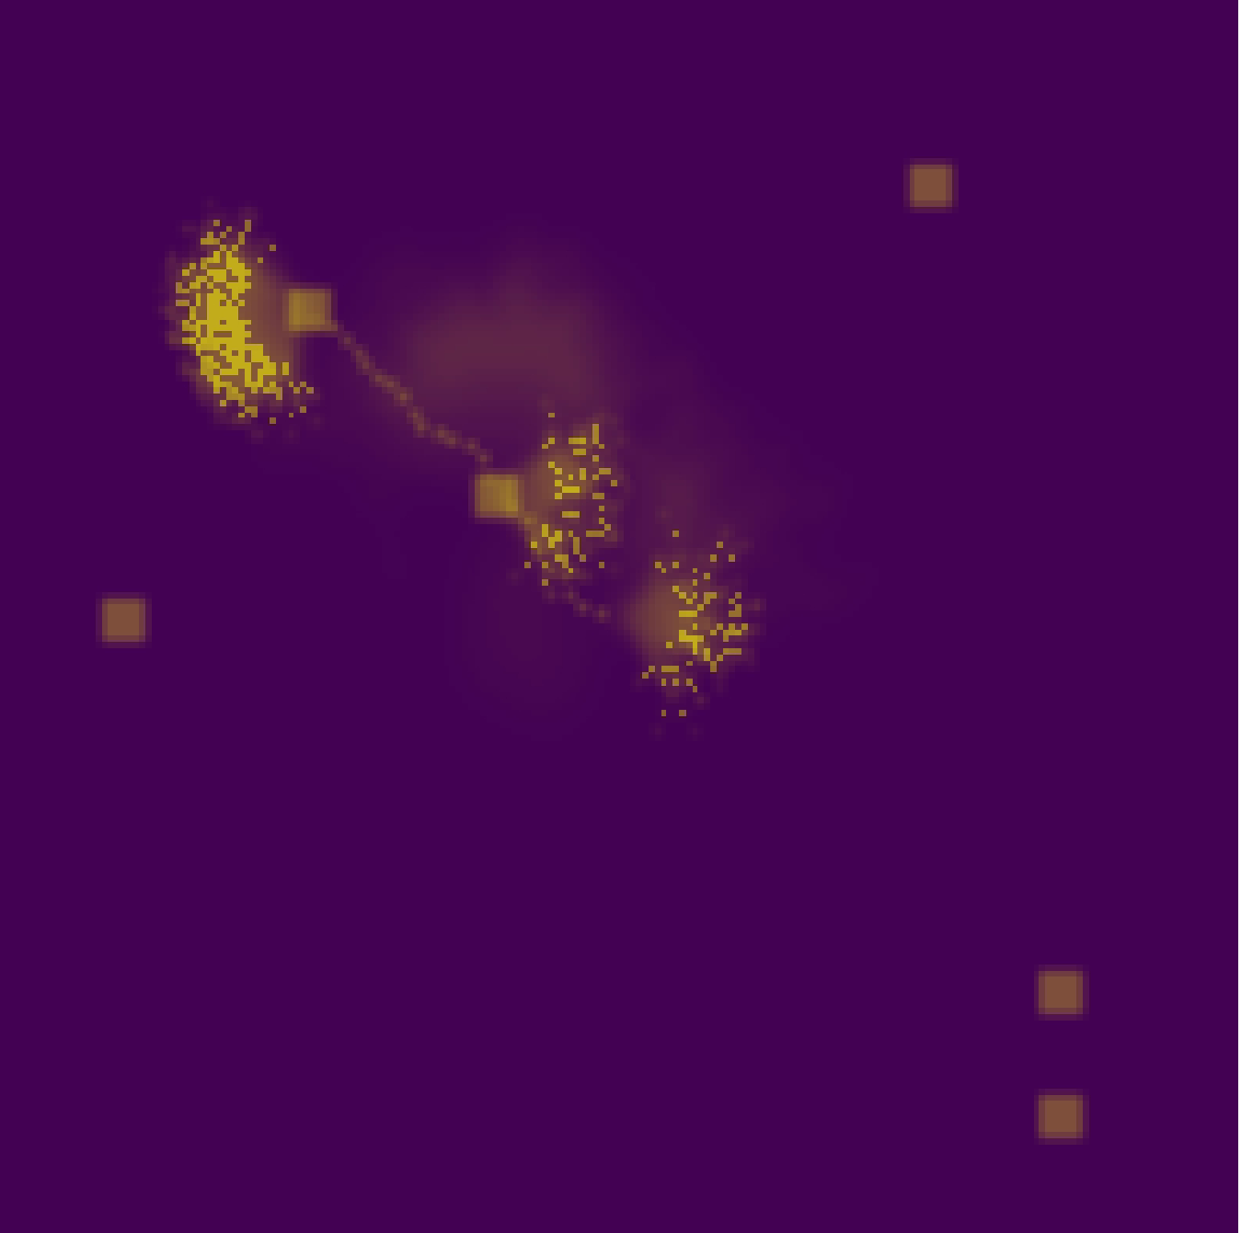
Simulation Method inspired by slime mold behavior
Starts from one point and fans out to explore
Slime mold cells moves independently to spread out
Leaves decaying/diffusing trail behind
Finds “efficient path” to food
Cells likely to be influenced by trails to food
->

Slide 4
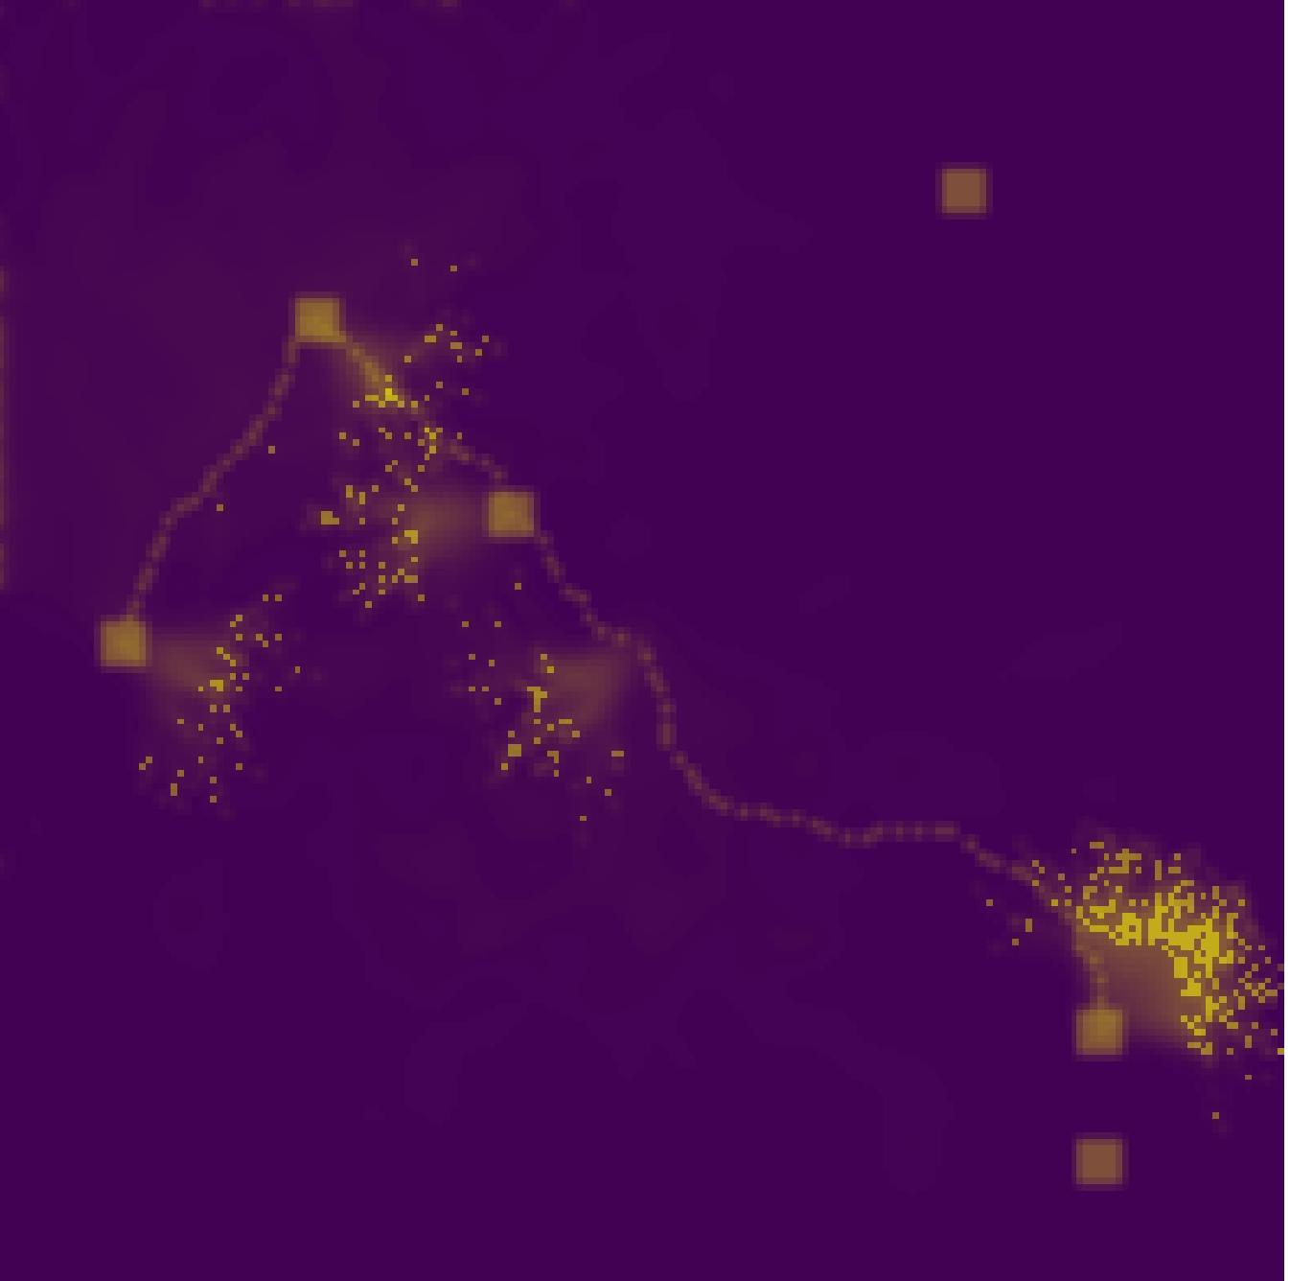
Simulation Method inspired by slime mold behavior
After food is found, begins exploring again
Most cells starting from the most recently discovered food
In each iteration, the slime mold cells explores in a different direction
Simulation stops when all food is found
->
->

Slide 5
USA Map

Slide 6
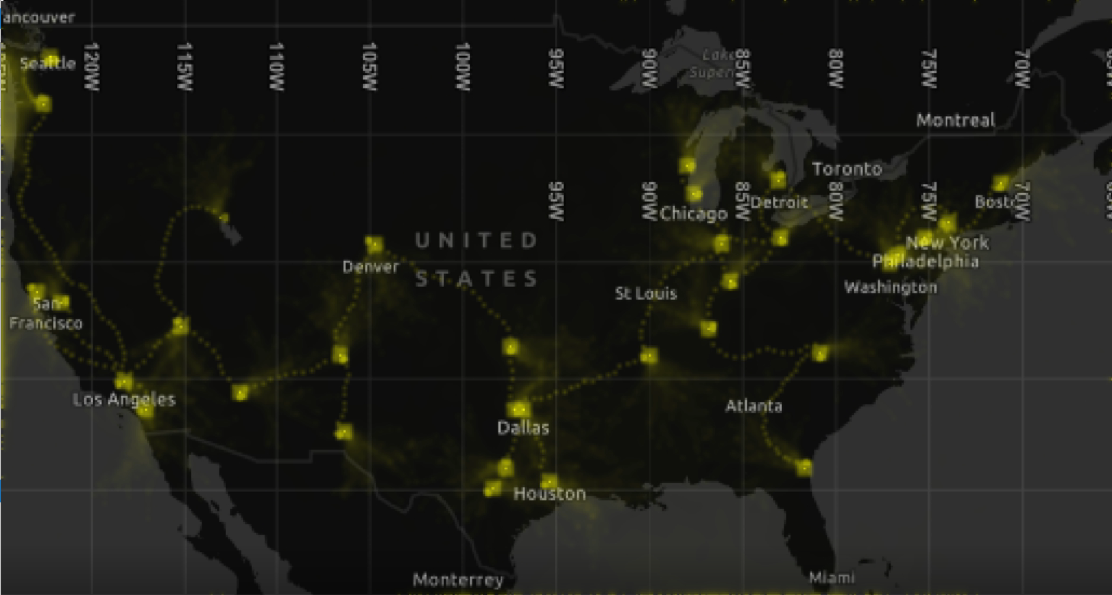
USA Map

Slide 7
References
Slime mold image
https://media.wired.com/photos/5955bb045992c54331ac1827/master/pass/SciSource_7Z3597.jpg
Slime mold recreating tokyo rail network
https://i.gzn.jp/img/2016/12/26/slime-molds/cap00030_m.jpg
Algorithm for trail, pattern formation, diffusion
https://sagejenson.com/physarum
https://uwe-repository.worktribe.com/output/980579/characteristics-of-pattern-formation-and-evolution-in-approximations-of-physarum-transport-networks
Map maker
https://mapmaker.nationalgeographic.org/map/313dfa4e9d97416687ee77c129a04824
Slime mold information
https://science.howstuffworks.com/life/biology-fields/slime-molds.htm
https://appvoices.org/2019/10/11/slime-mold-intelligence/
https://www.smithsonianmag.com/smart-news/how-brainless-slime-mold-stores-memories-180977097/

Slide 8
Finding Food

Slide 9
Finding Food

