Slide 1
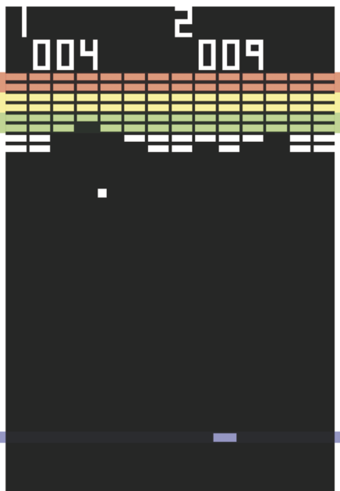
Breakout
By Joshua Delrosario

Slide 2
Methodology
Inspired by the retro game “Breakout” and the Random Walks Homework
Heavy use of Object Oriented Programming
Multiple Matrices: one for display and one for tracking object “hitboxes”

Slide 4
Adding Splitters
Added a new ball type, splitters, that can split when they impact another entity

Slide 6
Putting things together...

