Slide 1
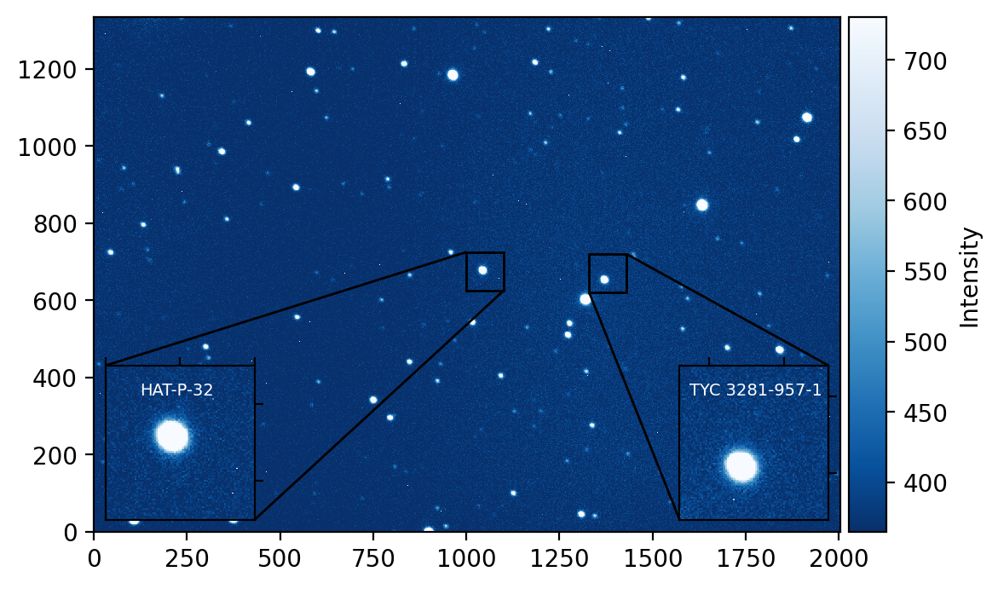
Detection of an Exoplanet Transit [HAT-P-32b]
Andrew Pitts

Slide 2
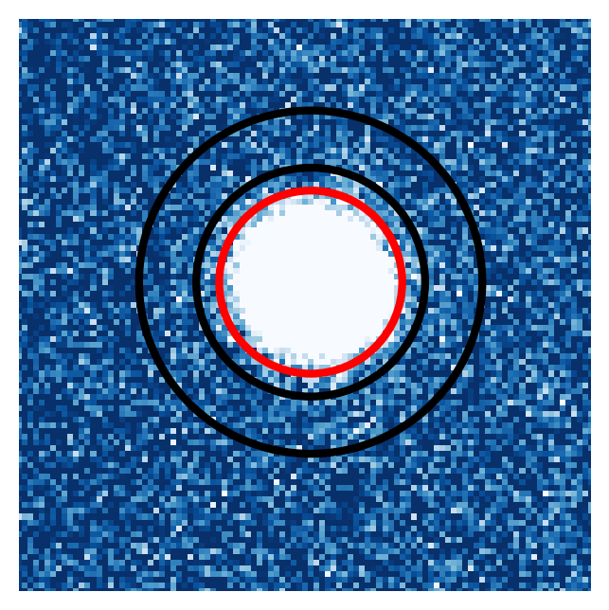
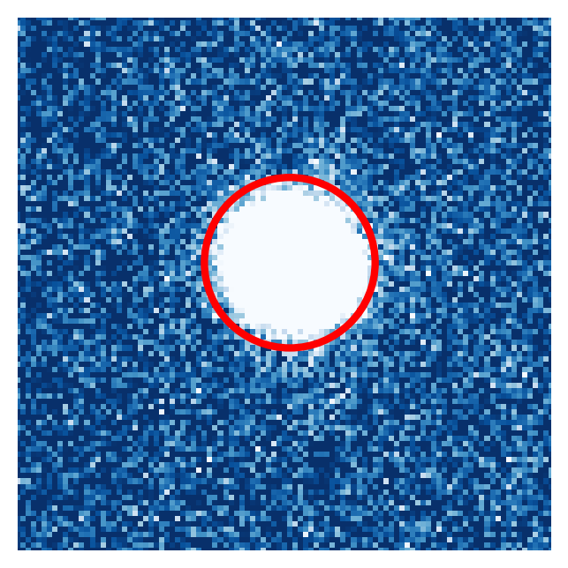
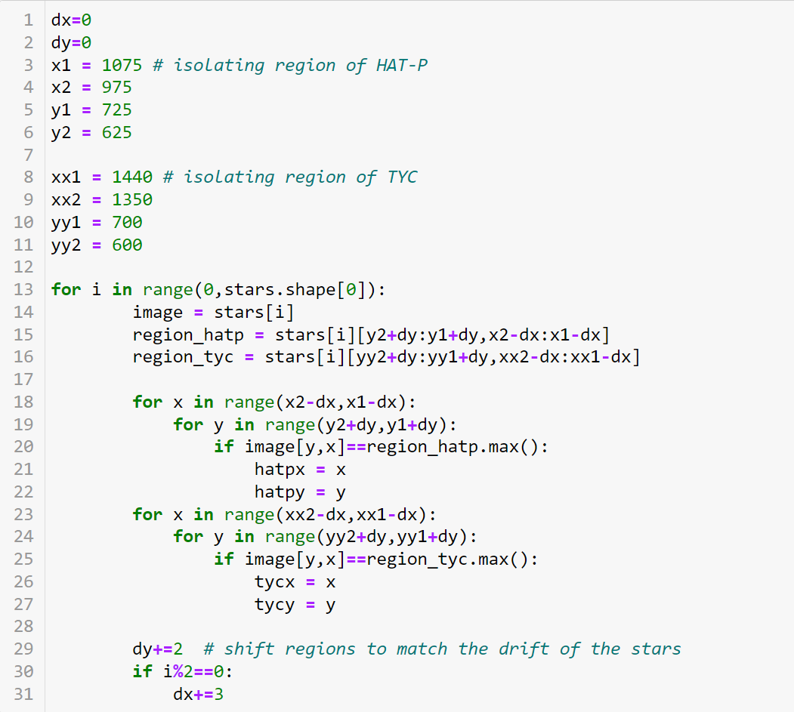
Relative Aperture Photometry
from photutils import CirculuarAperture, CircularAnnulus
from photutils import aperture_photometry
Perform Aperture Photometry
Aperture: circle, ellipse, or square.
Determine the average background value B
Annulus, or image median
Star Brightness: S = ∑ I _{aper} - B × n_{pix}
Lightcurve: Relative Brightness = S_{target} / S_{reference}
Uncertainty: 𝜎² = S_{target} + S_{reference} + (B × n_{pix})
Track the star, and repeat for each image

