Slide 1
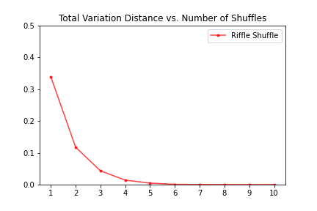
Card Shuffling and Measuring Randomness
Aaron Agulnick

Slide 2
Goals and Methods
Markov Chain theory allows for the explicit computation of the mixing time of a deck under certain models of shuffling. We use Python to simulate the shuffling of a bicolor deck to explore mixing times when such an analytic solution is more difficult or unknown.
Using Grant Sanderson’s animation software, Manim, we animate a bicolor deck being shuffled to visually understand the shuffling process and compare it to the more theoretical measurement. Our goal is to make sense of this very abstract concept of total variation distance.
In Random Walks on Finite Groups, Laurent Saloff-Coste describes the Gilbert-Shannon-Reeds model of riffle shuffling (273-4). We implement an algorithm that shuffles bit strings in this way, with each bit representing the color of the corresponding card.
The two related IPYNB files are entirely standalone. shufflingandmixing.ipynb generates the image on slide 1, while manim.ipynb generates the animations that follow. The files also contain outlines which describe the work that was cut for time from this presentation.

Slide 3
The GSR Riffle Shuffle

Slide 4
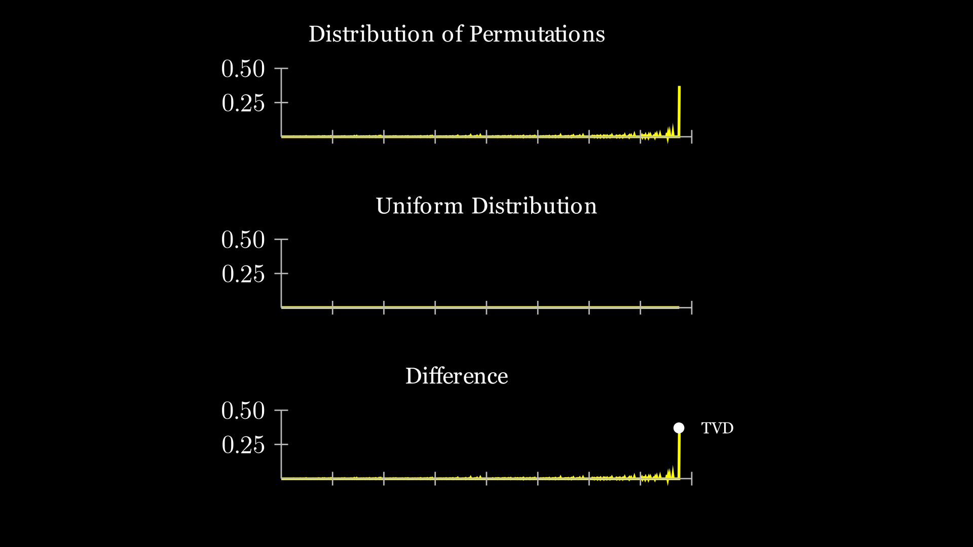
Total Variation Distance (TVD)
If we simulate, say, 10000 shuffles and record how frequently each arrangement of the deck appears, we get the distribution of permutations of the deck. The total variation distance is the largest deviation of this distribution from uniformity.

Slide 5
Distribution of Permutations vs. Number of Shuffles

