Slide 1
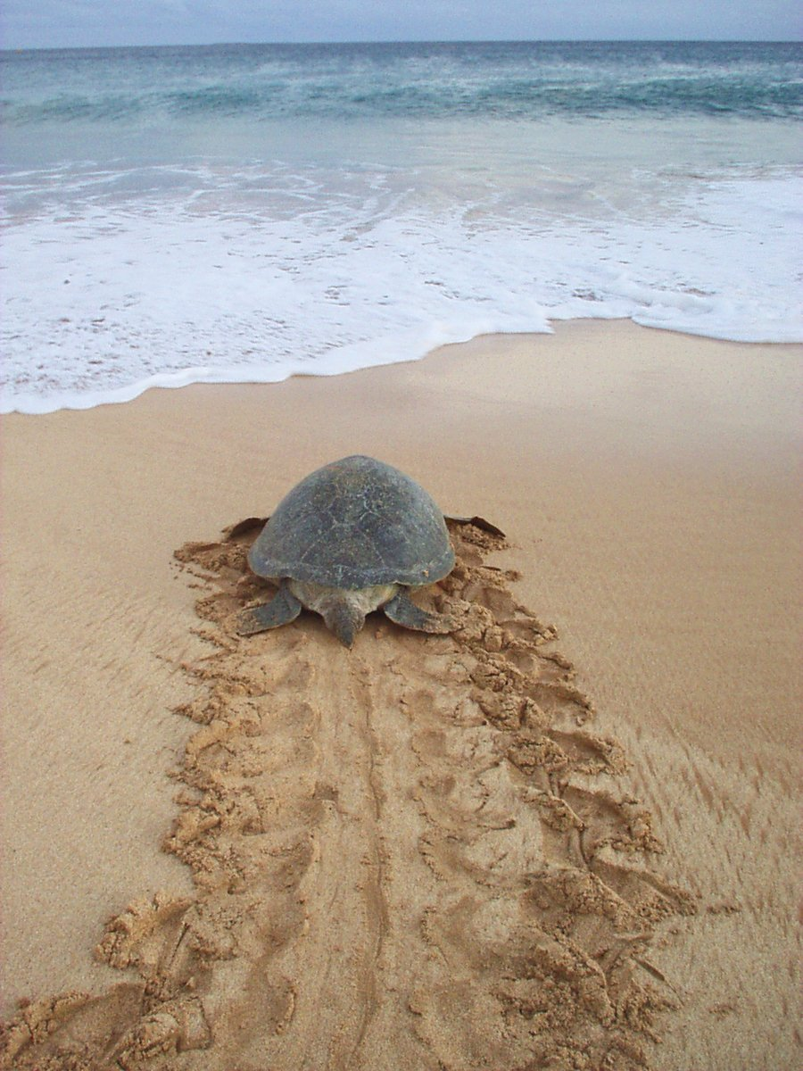
Learning to Swim Home with Random Walks and Mimicry
Kaichen Liu

Slide 2
The sea turtles of Ascension Island migrate to and from the coast of eastern Brazil using navigation methods still mysterious to scientists.
I use a dataset of a few real sea turtle migration paths, composed of graph edges of when their tags pinged, and tried to see if I could generate simplistic sim-turtles relying on random behavior that still found their way back to Ascension Island from eastern Brazil.
I started my sim-turtles off the coast of Brazil and swam my sim-turtles by sampling edges for their trajectories from the Gaussian distribution of the movements modeled on the real sea turtle movement data.
If the sim-turtle was nearby a real turtle’s past trajectory edge, it decided to “mimic” its peers’ trajectory with probability p. The idea is that if not all turtles knew the exact way to the island, one turtle meeting another could converge the paths of the more lost/unsure one to the island.

