Slide 1
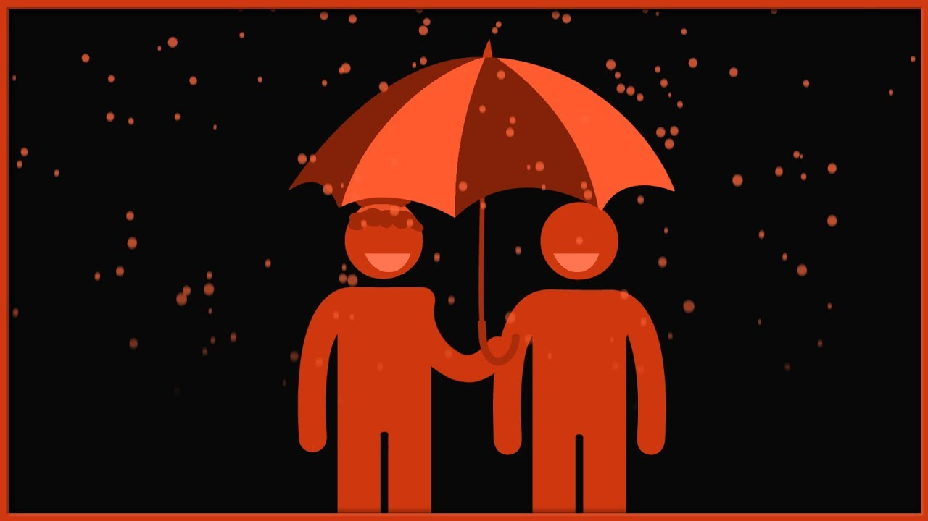
Altruism in Prey/Predator Relationships
By: Isaac Merritt

Slide 2
Project Overview
This project primarily explores the effect altruism has on a prey species as a whole.
Does altruism help or hurt the species?
The simulation uses random walks to simulate a prey/predator environment
It also uses Monte Carlo techniques to sample from a probability space that dictates individual behavior

Slide 3
What is Altruism?
In this project, I have defined altruism to be a trait exhibited by individuals of a prey species who value the lives of their peers and the livelihood of their species more than their own individual life.
In the context of this project, this means that altruistic prey will ‘shout out’ when there is a predator present, and attempt to distract that predator from the other prey in the area.
Does this self-sacrificial behavior help the species in the long run? Or is the risk not worth the reward?

Slide 4
The Simulation Model
The environment starts with a random assortment of prey, altruistic prey, and predators
Each timestep can be broken down into 3 stages:
Prey Movement Stage
Each existing prey moves 1 step in a random direction around it current location
Predator Hunting Stage
Each predator individual eats up to 2 individuals around it and then moves 1 step in a random direction around its current location
Prey Reproduction Stage
Any prey that are alive at the end of the timestep have a probability of reproducing onto a random location 1 step away
Though the real world is more nuanced than this simplified simulation (mating choices, passing on genes, anti-adversarial prey behavior, etc.), this project attempts to show how the most basic level of altruism could influence a population

Slide 5
The Models and Their Results

Slide 6
The Standard (Selfish) Model
25% Standard Prey
0% Altruistic Prey
4% Predators
25 timestep simulation on the left, 50 on the right

Slide 7
The Standard (Selfish) Model

Slide 8
The Hybrid Model
18.75% Standard Prey
6.25% Altruistic Prey
4% Predators
25 timestep simulation on the left, 50 on the right

Slide 9
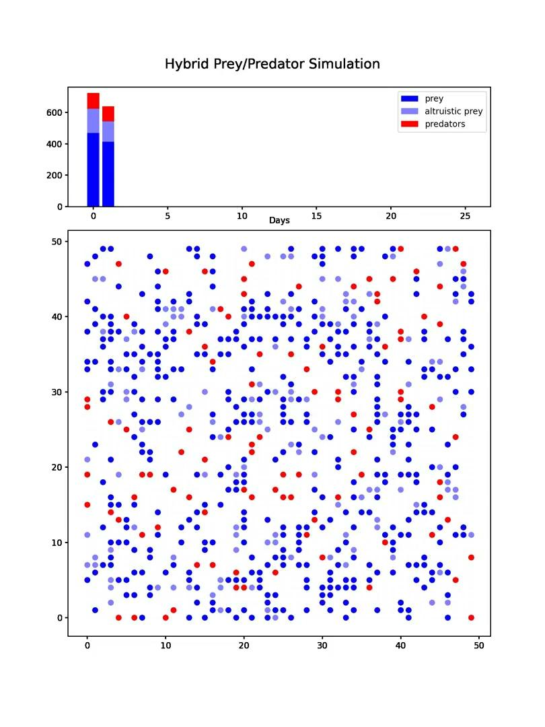
The Hybrid Model

Slide 10
The Altruistic Model
6.25% Standard Prey
18.75% Altruistic Prey
4% Predators
25 timestep simulation on the left, 50 on the right

Slide 11
The Altruistic Model

Slide 12
Conclusion

Slide 13
Conclusion
In the selfish model, the population trends downwards with no apparent indication of growth in the future
In the hybrid model, the population begins to grow a bit after initially decreasing in size
In the altruistic model, the population notably begins to recover after the initial decrease, showing an upward trend at the end of the simulation
This appears to indicate that altruism helps the species, but not necessarily the individual
Species benefit from altruism, but there may be an individual cost associated with exhibiting altruistic traits
Individual benefit/cost is a question for a subsequent project

Slide 14
References
Cover Image: https://www.google.com/url?sa=i&url=https%3A%2F%2Fwww.youtube.com%2Fwatch%3Fv%3DgJEhog-vZKU&psig=AOvVaw0rLr0eamzYRXgOEzxhWp-D&ust=1638403096972000&source=images&cd=vfe&ved=0CAsQjRxqFwoTCNDG6qalwfQCFQAAAAAdAAAAABAD

