Slide 1
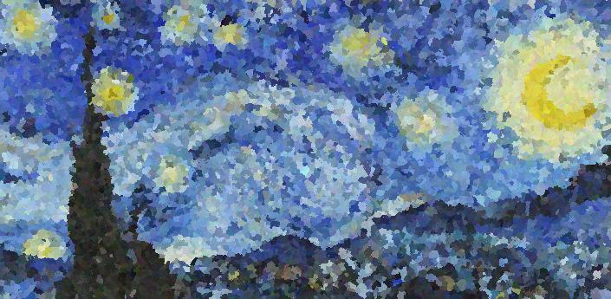
Painting With Random Walks
Christopher Pan

Slide 2
Topic and Methods Used
Random walks were used to paint the original picture in various ways
Method:
Random points representing pixels in the picture were chosen as seeds where the random walks would start from
Add points to queue
Pop random point from queue, paint point (or patch around point) with color of original point + some amount of “noise”
Add neighboring points to queue
Amount of noise, seed points, and size of patch can all be altered for varying effects

Slide 7
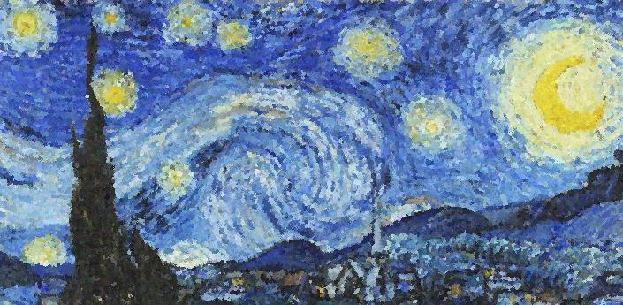
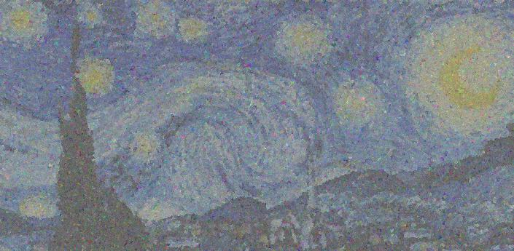
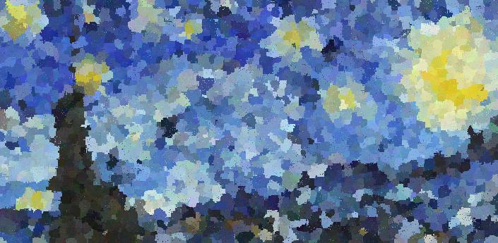
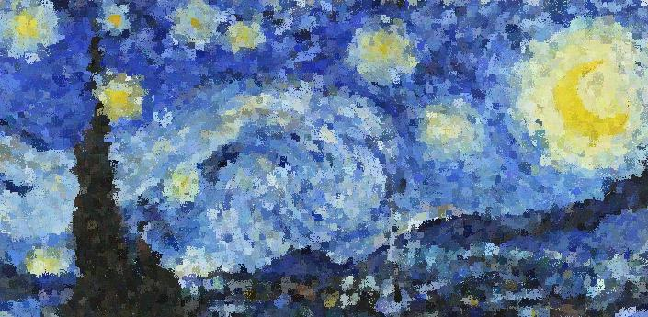
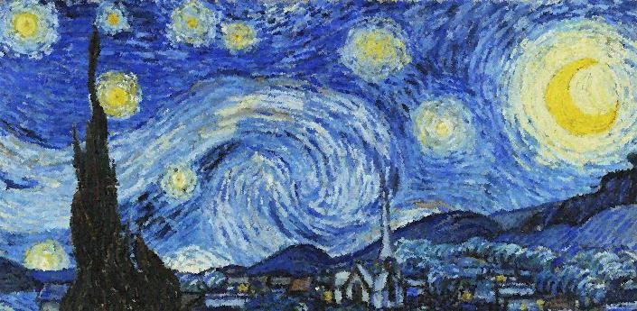
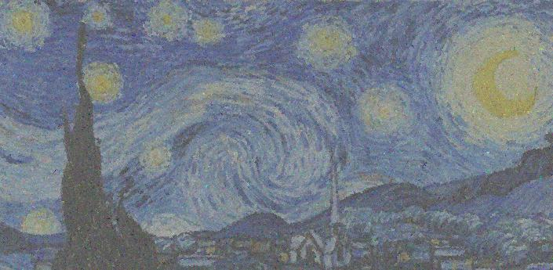
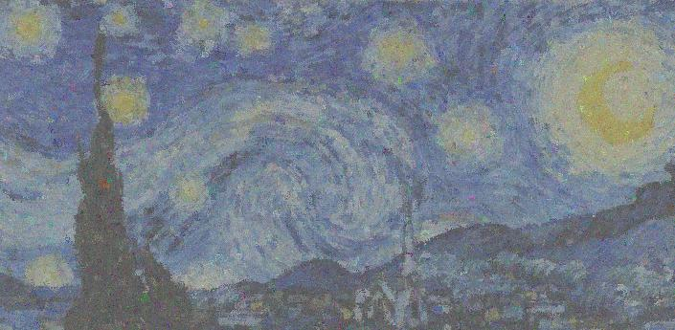
Patch Size: 1
Patch Size: 3
Noise Deviation: 0.1
Noise Deviation: 1
Noise Deviation: 0.1
Noise Deviation: 1
Seed Points: 5%
Seed Points: 25%
Seed Points: 50%

