Slide 1
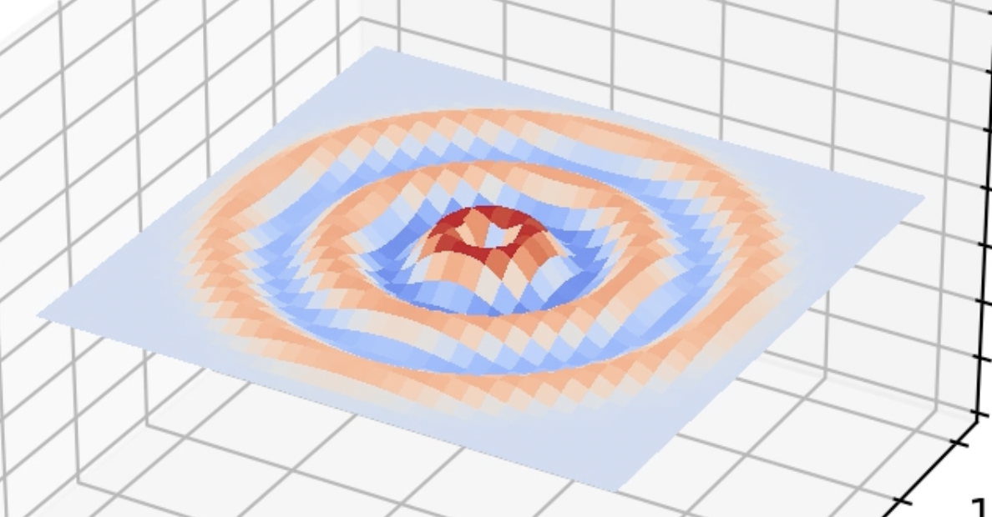
Modeling Acoustic Waves
Shawn Huang

Slide 2
Topic/Methods
acoustic waves travel with different amplitude and velocity according to acoustic wave equation
model waves using discretized equation, 2d matrix of sound pressure values at each timestep
- Dirichlet boundaries (kept constant at zero)
generate sine waves for sources of sound - vary location, amplitude, frequency
change speed of sound to model sound waves in different mediums
- 343 m/s for air, 1480 m/s for water
tune parameters (s, dt, dx)
- prevent model from diverging (happens when dt is too large)
- ensure wave amplitude is large enough to be visible

