Slide 1
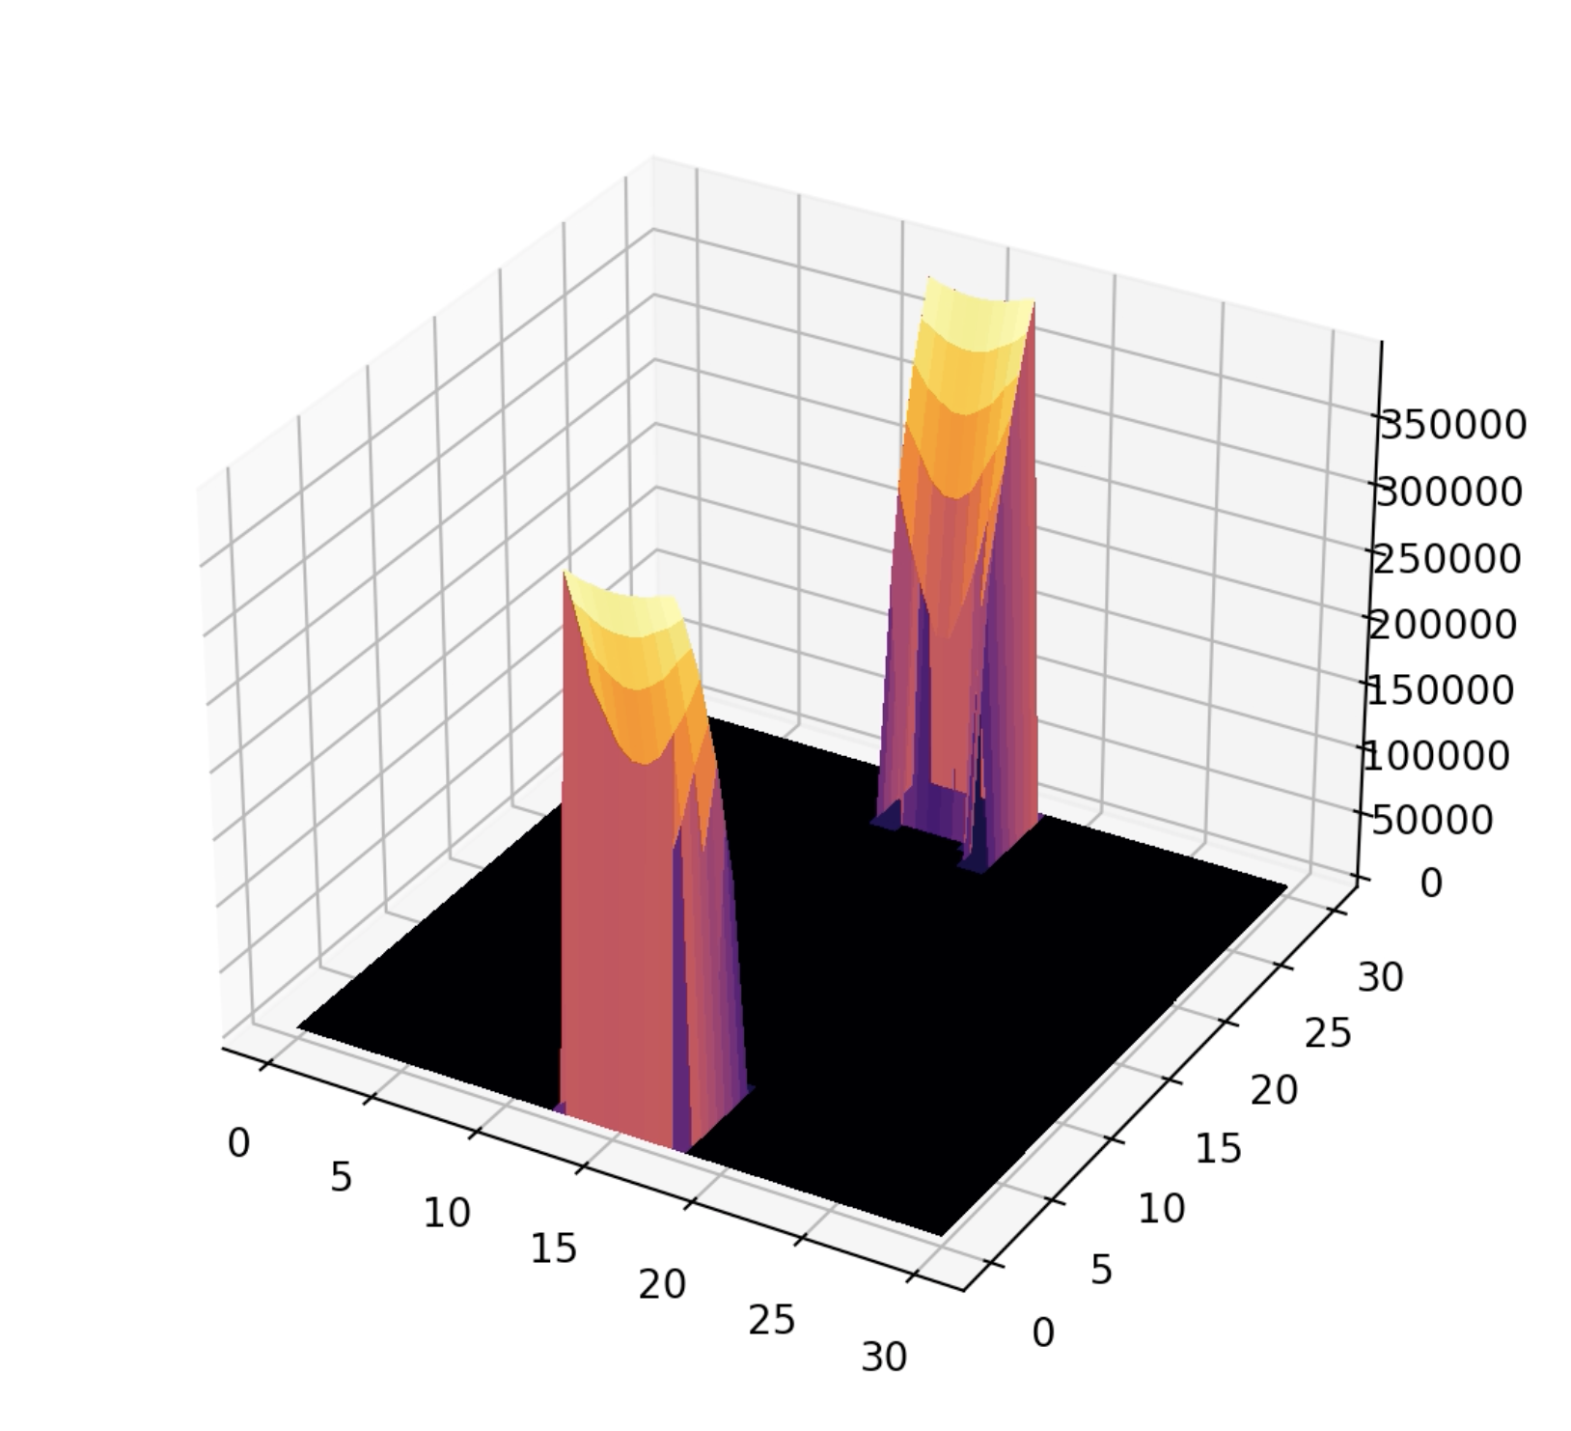
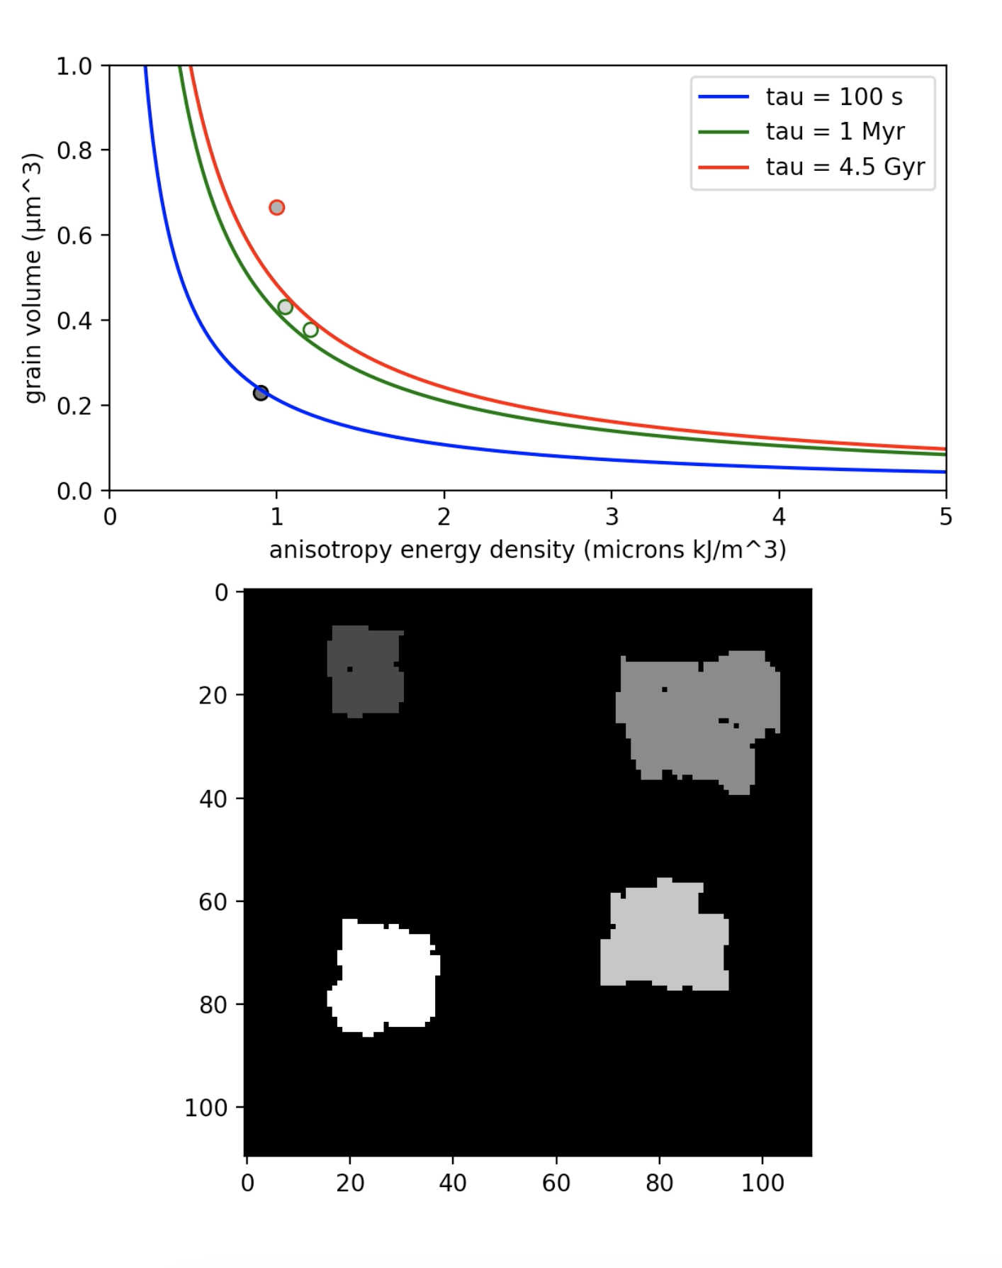
Mechanisms of Rock Magnetic Remanence Acquisition
Leyla Namazie

Slide 2
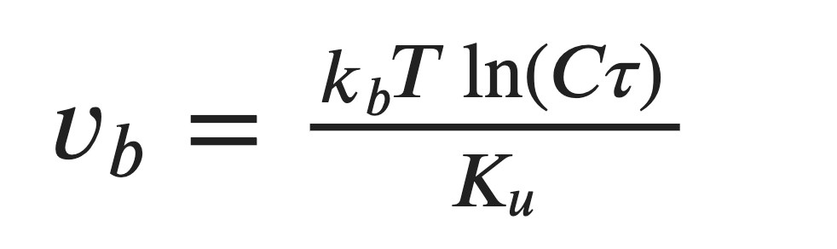
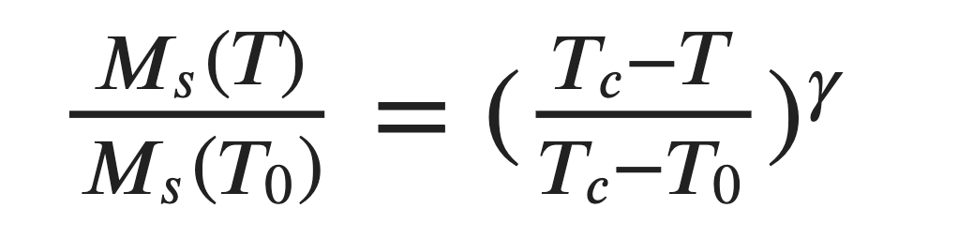
(1) Thermal Remanent Magnetization
Acquired when minerals crystallize in magma and cool through a characteristic curie temperature
2D heat equation used to model magma cooling in a dike intrusion
Basaltic composition, 5% volume ferromagnetic magnetite minerals
Additional Magnetization matrix was created and updated with each heat flow iteration
Magnetization obeyed the saturation magnetization equation of rock magnetism:
Result: Magnetization intensity of each unit in the dike increased as magma cooled
(2) Chemical Remanent Magnetization
Acquired when minerals crystallize below the curie temperature and grow past a characteristic “blocking volume”
Diffusion Limited Aggregation representing hematite crystallization at surface temperature (20°C)
Image analysis to calculate particle areas, converted to volumes
Plotted resulting volumes against hematite crystallographic anisotropy values to determine “magnetic stability” of each particle
Result: larger volumes corresponded to larger characteristic relaxation time, which corresponds to higher magnetic stability

Slide 3
Thermal Magnetic Remanence Model

