Slide 1
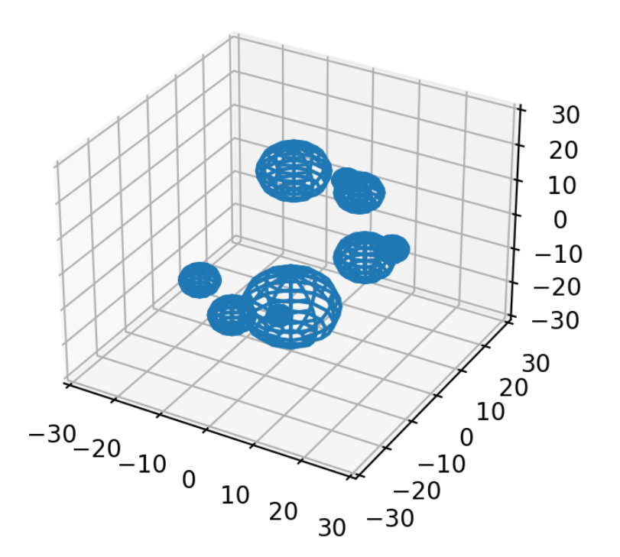
N-Body Force Simulations
Max Coy

Slide 2
Basic Code Pipeline
Create an Object class ‘Particle’ to store information (e.g. position, velocity, mass…)
Create an array of Particle objects to specify some initial condition
Using a force function, calculate the change in position and velocity (Using Runge-Kutta method) over some small timestep
Check to see if any particles have collided; if they have, join the two particles together
Repeat steps 3-4 until specified iteration limit is reached.

Slide 3
Code Advantages
Written in a generalized manner
Can simulate lots of different forces, physical and nonphysical
Can simulate multiple forces at once
Can simulate in any N dimensions specified
Has lots of premade functions for ease of use (takes 2 lines of code to run a new simulation)

Slide 4
Code Limitations
Brute Force solver (i.e. order of n^2 operations) so it has a limited range of particle counts where it has a reasonable runtime
(My laptop can run about 200 particles at a time)
Difficult to determine what a good time step is

Slide 5
100 Particle Gravity Simulation

Slide 6
10 Particle “Linear Spiral” Simulation

Slide 7
225 Particle Electric Force Simulation

Slide 8
50 Particle ‘Massive Proton’ Simulation

