Slide 1
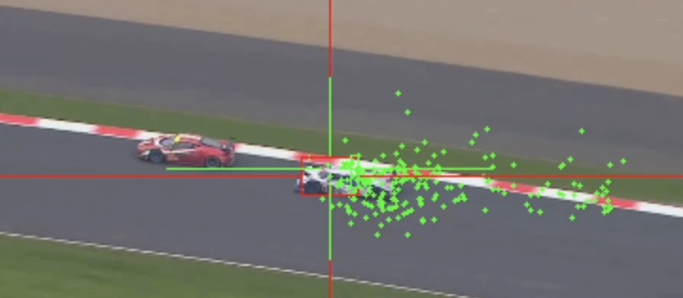
Tracking Stuff
Using random walks & image processing
Noe Trejo
Noe Trejo

Slide 2
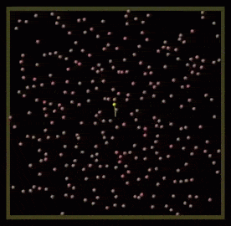
Random walks
Usually use uniform distributions
Ex. P(left or right or up or down) = 0.25
How do they do more complex things?
Math
Using particles as samples that create distributions
In memory these are just a list of particles
Needed: positions, scores, patches
Scores are based off a model patch and a particle’s patch of
An image
mse = np.mean((model_patch - temp_patch) ** 2)

Slide 3
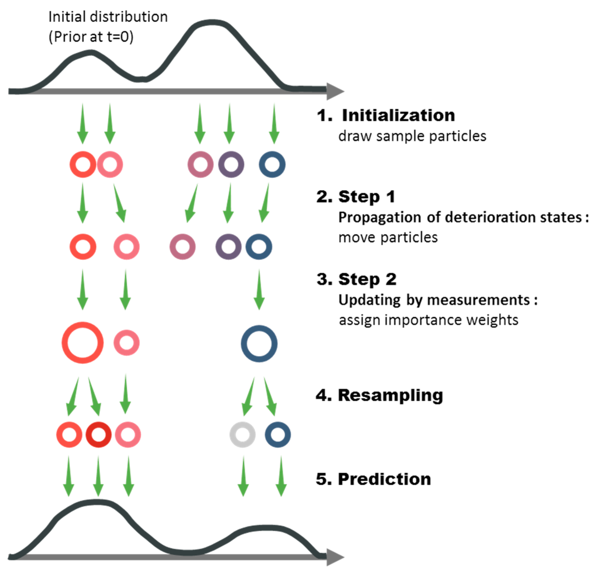
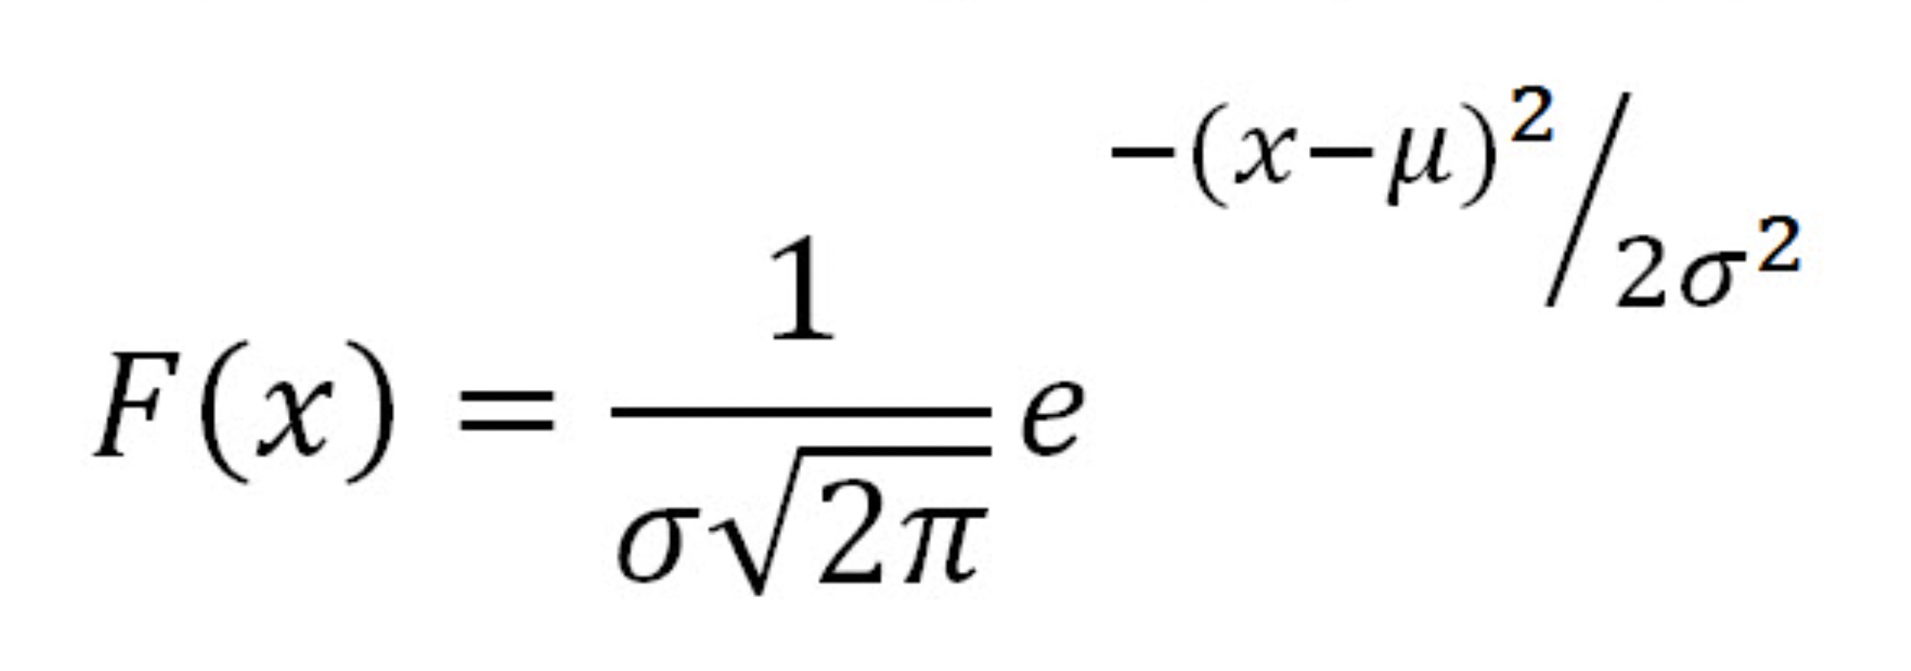
Start as a naive location => based off observation it’ll get ‘smarter’ (according to the new distribution)
Some particles have stronger weights than others, depending on how successful they are
Allows us to make better predictions for nonlinear problem

Slide 4
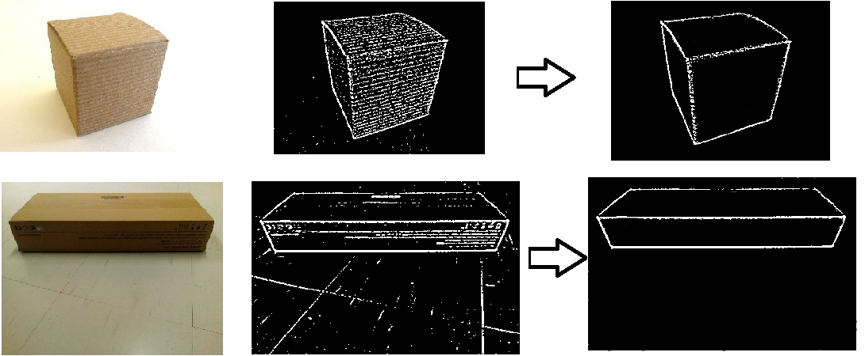
Image Processing: Reducing Noise
Videos are basically just a bunch of pictures weaved together
Using OpenCV
Took a patch of the image around the particle, and compared it to a model patch
To run:
python tracker.py video_name
If you put ‘camera’ for video name, it’ll use your webcam!
Press ‘c’ to spawn the particles
Press ‘d’ to remove them
https://stackoverflow.com/questions/42065405/remove-noise-from-threshold-image-opencv-python

Slide 5
Kernel = 3
Kernel = 19

Slide 6
No Filter VS Filtered

Slide 7
End Result & Questions?
This is a frame differencing motion detector with an adaptive threshold to select the most intense pixel changes. The largest changes are very often related to the motion of the foreground object (or objects).
But sometimes that assumption does not work.

