Slide 1
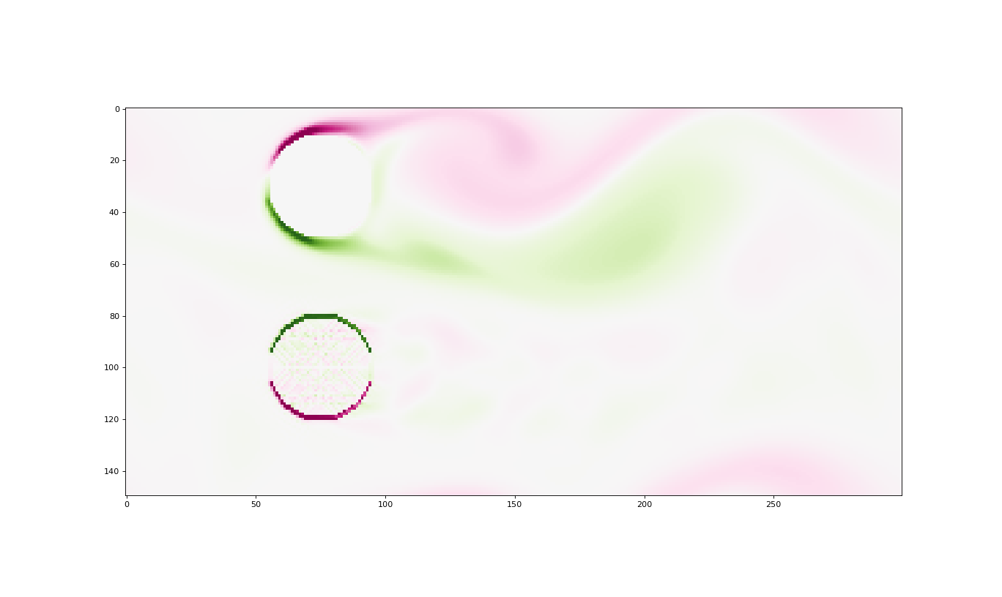
EPS 109:
Computer Simulations with Jupyter Notebooks
“Fluid Flow Against Objects”
Mario Montoya

Slide 2
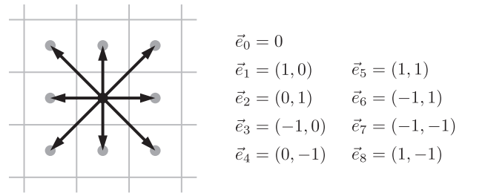
Lattice Boltzmann method:
Understanding particle behaviour
Vortex Shedding:
D2Q9 lattice in which there are two dimensions and just nine allowed displacement
Vectors. These 9 options are weighted by probabilities.
Lattice Boltzmann methods (LBM) is a is a fluid simulation method that allow us to simulate fluid density with streaming and collision processes.
The discrete map that results of the Lattice Boltzmann equation can be interpreted as the propagation and collision of particles. Fundamentally, particles stream and collide evolving the density of the fluid 𝜌(𝑥⃗ ,𝑡) where 𝑥⃗ is the position and 𝑡 serves as time. Streaming: 𝜌𝑖(𝑥⃗ +𝑒⃗_𝑖, 𝑡+𝛿𝑡)=𝜌_𝑖(𝑥⃗ ,𝑡) This means that the fluid density at point 𝑥⃗ and time 𝑡 will have flowed to the point 𝑥⃗ +𝑒𝑖→ by the time 𝑡+𝛿𝑡
Being able to simulate fluids, allow us to look at interesting phenomena like Vortex Shedding
Vortex shedding is an oscillating flow that takes place when a fluid such as air or water flows past a bluff (as opposed to streamlined) body at certain velocities, depending on the size and shape of the body.
Collision:
where 𝑓𝑒𝑞𝑖(𝑥⃗ ,𝑡) is the equilibrium density along direction i at the current density there. The model assumes that the fluid locally relaxes to equilibrium over a characteristic timescale 𝜏𝑓 This timescale determines the kinematic viscosity, the larger it is, the larger is the kinematic viscosity.
Lattice-Boltzmann Algorithm:
In a lattice-Boltzmann simulation, the fundamental dynamical variables are **the nine different number densities, of molecules moving at the nine allowed velocities,at each lattice site.**
Sources: LatticeBoltzmann.pdf (weber.edu), vortex shedding, Lattice Boltzmann method

Slide 3
Video demonstration:
This video represents vorticity comparison between solids and non-solid cylinder.

