Slide 1
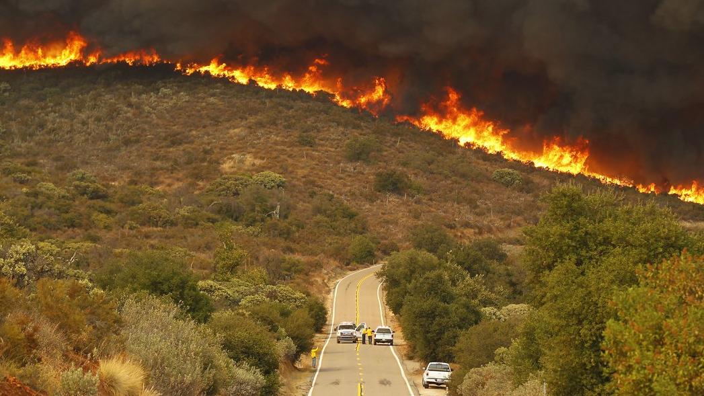
Wildfires and Prescribed Burns on Random 2D Terrains
By Rayni Wells

Slide 2
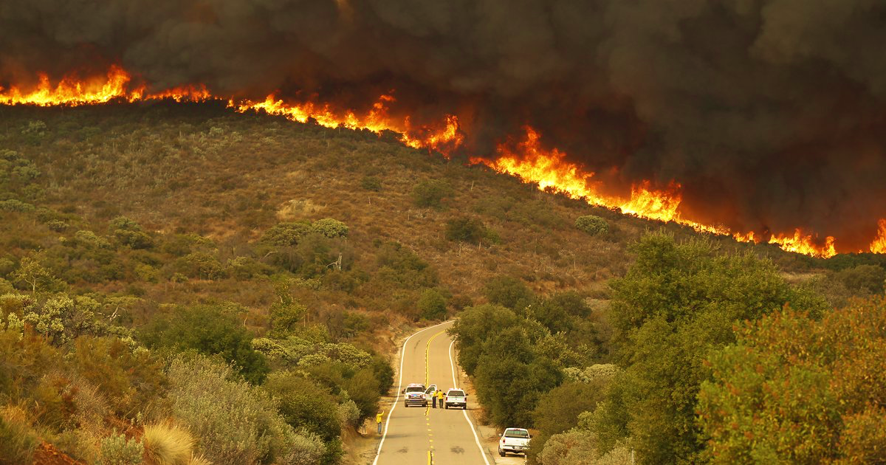
Wildfire Behavior
Time Lag (Time it takes for a fuel to lose 63% of its moisture) | Fuel Type
1 hour | <¼ inch (twigs, dead grass, leaves, needles)
10 hour | ¼-1 inch (twigs, small branches, cones)
100 hour | 1-3 inch (branches, tops)
1000-hour | >3 inch (large branches, tops, logs)
Temperature
Wind Speed and Direction
Increases supply of oxygen
Drives convective heat into adjacent fuels
Carries away moist air, replace with dry air
Dries fuel
Dependent on fuel type

Slide 3
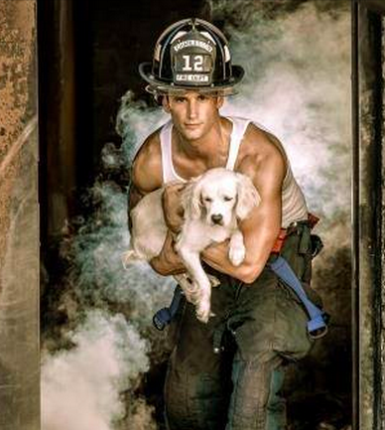
Prescribed Burns
Usually performed by firefighters (pictured) , or forest service
Reduce accumulation of fuels
Release nutrients, increase eco diversity, release seeds
Usually performed in the winter/wet season for better control

Slide 4
Method : Random Terrain
Terrain Types:
Active fire
Previously burned, dirt
Trees, large branches
Healthy grass, small trees, bushes
Dry grass, dry leaves, twigs
Water, high moisture area
Probability for each terrain type occurring, probability for each terrain type grouping together
Prescribed burn landscape has more dirt, less dry grass, dirt fire barrier

Slide 5
Method: Fire
Probability for each terrain square to turn into a burning terrain type
0 for water and dirt, 0.1 for tree, 0.3 for green grass, 0.6 for dry grass
Probability of the fire going out/turning into dirt terrain type
Dependent on temperature, humidity, wind

Slide 6
Wildfire on Relatively Moist Terrain, Higher Humidity
Active fire
Previously burned, dirt
Trees, large branches
Healthy grass, small trees, bushes
Dry grass, dry leaves, twigs
Water, high moisture area

Slide 7
Wildfire on Relatively Moist Terrain, Higher Humidity with Prescribed Burn
Active fire
Previously burned, dirt
Trees, large branches
Healthy grass, small trees, bushes
Dry grass, dry leaves, twigs
Water, high moisture area

Slide 8
Hot, Dry, Windy Summer
Active fire
Previously burned, dirt
Trees, large branches
Healthy grass, small trees, bushes
Dry grass, dry leaves, twigs
Water, high moisture area

Slide 9
Hot, Dry, Windy Summer with Prescribed Burn
Active fire
Previously burned, dirt
Trees, large branches
Healthy grass, small trees, bushes
Dry grass, dry leaves, twigs
Water, high moisture area

Slide 10
Thank you.

